Slide 1
Increasing the capacity of signalized intersections with unconventional designs of shared right-turn lanes
Zilin Shen
Tongji University
2024/11/06
Notes:
Good morning, everyone. I am Zilin Shen from Tongji University. Today I will bring a presentation of my previous research, named “increasing the capacity of signalized intersections with unconventional designs of shared right-turn lanes.”

Slide 2
Contents
01
Problem description
02
Unconventional design concepts
03
Model formulation
04
Experiments
05
Conclusion
Notes:
First, I will describe the problem that this study focuses on.

Slide 3
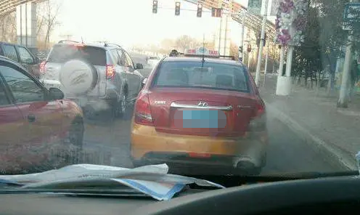
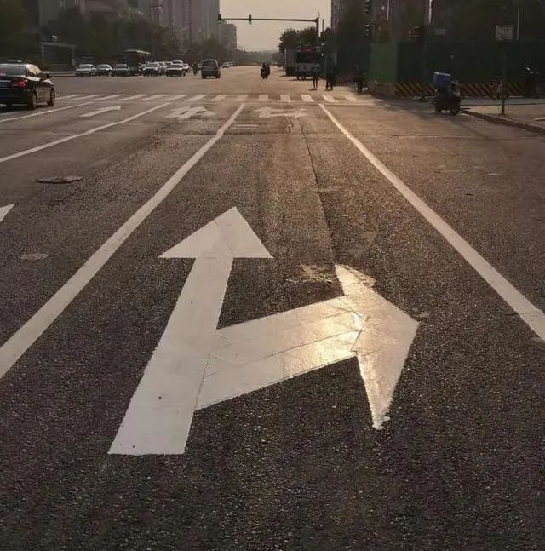
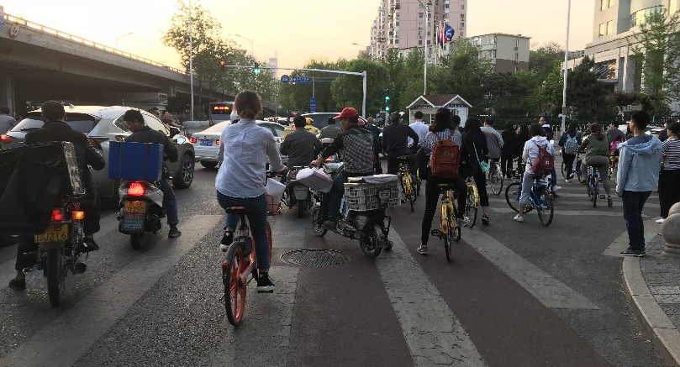
Problem description
The design of SRL
Blockage on the SRLs
Right-turn demand is not too high, OR
There is no enough space.
Through vehicles block RT vehicles
RT vehicles yielding to pedestrians
block RT vehicles
Notes:
Shared right-turn lane or the SRL, is commonly designed at signalized intersections, especially in China. If the right-turn demand is not too high, or there is no enough space on the approach, a shared right-turn lane may be a good choice to increase the capacity of through movement.
However, in real-world practice, the right-turn vehicles and through vehicles on the SRL may block each other. In the first picture, the through vehicles waiting for the green light block the right-turn-on-red vehicles. In the second picture, since right-turn vehicles are yielding to pedestrians, they may again block through vehicles.

Slide 4
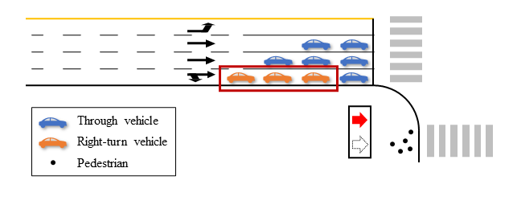
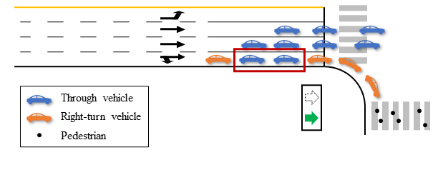


Problem description
Conceptualization
Expected state
$$x$$
Right-turn vehicles
Through vehicles
Through vehicles block RT vehicles
$$t$$
RT vehicles yielding to pedestrians
block RT vehicles
Change the service mode, OR
Modify the demand pattern.
Notes:
Now we conceptualize the problem, as shown in the pictures. The key point is that normal SRL cannot treat right-turn vehicles and through vehicles differently according to the traffic light. The expected state that we want to reach is that right-turn vehicles can be discharged when the through traffic light is red, and through vehicles are discharged when the light turns green.
Thus, we have to either change the service mode, or modify the demand pattern.

Slide 5
Contents
01
Problem description
02
Unconventional design concepts
03
Model formulation
04
Experiments
05
Conclusion
Notes:
Now I will introduce the unconventional design concepts proposed in this study.

Slide 6
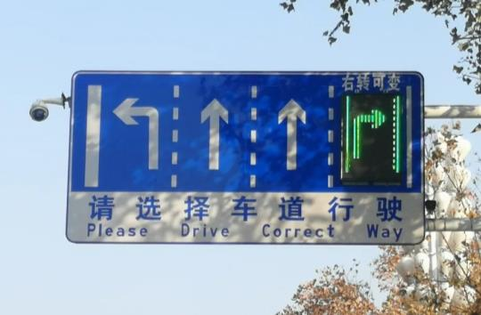
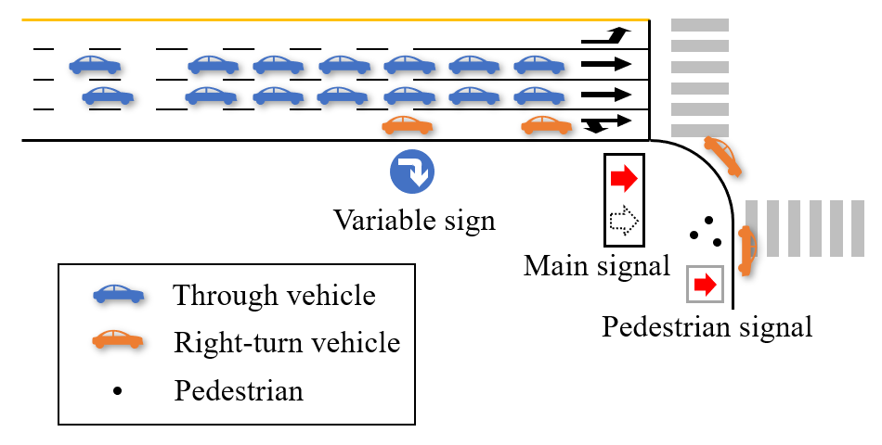
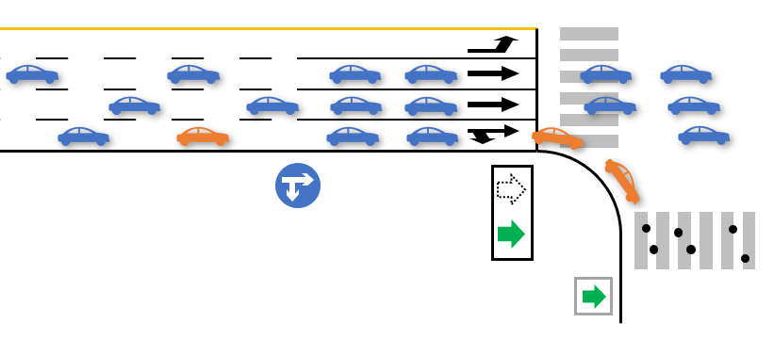
Unconventional design concepts
Change the service mode: Variable SRL (V-SRL) design
Served as exclusive right-turn lane
Served as SRL
Variable message sign
Change the lane function at different periods
Notes:
The first idea is that we can change the service mode of the SRL with the help of variable message sign, as shown in the slide. When the main signal gives red to through movement, the variable sign will show right-turn-only arrow, indicating that only right-turn vehicles can occupy this lane. In other words, the kerbside lane is served as an exclusive right-turn lane and can ensure that right-turn vehicles pass the intersection. When the main signal turns green, the sign will show both through and right-turn arrow, which means that the kerbside lane is a normal SRL.

Slide 7
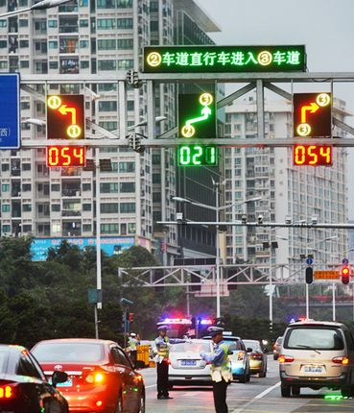
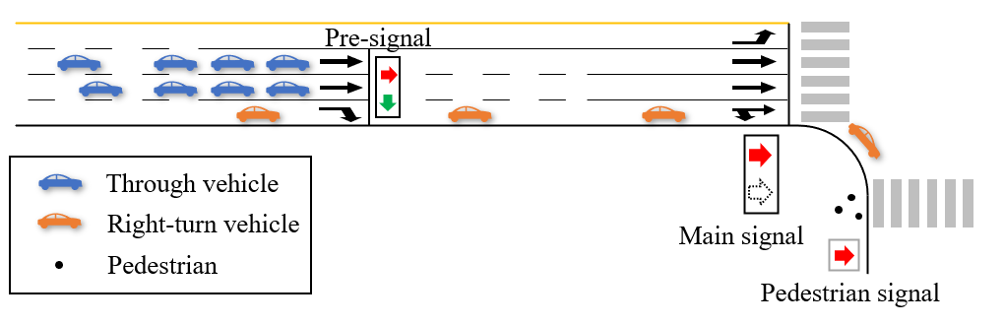
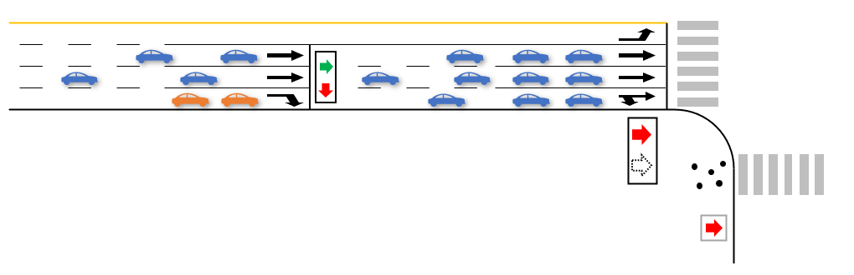
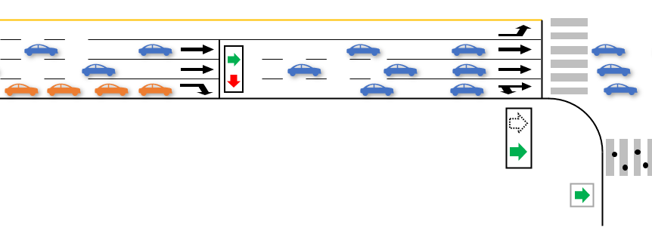
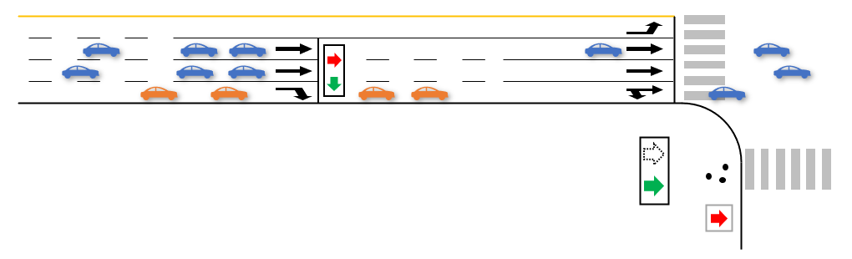
Unconventional design concepts
Modify the demand pattern: Pre-signal SRL (P-SRL) design
(a) Discharge right-turn vehicles
(b) Through vehicles enter sorting area
(c) Discharge through vehicles
(d) Right-turn vehicles enter sorting area
Pre-signal
Modify the arrival pattern of through and right-turn vehicles
Notes:
On the other hand, we can also modify the demand pattern by pre-signal design. In pre-signal SRL design, the through vehicles and right-turn vehicles are discharged alternately at the upstream pre-signal into the sorting area. The main signal then discharges either the through vehicles or right-turn vehicles in different periods. In this way, the conflict between right-turn vehicles and pedestrians can also be reduced.

Slide 8
Contents
01
Problem description
02
Unconventional design concepts
03
Model formulation
04
Experiments
05
Conclusion
Notes:
Next, I will formulate the optimization model of the intersection with unconventional SRL design concepts.

Slide 9

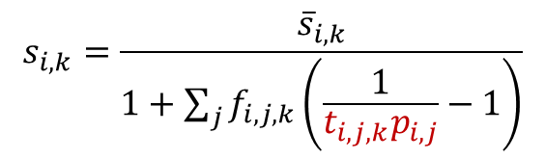
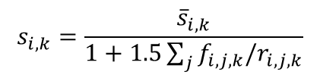



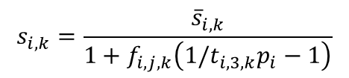
Model formulation
Lane-based model
Wong and Wong (2003): Lane-based optimization of signal timings for isolated junctions
Simultaneously optimize the lane allocation and signal timing plan to maximize the capacity
However, the original lane-based model cannot deal with permissive movements.
  Permitted movements in our case: right-turn vehicles and pedestrians
  The saturation flow rate (SFR) of protected and permitted movements differ.
Modified SFR under pedestrian blockage
If movement on lane $\left(i,k\right)$ is protected:
$$s_{i,k}=\frac{{\overline{s}}_{i,k}}{1+\sum_{j}{f_{i,j,k}\left(\frac{1}{t_{i,j,k}p_{i,j}}−1\right)}}$$
$$s_{i,k}=\frac{{\overline{s}}_{i,k}}{1+1.5\sum_{j}{f_{i,j,k}/r_{i,j,k}}}$$
$t_{i,j,k}$: Turning factor
Wong and Wong (2003)
$p_{i,j}$: Pedestrian factor
If lane $\left(i,k\right)$ is an SRL:
$$s_{i,k}=\frac{{\overline{s}}_{i,k}}{1+f_{i,j,k}\left(1/t_{i,3,k}p_{i}−1\right)}$$
HCM (2009)
Wong, C. K., & Wong, S. C. (2003). Lane-based optimization of signal timings for isolated junctions. Transportation Research Part B: Methodological, 37(1), 63-84.
Notes:
We use the lane-based model in this study to achieve the integrated optimization. The lane-based model was first proposed by Wong and Wong. It can simultaneously optimize the lane allocation and signal timing plan to maximize the capacity.
However, one of the disadvantages of this original model is that it assumes all movements to be protected movements. In this study, the right-turn movement is a permissive movement since it may conflict with pedestrian movement. The key point is that the saturation flow rate between protected and permitted movements are different, which will influence the optimal design.
Thus, we modify the SFR expression under pedestrian blockage, as shown in the slide. We use such an expression to ensure that the flow ratio will be a linear expression. It should be noted that this modified expression is consistent with the original expression in the basic lane-based model, as well as the expression in HCM under certain conditions. (可以展开)

Slide 10
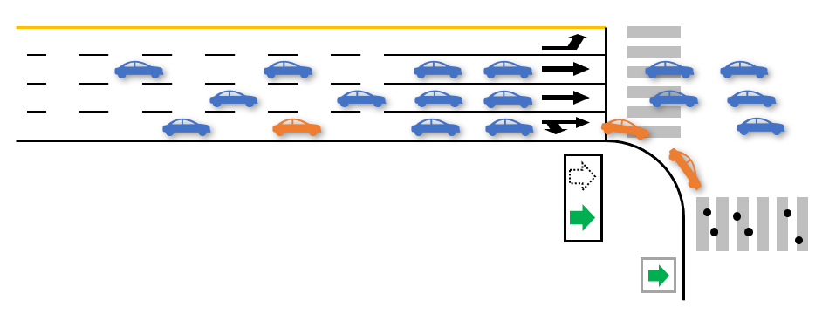
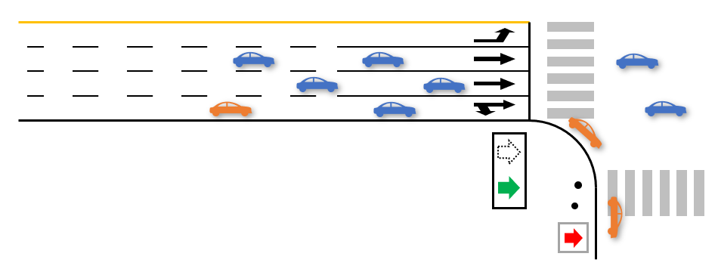
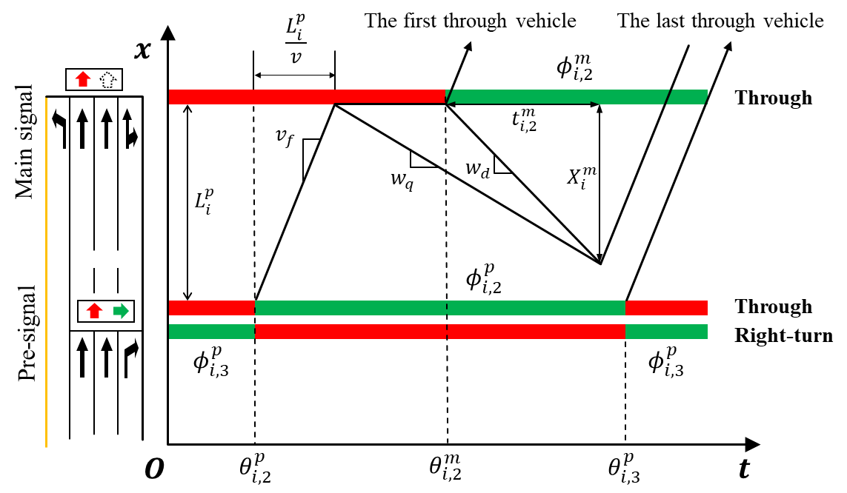

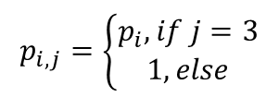
Model formulation
Sub-stage definitions
Conflict stage
Non-conflict stage
$$p_{i,j}=\left\{\begin{aligned}p_{i}, if j=3 \\ 1, else\end{aligned}\right.$$
$$p_{i,j}=1$$
Improved lane-based model
Simultaneously optimize the lane allocation, signal timing plan, and control strategies
Common constraints
Additional constraints
Flow conservation
Conflict avoidance
Lane allocation
Flow ratio
Sub-stage duration
Coordination settings
Phase sequence
Degree of saturation
Notes:
Besides, we also defined several sub-stages to clarify the value of some key variables in different periods. In the conflict stage, the adjustment factor for pedestrians equals to $p_{i}$ for right-turn movements and equals to 1 for other movements. $p_{i}$ can be calculated with the HCM method. In the non-conflict stage, the adjustment factor for pedestrians equals to 1 for all movements.
Based on the analysis, an improved lane-based optimization model is formulated. Similar to the original model, the improved model in this study can simultaneously optimize the lane allocation, signal timing plan, and control strategies. The objective of the model is maximizing the reserve capacity, same as the original model. The constraints of the model include some common constraints, such as flow conservation, lane allocation, phase sequence, conflict avoidance, flow ratio calculation, and degree of saturation constraints. These constraints are basically similar to the original model. Thus, I will not go into detail here.
On the other hand, there are also some additional constraints in this study compared to the original lane-based model. Firstly, the duration of each sub-stage should be specified to calculate the flow ratio. The expression of sub-stage duration is a function of signal timing variables of variable signal, pre-signal and main signal. Secondly, some coordination settings should be considered between variable sign or pre-signal and main signal. For example, the distance between the main signal and the pre-signal should be long enough to accommodate the queue in the sorting area and avoid the spillback at the pre-signal. We use the shockwave model to specify the maximum queue length in the sorting area, and constrain the length of the sorting area to be longer than this queue length.

Slide 11
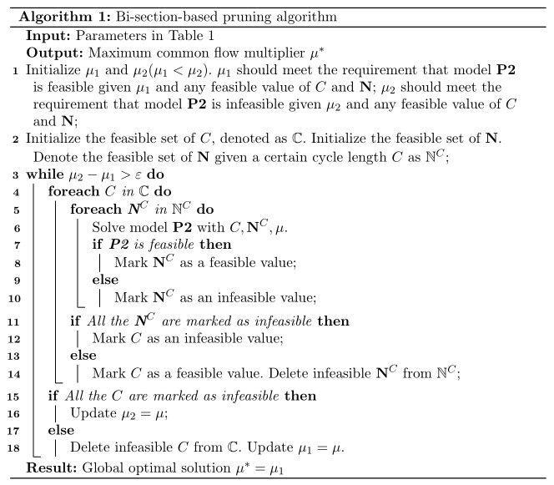

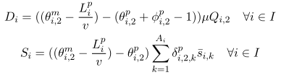

Algorithm
Bi-section-based Pruning Algorithm
Original problem: MINLP
Non-linear constraints
Transformed into a series of MILP by:
Cycle length $C$: Enumerate all feasiable values
Indicator $δ_{i,2,k}^{p}$: Enumerate with in $[1, A_{i}−2]$
Multiplier $μ$: Binary search
Notes:
Now we have formulated this optimization problem. However, since some of the constraints are non-linear, the problem is a mixed integer non-linear program, which is hard to solve directly.
By further observing these constraints, we found that three key variables make the constraints non-linear, which include cycle length, lane function indicator at the pre-signal, and the common flow multiplier. Thus, we try to use different ways to fix these variables as a constant, and transform the original MINLP to a series of MILP, which can be solved with the common branch-and-cut method. For cycle length and lane function indicator, since they are integer and within a certain range, we can enumerate all feasible values. For the common flow multiplier, since the problem will become infeasible when the value of mu is larger than the optimal value, we can find the maximum feasible mu, which is also the optimal mu, with binary search. We then proposed a bi-section-based pruning algorithm to accelerate the enumeration process by cutting off the sub-optimal branches. Since the time is limited, I will also not go into detail here.

Slide 12
Contents
01
Problem description
02
Unconventional design concepts
03
Model formulation
04
Experiments
05
Conclusion
Notes:
Now I will show some results of the experiments.

Slide 13
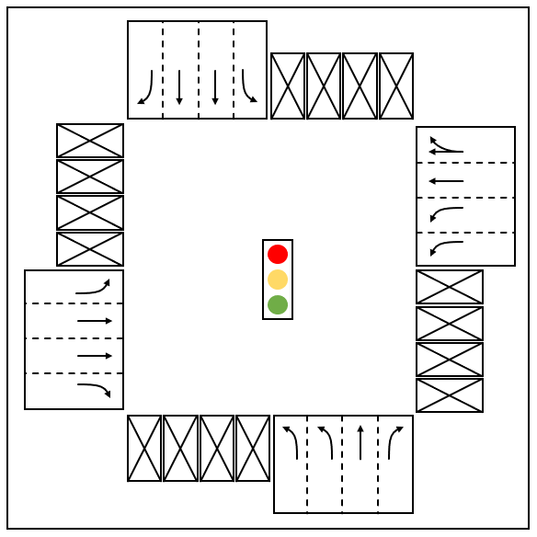
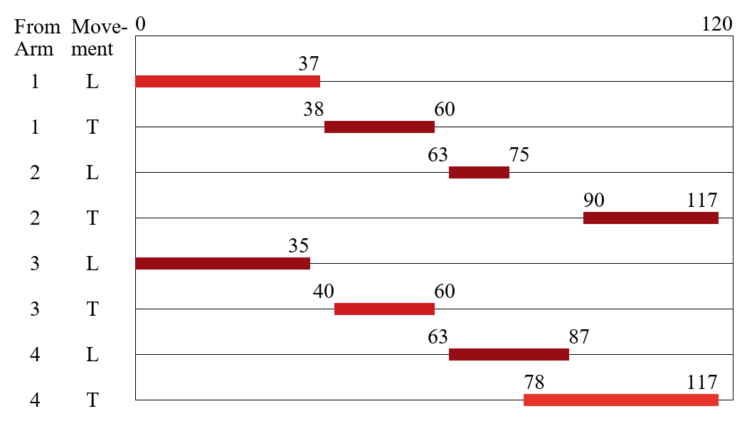
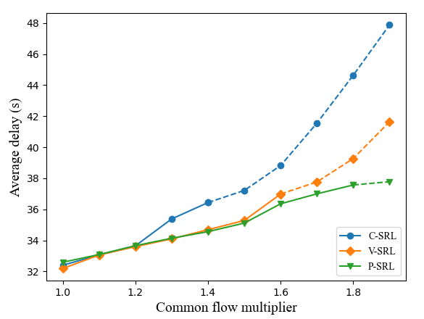
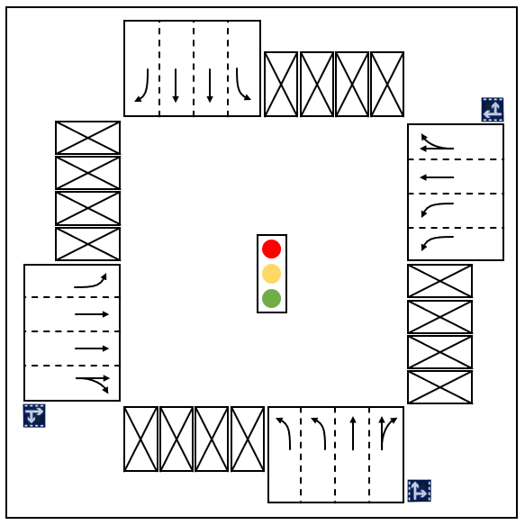
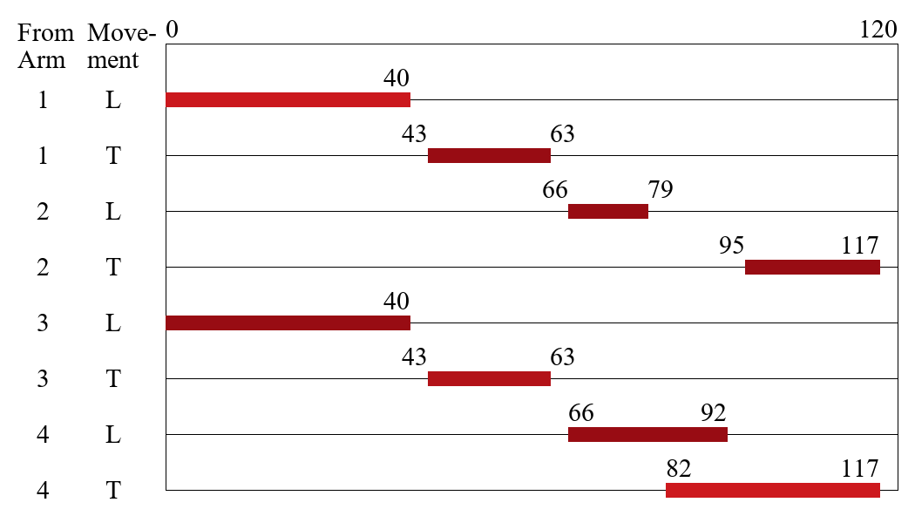
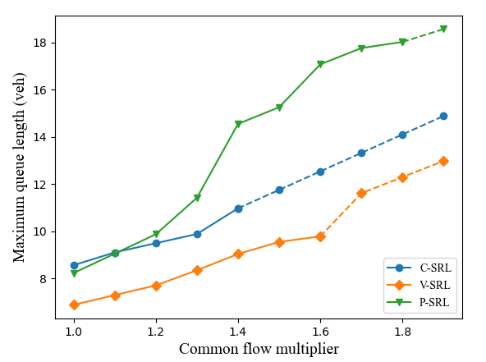
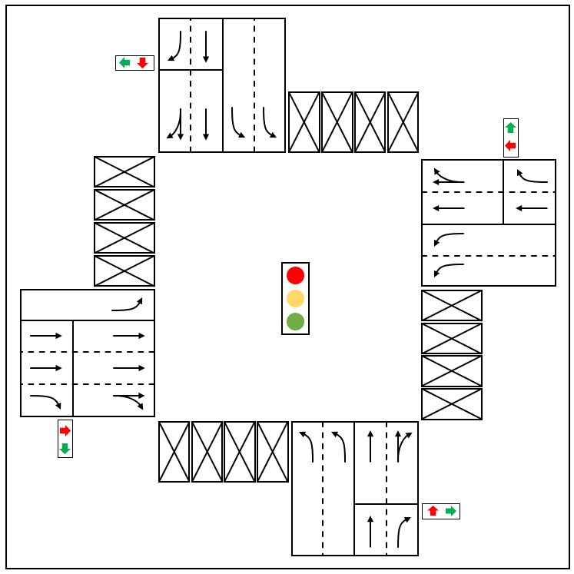
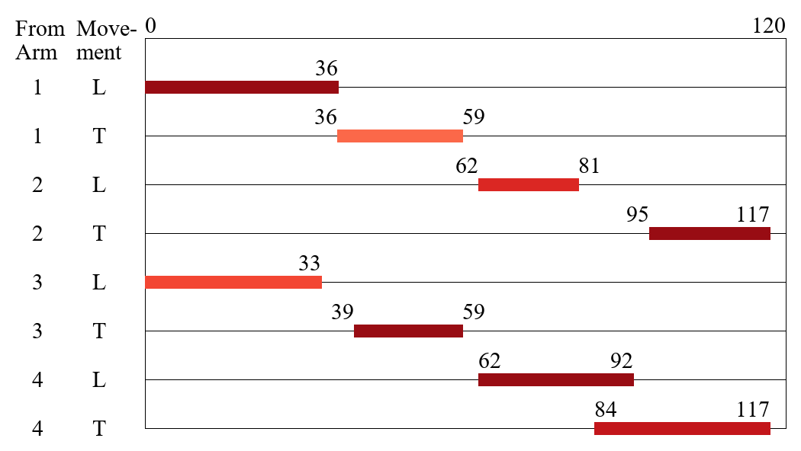



Experiments
Optimal intersection design
Performance index
Average delay
C-SRL
C-SRL>V-SRL>P-SRL
($μ$=1.48)
Reduce more delay at saturated intersections
Longer green for
left-turn movements
More SRL designed
V-SRL
($μ$=1.65)
Queue length
P-SRL>C-SRL>V-SRL
P-SRL: Require more space to modify the arrival pattern
P-SRL
($μ$=1.82)
Notes:
This slide shows the optimal intersection design with the same traffic input under C-SRL, V-SRL, and P-SRL design. The common flow multiplier for V-SRL and P-SRL is larger, indicating the increase of capacity. Secondly, one can find that only one SRL is adopted in C-SRL design, while V-SRL adopts three SRLs and for P-SRL, four are adopted.
This implies that the V-SRL and P-SRL design can improve the efficiency of shared right-turn lanes. Thirdly, for signal timing plan, compared to C-SRL, V-SRL and P-SRL design assigned longer green time for left-turn movement. (For arm 3, the southbound approach, the green time for P-SRL is shorter, but this is because one more left-turn lane is designed on arm 3 in P-SRL.)
This is because left-turn movement is the bottleneck movement, and will directly influence the common flow multiplier.
Besides capacity, two more performance indices are analyzed. In the picture above, the average vehicle delay under different levels of traffic demand for each control strategy are drawn. (The dashed line indicates that the intersection is oversaturated at that traffic demand.) The proposed unconventional designs can effectively reduce average vehicle delay, especially when the intersection is oversaturated, which means that V-SRL and P-SRL are more suitable at intersections with high demand. For maximum queue length, V-SRL design can reduce the queue length, while P-SRL design leads to longer queue length. This is because P-SRL requires the additional space of sorting area to modify the arrival pattern on the approach.

Slide 14
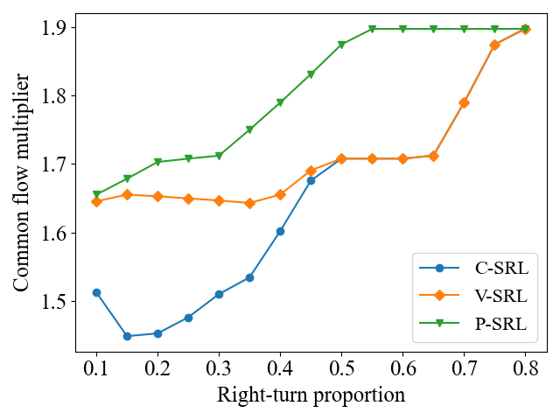
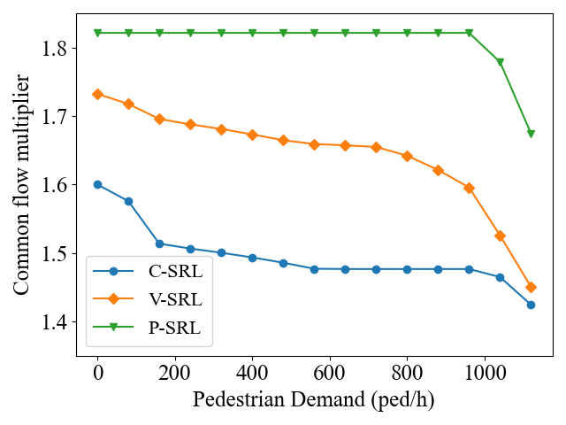
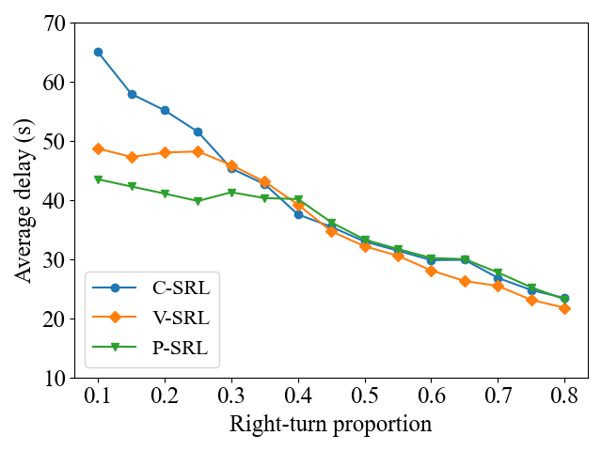
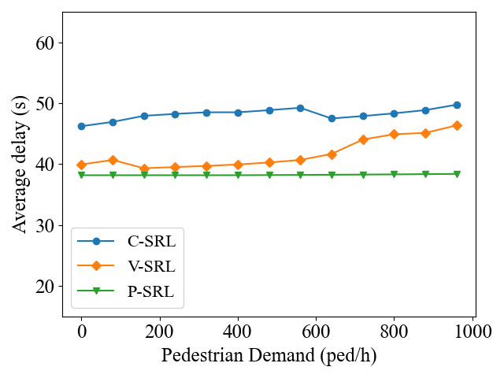
Sensitive analysis
Right-turn proportion
Pedestrian demand
Capacity
Capacity
Degrades to exclusive right-turn lane under high right-turn demand
P-SRL>V-SRL>C-SRL
Right-turn-only lane
Show the tendancy to degrade to exclusive right-turn lanes
Delay
Delay
Delay reduced when right-turn proportion is not too high
P-SRL<V-SRL<C-SRL
P-SRL: Robust to the pedestrian interference
Notes:
We also conduct a sensitive analysis on right-turn proportion and pedestrian demand. For right-turn proportion, the proposed unconventional designs outperform the normal SRL design when the proportion is not too high.
As the proportion increases, the V-SRL design will degrade to exclusive right-turn lane design, which has a higher efficiency under such condition.
Similarly, V-SRL and P-SRL reduce average vehicle delay when right-turn proportion is not too high.
In regard to pedestrian demand, the proposed strategies can indeed increase the capacity and reduce average vehicle delay under different levels of pedestrian demand. However, they tend to degrade to exclusive right-turn lanes when pedestrian demand is much higher. We can also find that P-SRL is the most robust to pedestrian blockage. This is because the conflict between right-turn vehicles and pedestrians are avoided to the most extent after modifying the arrival pattern, but this is at the cost of additional space on the approach.

Slide 15
Contents
01
Problem description
02
Unconventional design concepts
03
Model formulation
04
Experiments
05
Conclusion
Notes:
Finally, I will conclude this study.

Slide 16
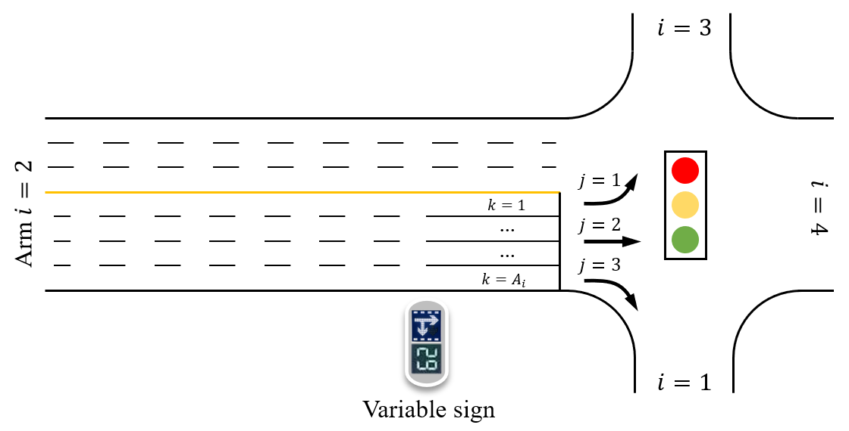
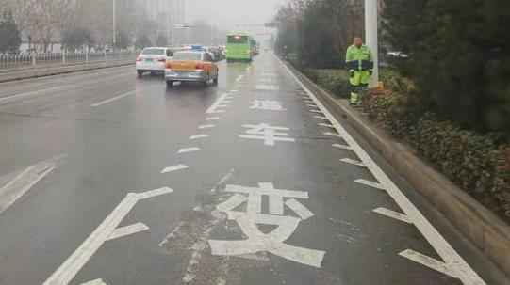
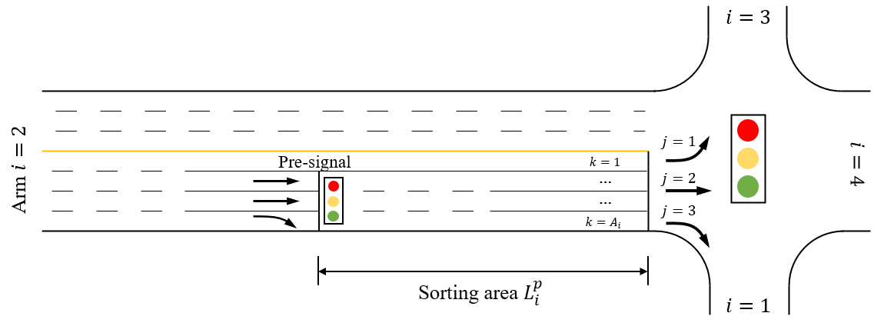
Conclusion
Unconventional SRL designs
Future works
Application issue: Driver acceptance
V-SRL design
Jagged lane markings and notations
P-SRL design
Model improvement
Minimizing vehicle delay
Stochastic demand input
Notes:
We proposed two unconventional designs for shared right-turn lanes in this study to avoid the blockage between right-turn vehicles and through vehicles and improve the efficiency. We verify the effectiveness of the proposed designs with an improved lane-based model.
Some future work may be done on the application issues. For example, how to make the design not too confusing to drivers who are not familiar to this design. Besides, the model can also be improved to minimize the average vehicle delay, which is more suitable when traffic demand is not too high. Also, one can try to use stochastic demand input to take account of the randomness of traffic flow.

Slide 17
Thank you!
Zilin Shen
2024/11/06
Notes:
That’s all for my sharing. Thank you for your listening.

