Slide 1

A NON-COOPERATIVE GAME FOR ANALYSING HIGH-SPEED RAIL AND AIR COMPETITION
5th – 7th November, 2024, in Paris and Online
THNS 2024
Forum THNS 2024: Transforming Transport
17th International symposium on the Sustainable Development of Urban Transport System
Tahseen Bashir, Guglielmo De Iulio, Lina Mallozzi and Francesca Pagliara*
Department of Civil, Architectural and Environmental Engineering,
University of Naples Federico II
*speaker: t.bashir@studenti.unina.it

Slide 2
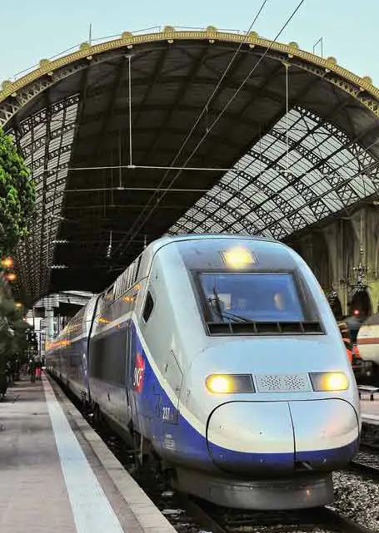
Outlines
1.
Introduction
2.
Objectives
3.
Methodology
4.
Case Study
5.
Main findings
6.
Conclusions and Further Research Perspectives

Slide 3
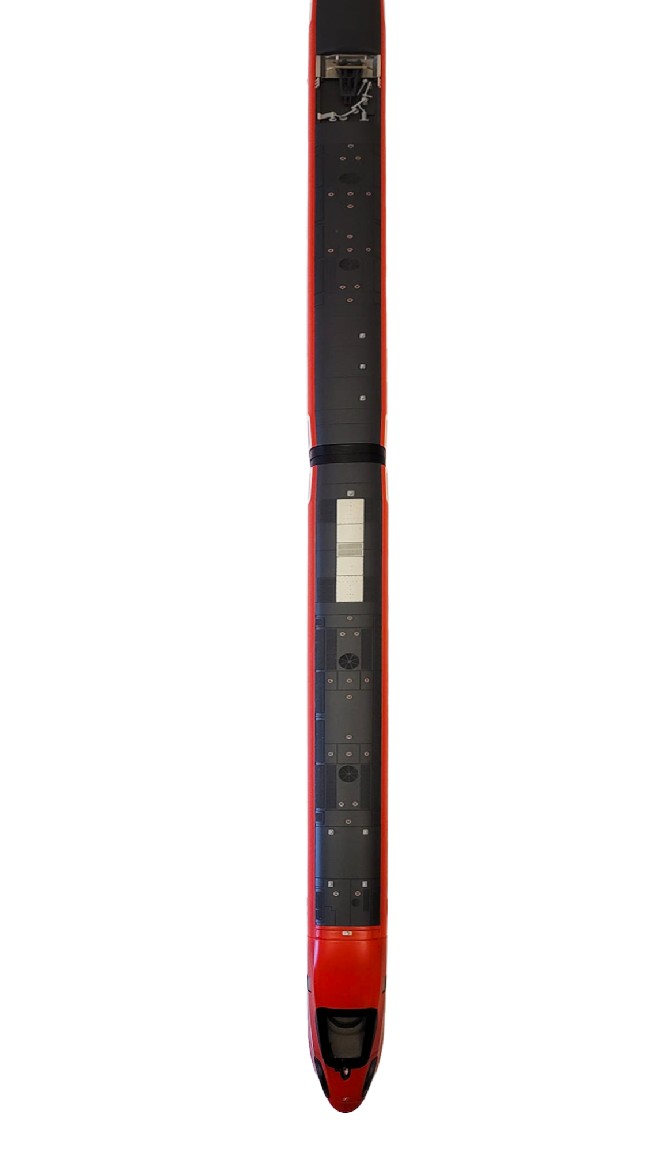


High Speed Rail in Europe
1. Introduction

Slide 4
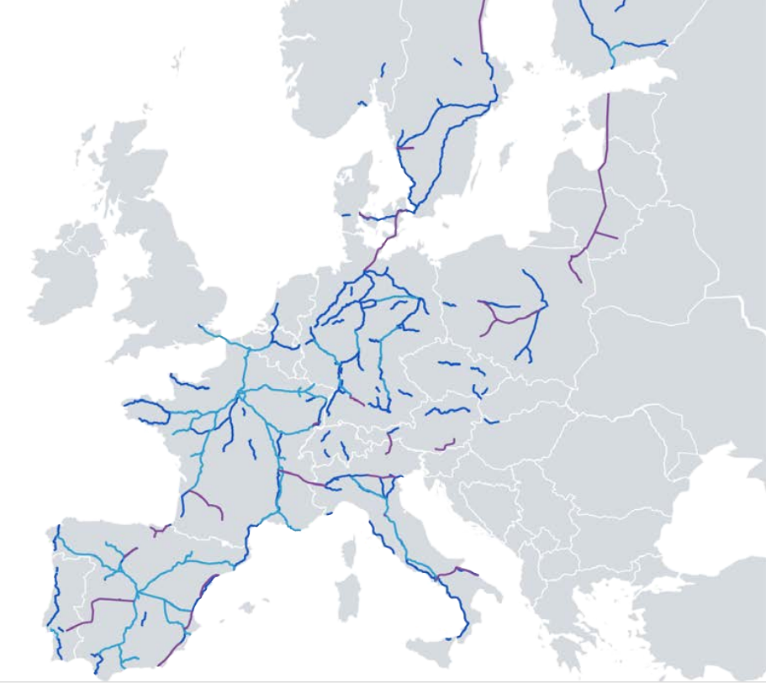
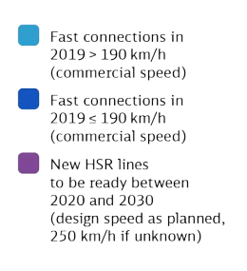
HIGH SPEED RAIL IN EUROPE
Existing High-Speed Rail links in Europe
Legends
Source: Deutsche Bahn, 2023

Slide 5

HIGH SPEED RAIL IN EUROPE
Sustainable Development
Users choosing High Speed Rail (HSR) emit 80% less w.r.t. the ones using the plane, and 75% less than those choosing the car.
Source: Deutsche Bahn (2023)

Slide 6

HIGH SPEED RAIL IN EUROPE
Sustainable Development
Industrial Development
Users choosing High Speed Rail (HSR) emit 80% less w.r.t. the ones using the plane, and 75% less than those choosing the car.
Connecting the capitals of European countries would mean achieving the objectives of the EU Regional Policy through the creation of new jobs, economic growth etc.
Source: Deutsche Bahn (2023)

Slide 7

HIGH SPEED RAIL IN EUROPE
Sustainable Development
Industrial Development
Integration and European Identity
Users choosing High Speed Rail (HSR) emit 80% less w.r.t. the ones using the plane, and 75% less than those choosing the car.
Connecting the capitals of European countries would mean achieving the objectives of the EU Regional Policy through the creation of new jobs, economic growth etc.
The possibility to travel fast between European countries will allow young people to take advantage of discounted tickets such as the Interrail Pass, fostering the integration and European Identity.
Source : Deutsche Bahn, 2023

Slide 8
Eastern Europe faces significant challenges in developing efficient and sustainable transportation infrastructure.
The HSR project between Bucharest (Romania) and Sofia (Bulgaria) aims to enhance connectivity stimulating economic growth.
The existing air travel services dominate the current transportation market for this corridor, offering faster travel times but at higher costs and environmental impacts.
The introduction of HSR poses both new opportunities and challenges.
2. Objectives

Slide 9



Objectives
Assess Market Competition
Optimize Pricing Strategies
Predict Market Outcomes
Evaluate how the introduction of HSR will affect the market and demand distribution between HSR and Air.
Determine the optimal pricing strategies for both HSR and Air operators to maximize their corresponding profits.
Simulate the competition interactions and predict equilibrium outcomes, including potential fare reductions in the air travel market due to the entry of HSR.

Slide 10
Game Theory
Nash Equilibrium
3. Methodology
Assumptions of the model
Specification of the model

Slide 11
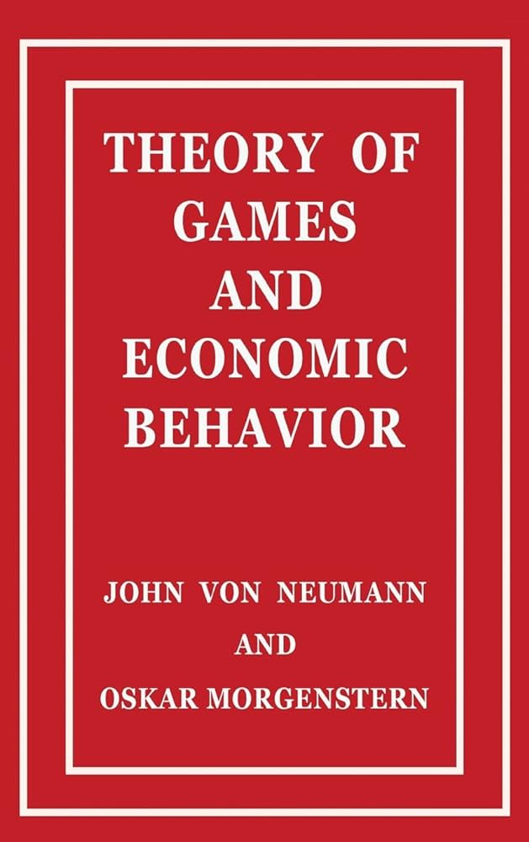

Game Theory is a branch of applied mathematics and economics that studies multi-person decision problems and provides tools to analyze situations where the “players” make interdependent decisions, where each player considers the other player’s possible strategies and where the outcome for each participant depends on the action of all other players (Alpcan, 2021).
Game Theory
Non Cooperative Game Theory
Cooperative Game Theory
Players
Strategies
Payoff
Information
Source : Gibbons (1994)

Slide 12


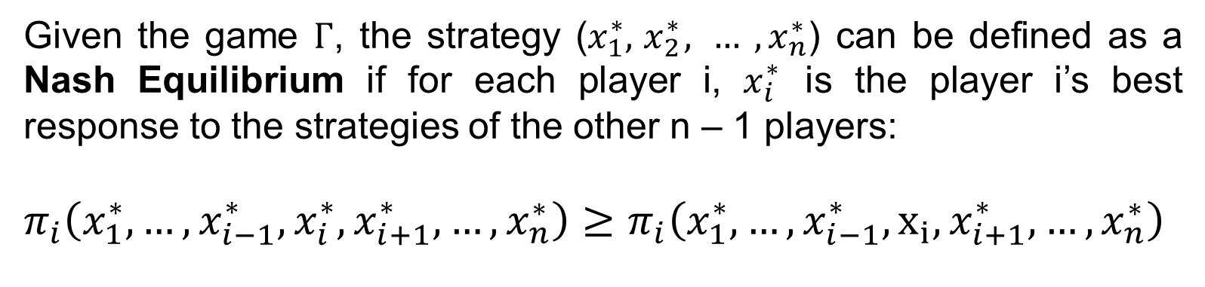

The normal form representation of a game defines the players participating in it, the strategies available to each player and the resulting payoffs for each player corresponding to each possible combination of strategies.
Players strategies
$Γ={ <\left\{P_{1}, …,P_{n}\right\}; X}_{1},…,X_{n};π_{1},…,π_{n}>$
Nash Equilibrium
Players
Players payoffs
Given the game $Γ$, the strategy ($x_{1}^{∗},{ x}_{2}^{∗}, … ,x_{n}^{∗}$) can be defined as a Nash Equilibrium if for each player i, $x_{i}^{∗}$ is the player i’s best response to the strategies of the other n – 1 players:
$π_{i}\left(x_{1}^{∗},…,x_{i−1}^{∗},x_{i}^{∗},x_{i+1}^{∗},…,x_{n}^{∗}\right)≥π_{i}\left(x_{1}^{∗},…,x_{i−1}^{∗},x_{i},x_{i+1}^{∗},…,x_{n}^{∗}\right)$
For each equillibrium strategy $x_{i}$ in set $X_{i }\text{the} \text{strategy} \text{set} \text{available} \text{to} \text{the} \text{player} i\text{.}$
Source : Gibbons (1994)

Slide 13
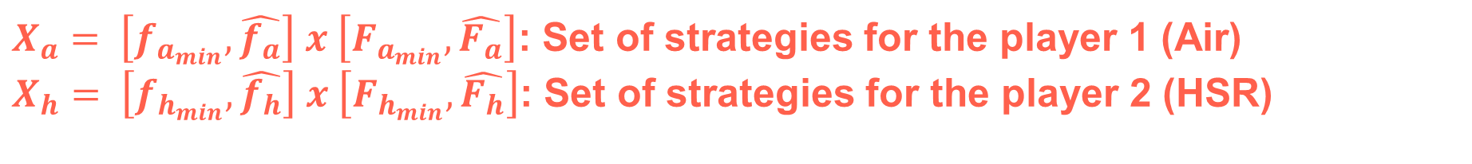
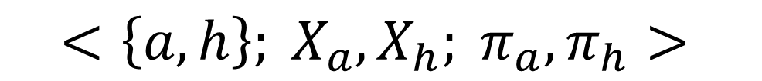
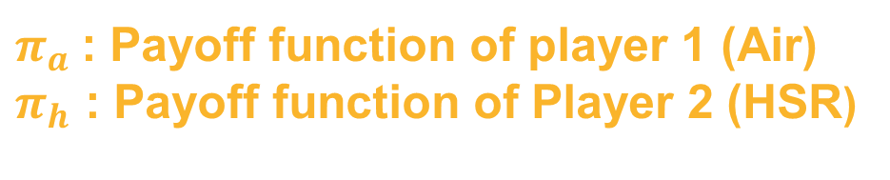

Game to solve
$a$ – Player 1: Air
$h$ - Player 2: HSR
$π_{a}$: Payoff function of player 1 (Air)
$π_{h}$ : Payoff function of Player 2 (HSR)
Nash Equilibrium
Players
Players Payoff
$$<\left\{a, h\right\}; X_{a}, X_{h}; π_{a}, π_{h}>$$
Introduction to the game to solve
Player strategies
$X_{a}= \left[f_{a_{min}}, \hat{f_{a}}\right] x \left[F_{a_{min}},\hat{F_{a}}\right]$: Set of strategies for the player 1 (Air)
$X_{h}= \left[f_{h_{min}}, \hat{f_{h}}\right] x \left[F_{h_{min}},\hat{F_{h}}\right]$: Set of strategies for the player 2 (HSR)
Solution
$$GNE=(f_{a},F_{a},f_{h},F_{h})$$
Generalized Nash Equilibrium

Slide 14
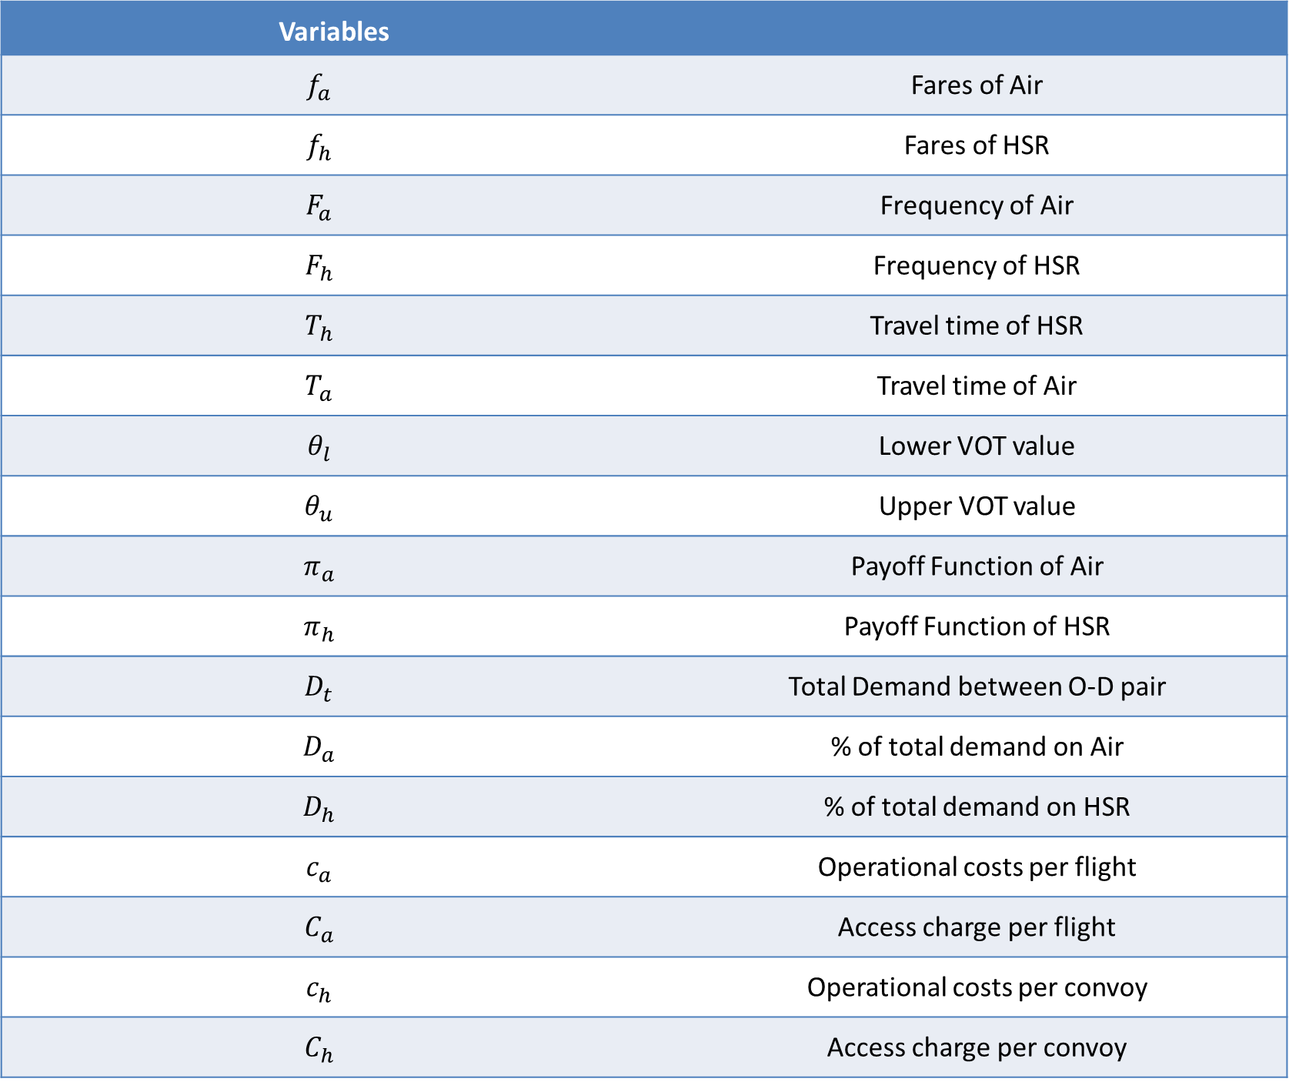
Variables
$$f_{a}$$ | Fares of Air
$$f_{h}$$ | Fares of HSR
$$F_{a}$$ | Frequency of Air
$$F_{h}$$ | Frequency of HSR
$$T_{h}$$ | Travel time of HSR
$$T_{a}$$ | Travel time of Air
$$θ_{l}$$ | Lower VOT value
$$θ_{u}$$ | Upper VOT value
$$π_{a}$$ | Payoff Function of Air
$$π_{h}$$ | Payoff Function of HSR
$$D_{t}$$ | Total Demand between O-D pair
$$D_{a}$$ | % of total demand on Air
$$D_{h}$$ | % of total demand on HSR
$$c_{a}$$ | Operational costs per flight
$$C_{a}$$ | Access charge per flight
$$c_{h}$$ | Operational costs per convoy
$$C_{h}$$ | Access charge per convoy
Assumptions of the model

Slide 15





Total Transport Demand is assumed to be variable in a range set for a given OD pair.
The population is assumed "heterogeneous" in terms of Value-of-Time (VOT), with a probability density function that is assumed uniform:
$$D_{t} ∈\left[1,000;10,000\right] pessengers/day$$
$f\left(τ\right)=\frac{1}{θ_{l}− θ_{u}}$ con $τ ∈ {[θ}_{l};θ_{u}]$
For both players, the objective is to maximize their payoffs
Assumptions of the model
Generalised Transport Costs for users with a generic "t" value of VOT have been defined as:
The Air fare is lower than that of the HSR, while its travel time is higher:
$$G_{a}\left(t\right)=f_{a}+(T_{a}t)$$
$$G_{h}\left(t\right)=f_{h}+(T_{h}t)$$
$$f_{a}<f_{h}$$
$$T_{a}>T_{h}$$

Slide 16
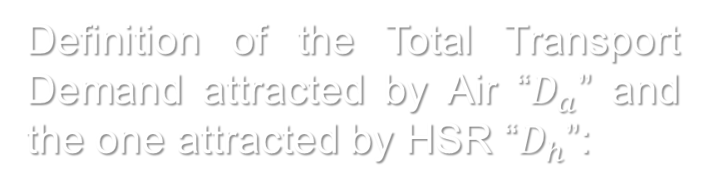




$$G_{h}\left(\overset{̿}{t}\right)=G_{a}\left(\overset{̿}{t}\right)$$
$$G_{h}\left(\overset{̿}{t}\right)=f_{h}+\left(T_{h}\overset{̿}{t}\right)=f_{a}+\left(T_{a}\overset{̿}{t}\right) = G_{a}\left(\overset{̿}{t}\right)$$
$$\overset{̿}{t}=\frac{f_{h}−f_{a}}{T_{a}−T_{h}} where \overset{̿}{t} ∈ {[θ}_{l }; θ_{u}]$$
Specification of the model
Definition of the VOT limit value “$\overset{̿}{t}$”
$$D_{a}=D_{t}\int_{θ_{l}}^{\overset{̿}{t}}{\frac{1}{θ_{u}−θ_{l}}dx}$$
$$D_{h}=D_{t}\int_{\overset{̿}{t}}^{θ_{u}}{\frac{1}{θ_{u}−θ_{l}}dx}$$
Definition of the transport demand associated with the two players
$$D_{a}\left(f\right)=D_{t}\frac{\frac{f_{h}−f_{a}}{T_{a}−T_{h}}− θ_{l}}{θ_{u}−θ_{l}}$$
$$D_{h}\left(f\right)=D_{t}\frac{θ_{u}−\frac{f_{h}−f_{a}}{T_{a}−T_{h}}}{θ_{u}−θ_{l}}$$
Definition of the Total Transport Demand attracted by Air “$D_{a}$” and the one attracted by HSR “$D_{h}$”:

Slide 17
$$π_{a}\left(f_{a},F_{a},f_{h},F_{h}\right)=D_{t}\left[\frac{f_{a}}{θ_{u}−θ_{l}}\left(\frac{f_{h}−f_{a}}{T_{a}−T_{h}}− θ_{l}\right)\right]−F_{a}\left(c_{a}+ C_{a}\right)$$
Specification of the model
Payoff Function and Capacity Constraint associated with Air:
$$D_{a}=D_{t}\left[\frac{1}{θ_{u}−θ_{l}}\left(\frac{f_{h}−f_{a}}{T_{a}−T_{h}}− θ_{l}\right)\right] ≤K_{a}F_{a}$$
Definition of Payoffs Functions and Capacity Constraints for Players
Payoff Function and Capacity Constraint associated with HSR:
$$π_{h}\left(f_{a},F_{a},f_{h},F_{h}\right)=D_{t}\left[\frac{f_{h}}{θ_{u}−θ_{l}}\left(θ_{u}−\frac{f_{h}−f_{a}}{T_{a}−T_{h}}\right)\right]−F_{h}\left(c_{h}+C_{h}\right)$$
$$D_{h}=D_{t}\left[\frac{1}{θ_{u}−θ_{l}}\left(θ_{u}−\frac{f_{h}−f_{a}}{T_{a}−T_{h}}\right)\right] ≤K_{h}F_{h}$$

Slide 18
Southern Balkans Corridor
4. Case Study

Slide 19
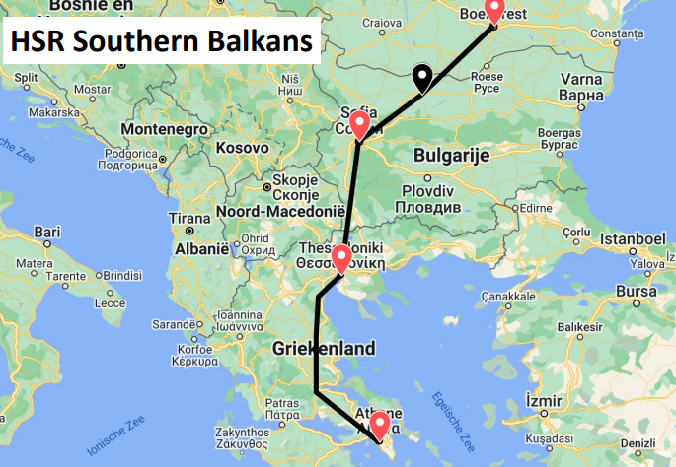
Southern Balkans Corridor

Slide 20
Southern Balkans Corridor
 |  | Length [Km] | Max train speed [Km/h] | Estimated travel time [h]
Direct Line | Bucharest – Sofia - Athens | 920 | 300 | 4.12
With Intermediate stops | Bucharest- Pleven - Sofia - Thessaloniki - Athens | 920 | 300 | 4.39
Characteristics of the line and connected cities
Stops | Average waiting time at the station [min] | Population of the connected cities [inh]
Bucharest | - | 2,162,280
Pleven | 3 | 159,264
Sofia | 10 | 1,221,785
Thessaloniki | 3 | 363,987
Athens | - | 3,167,000

Slide 21
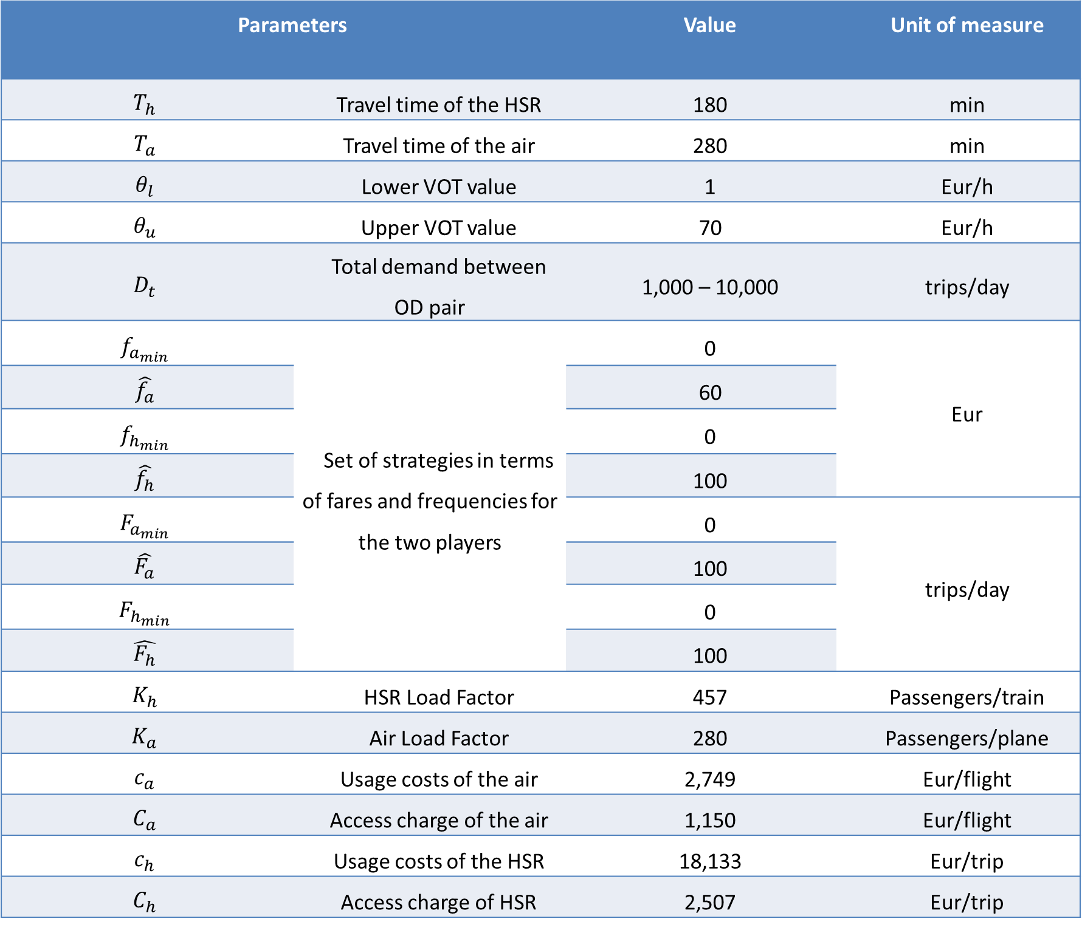
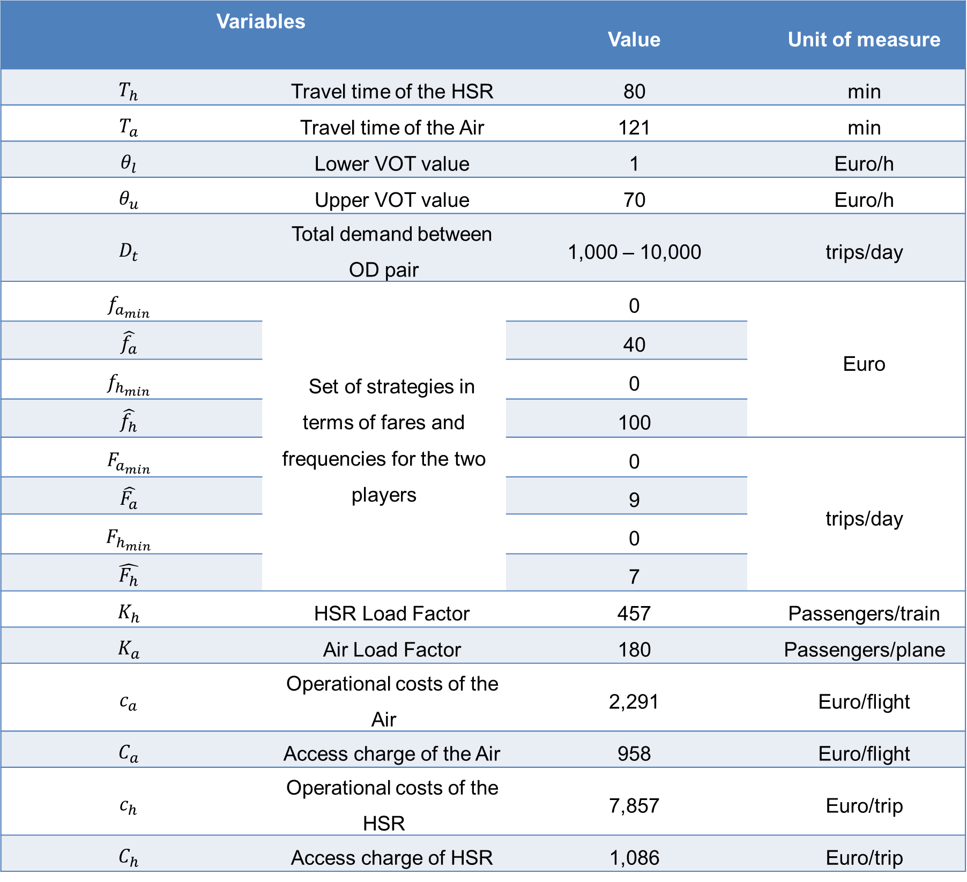
Variables |  | Value | Unit of measure
$$T_{h}$$ | Travel time of the HSR | 80 | min
$$T_{a}$$ | Travel time of the Air | 121 | min
$$θ_{l}$$ | Lower VOT value | 1 | Euro/h
$$θ_{u}$$ | Upper VOT value | 70 | Euro/h
$$D_{t}$$ | Total demand between OD pair | 1,000 – 10,000 | trips/day
$$f_{a_{min}}$$ | Set of strategies in terms of fares and frequencies for the two players | 0 | Euro
$$\hat{f_{a}}$$ |  | 40
$$f_{h_{min}}$$ |  | 0
$$\hat{f_{h}}$$ |  | 100
$$F_{a_{min}}$$ |  | 0 | trips/day
$$\hat{F_{a}}$$ |  | 9
$$F_{h_{min}}$$ |  | 0
$$\hat{F_{h}}$$ |  | 7
$$K_{h}$$ | HSR Load Factor | 457 | Passengers/train
$$K_{a}$$ | Air Load Factor | 180 | Passengers/plane
$$c_{a}$$ | Operational costs of the Air | 2,291 | Euro/flight
$$C_{a}$$ | Access charge of the Air | 958 | Euro/flight
$$c_{h}$$ | Operational costs of the HSR | 7,857 | Euro/trip
$$C_{h}$$ | Access charge of HSR | 1,086 | Euro/trip
Case Study : Southern Balkans Corridor
Parameters |  | Value | Unit of measure
$$T_{h}$$ | Travel time of the HSR | 180 | min
$$T_{a}$$ | Travel time of the air | 280 | min
$$θ_{l}$$ | Lower VOT value | 1 | Eur/h
$$θ_{u}$$ | Upper VOT value | 70 | Eur/h
$$D_{t}$$ | Total demand between OD pair | 1,000 – 10,000 | trips/day
$$f_{a_{min}}$$ | Set of strategies in terms of fares and frequencies for the two players | 0 | Eur
$$\hat{f_{a}}$$ |  | 60
$$f_{h_{min}}$$ |  | 0
$$\hat{f_{h}}$$ |  | 100
$$F_{a_{min}}$$ |  | 0 | trips/day
$$\hat{F_{a}}$$ |  | 100
$$F_{h_{min}}$$ |  | 0
$$\hat{F_{h}}$$ |  | 100
$$K_{h}$$ | HSR Load Factor | 457 | Passengers/train
$$K_{a}$$ | Air Load Factor | 280 | Passengers/plane
$$c_{a}$$ | Usage costs of the air | 2,749 | Eur/flight
$$C_{a}$$ | Access charge of the air | 1,150 | Eur/flight
$$c_{h}$$ | Usage costs of the HSR | 18,133 | Eur/trip
$$C_{h}$$ | Access charge of HSR | 2,507 | Eur/trip
Model Inputs

Slide 22
Main findings: Southern Balkans Corridor
5. Main findings

Slide 23
Travel Demand (trips/day) | HSR |  | Air
 | Fare (Euro) | Frequency (trips/day) | Fare (Euro) | Frequency (trips/day)
1,000 | 43.9 | 3.10 | 40 | 1.38
2,000 | 43.9 | 5.14 | 40 | 1.76
3,500 | 43.9 | 8.24 | 40 | 2.33
6,000 | 43.9 | 13.4 | 40 | 3.28
8,000 | 43.9 | 17.6 | 40 | 4.00
10,000 | 43.9 | 21.7 | 40 | 4.80
Equilibrium Strategies for both players
Southern Balkans Corridor
Bucharest - Sofia
Travel Demand (trips/day) | HSR Demand (trips/day) | Air Demand (trips/day)
1,000 | 931 | 69
2,000 | 1,862 | 137
3,500 | 3,260 | 240
6,000 | 5,589 | 411
8,000 | 7,451 | 549
10,000 | 9,314 | 686
Total Transport Demand split between the two players

Slide 24
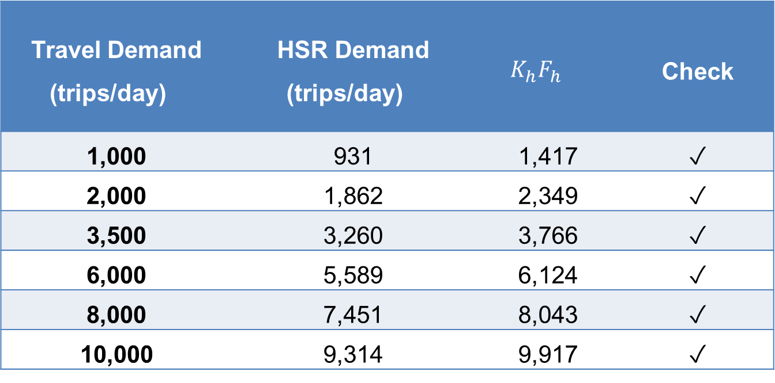
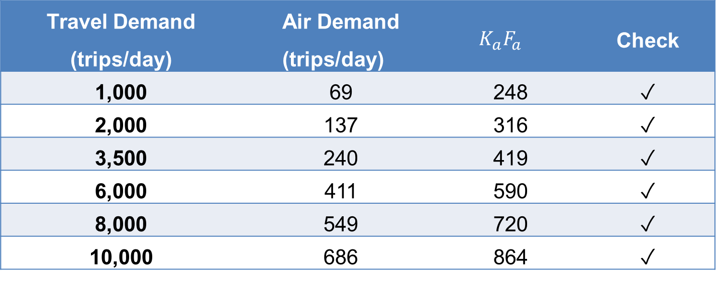
Travel Demand (trips/day) | HSR Demand (trips/day) | $$K_{h}F_{h}$$ | Check
1,000 | 931 | 1,417 | ✓
2,000 | 1,862 | 2,349 | ✓
3,500 | 3,260 | 3,766 | ✓
6,000 | 5,589 | 6,124 | ✓
8,000 | 7,451 | 8,043 | ✓
10,000 | 9,314 | 9,917 | ✓
Rispetto del vincolo di capacità per l’HSR
Capacity constraint respect for HSR
Travel Demand (trips/day) | Air Demand (trips/day) | $$K_{a}F_{a}$$ | Check
1,000 | 69 | 248 | ✓
2,000 | 137 | 316 | ✓
3,500 | 240 | 419 | ✓
6,000 | 411 | 590 | ✓
8,000 | 549 | 720 | ✓
10,000 | 686 | 864 | ✓
Rispetto del vincolo di capacità per l’Air
Capacity constraint respect for Air

Slide 25
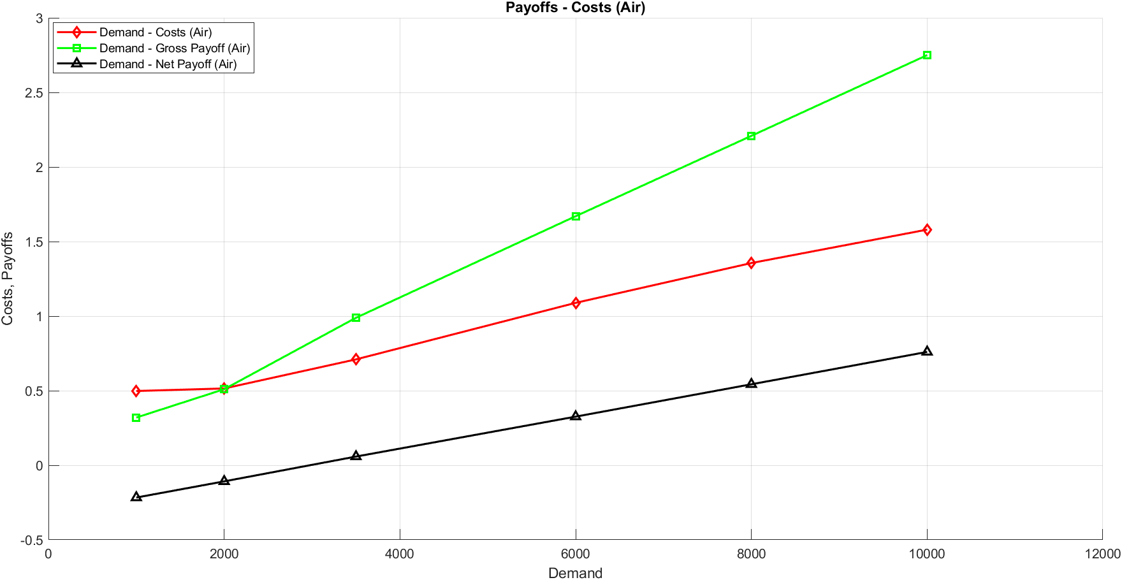
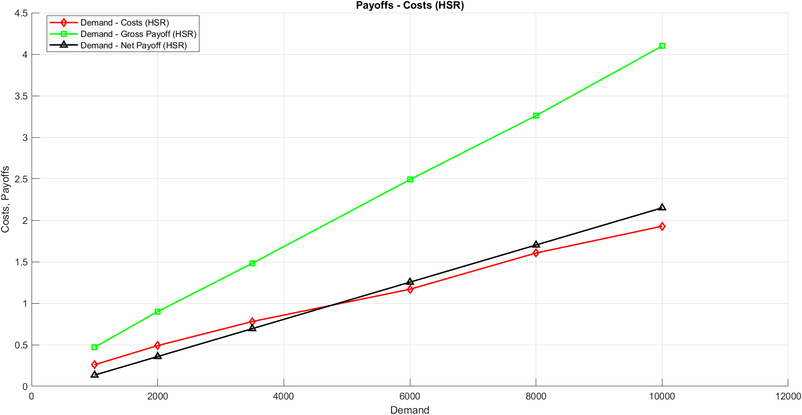
Travel Demand (pessengers/day) | HSR Payoff | Air Payoff
1,000 | 13,450 | - 2,164
2,000 | 35,846 | - 1,079
3,500 | 69,438 | 548.4
6,000 | 125,420 | 3,261
8,000 | 170,210 | 5,431
10,000 | 215,000 | 7,600
Payoffs of the players

Slide 26
Conclusions
6. Conclusions and Further Research Perspectives
Further Research Perspectives

Slide 27
Game Theory was used to analyze the competition between HSR and Air with reference to a Eastern European corridor, where Air transport is currently the only fast transport mode to travel between big cities.
The proposed methodology, based on a non-cooperative game, allowed determining:
Equilibrium Strategies: for both players in terms of fares [Euro] and frequencies [no. of planes-trains/day].
Conclusions
Attractiveness of the players: In terms of total travel demand attracted based on their strategies set by the players and the characteristics of the population.
Payoffs of the players

Slide 28
New Objectives: to study the competition between several players of the same transport mode or of other transport modes.
New Models Specifications with increasing Complexity: to analyze the competition between HSR and Air by specifying more complex mathematical models.
Further Research Perspectives
Model Adaptability: new case studies where HSR represents a reality, or it is under construction.

