Slide 1
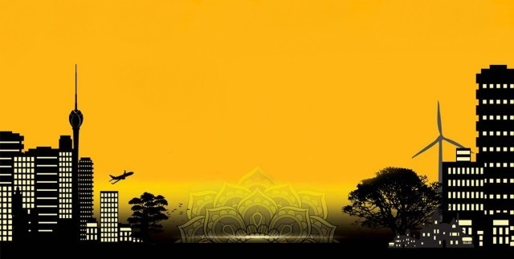

MINISTRY OF MEGAPOLIS & WESTERN DEVELOPMENT
Megapolis Master Plan
&
Key Investment Opportunities

Slide 2
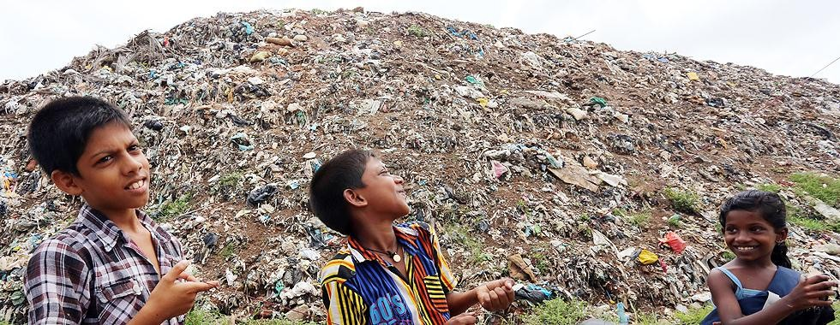
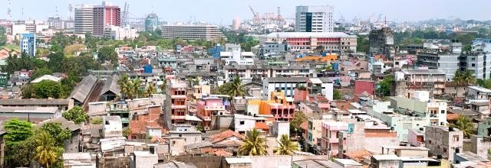
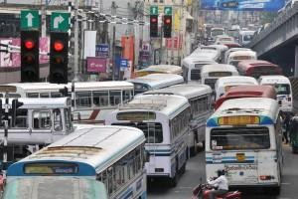
Why Megapolis..?
Control ribbon development and sprawl.
Minimize the congestion.
A gentrifying city.
Improve the waste management systems.
Manage haphazard land use.
Protect significant wetlands & natural assets
Create the enabling environment for an economic transformation.
Improve housing/living standards and create a social transformation
Concentrate and better manage industry
Create a truly unique network of cities

Slide 3
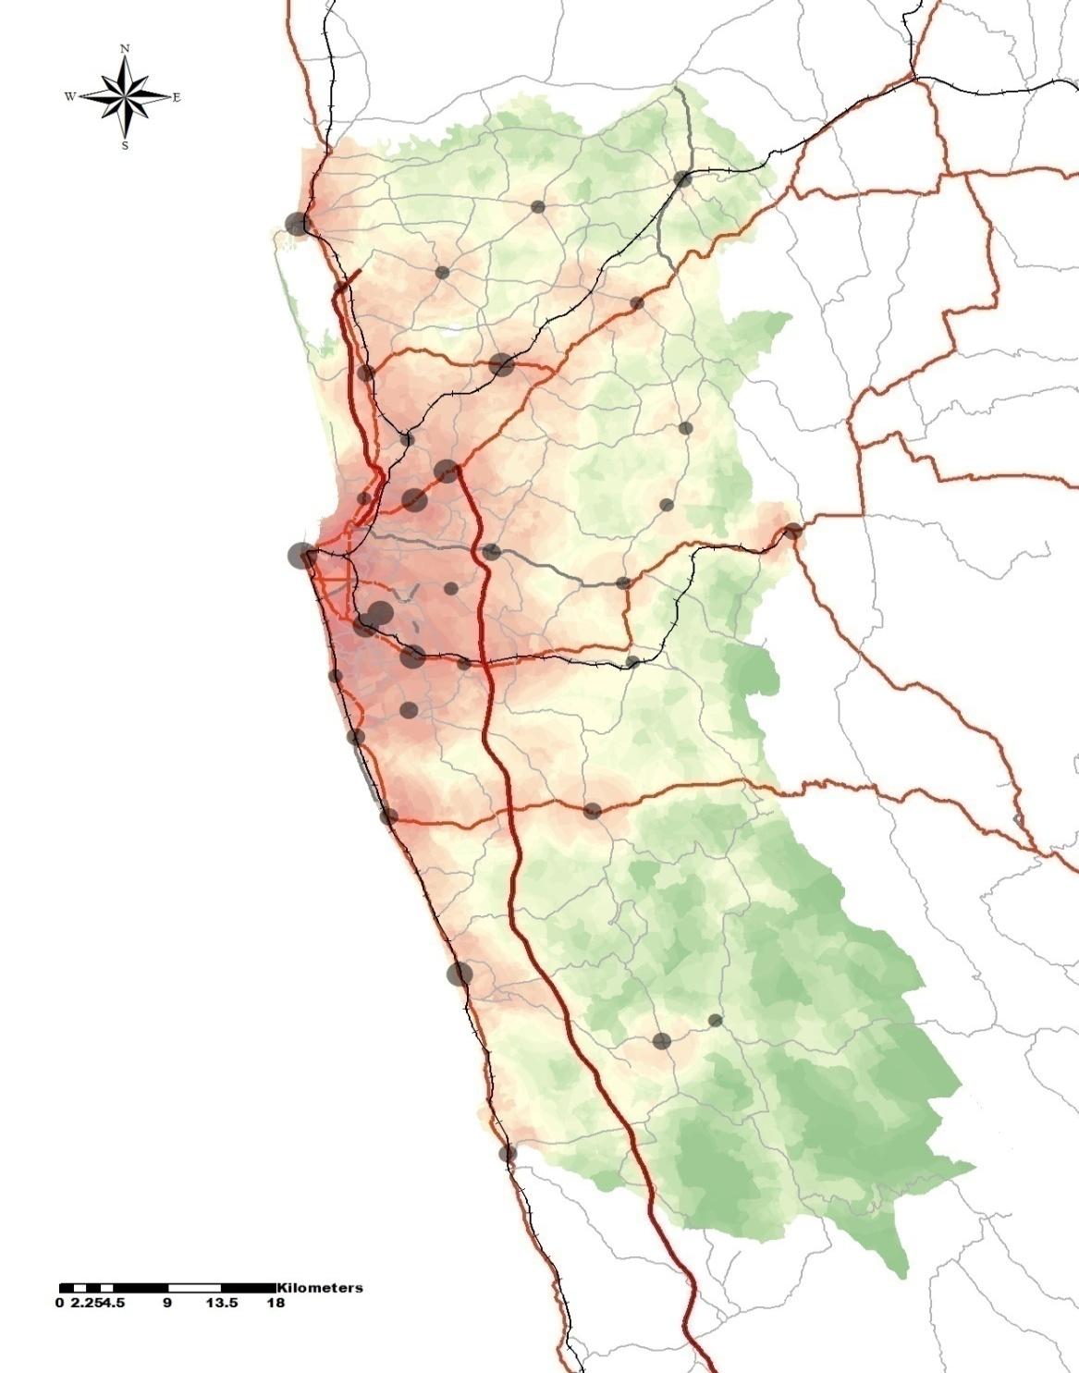
Western Region Megapolis Plan
Marine Zone
Colombo CBD – Financial City
Industrial/Manufacturing Townships (Mirigama & Horana)
Aero City (Katunayake)
Tech City (Kaduwela to Homagama)
Logistics,Tourism & Marine City (Katunayake to Colombo Harbor & Marine Zone)
Plantation City (Avissawella)
Forest Related Economic City (Baduraliya)

Slide 4
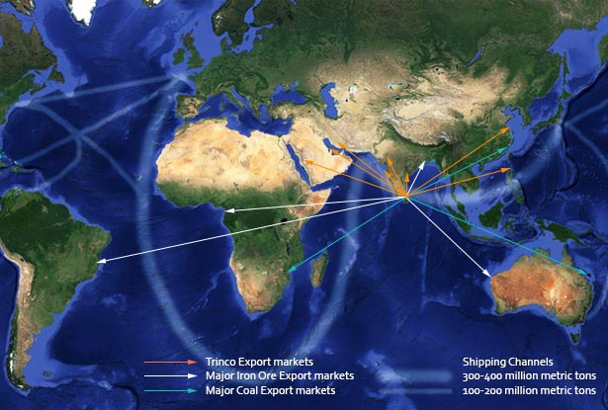
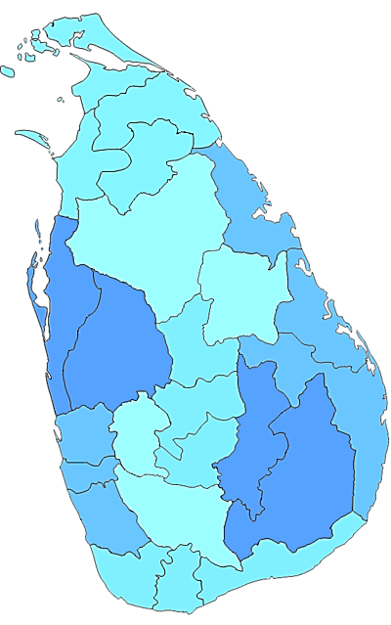
Sustainable Harbour Utilisation
Troncomalee Harbour
China
Miyanmar
HongKong
Japan
Bangaladesh
Colombo Harbour
India
Pakistan
UK
African Continent
Gulf Aden
Hambantota Harbour
Singapore
Malaysia
Australia
Indonesia

Slide 5
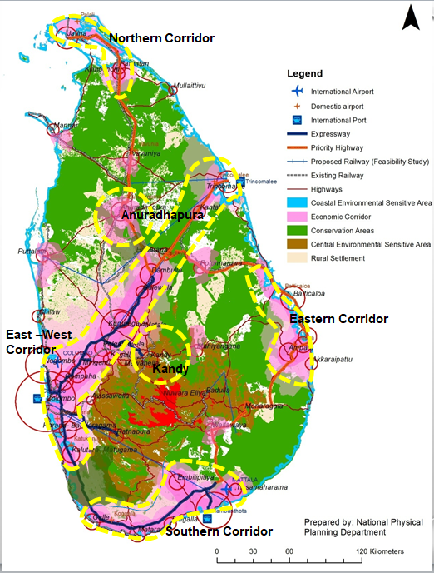
Key Economic Corridors
Proposed Spatial Structure 2050 By National Physical Plan
Four Development Corridors
Two Metro Regions

Slide 6
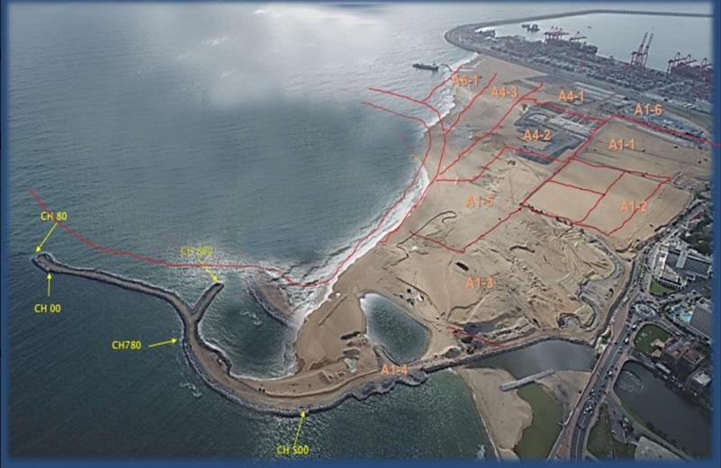
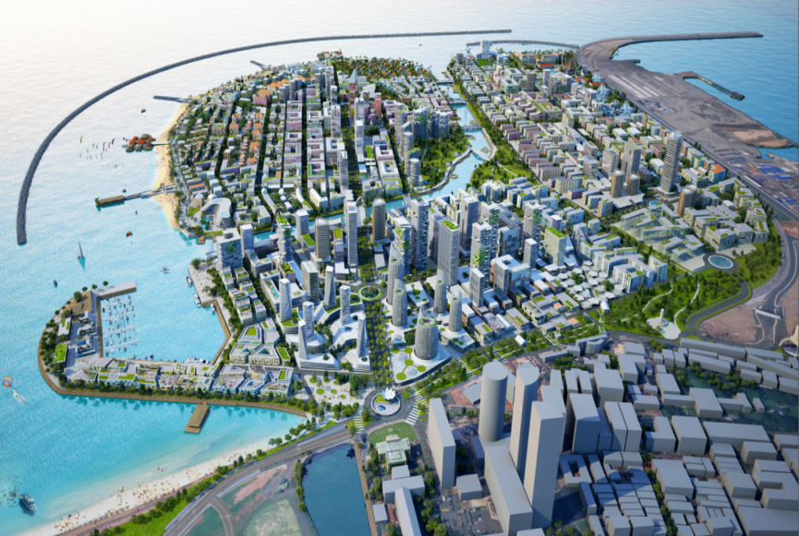
Colombo Port City
Progress of Work | Total Requirement | Work Done | Work Schedule
Land Reclamation | 70 Million mt | 45% | Ahead of schedule
Rock Delivery | 3.5 Million mt | 40% | On schedule
Colombo Port City Development Project
Tasks to be achieved
Commencement of International Financial Center: 60 stories - 2018
Date of completion for Reclamation and Breakwater: June 2019
Total Land Extent | 269 Ha.
CPCC Owned Land Extent | 116 Ha.
GOSL Owned Land Extent | 62 Ha.
Other (Roads, Green Areas Etc.) | 91 Ha.
Total Investment | USD $ 1.4 Billion
Total Land Plots | Approx. 74 Lands
Total Job Creation | 83,000

Slide 7
Government Owned Lands in Port City
The government of Sri Lanka has planned to have following three projects,
International Education Centre
International Health Centre
International Conventional Centre
Colombo Port City Development Project

Slide 8
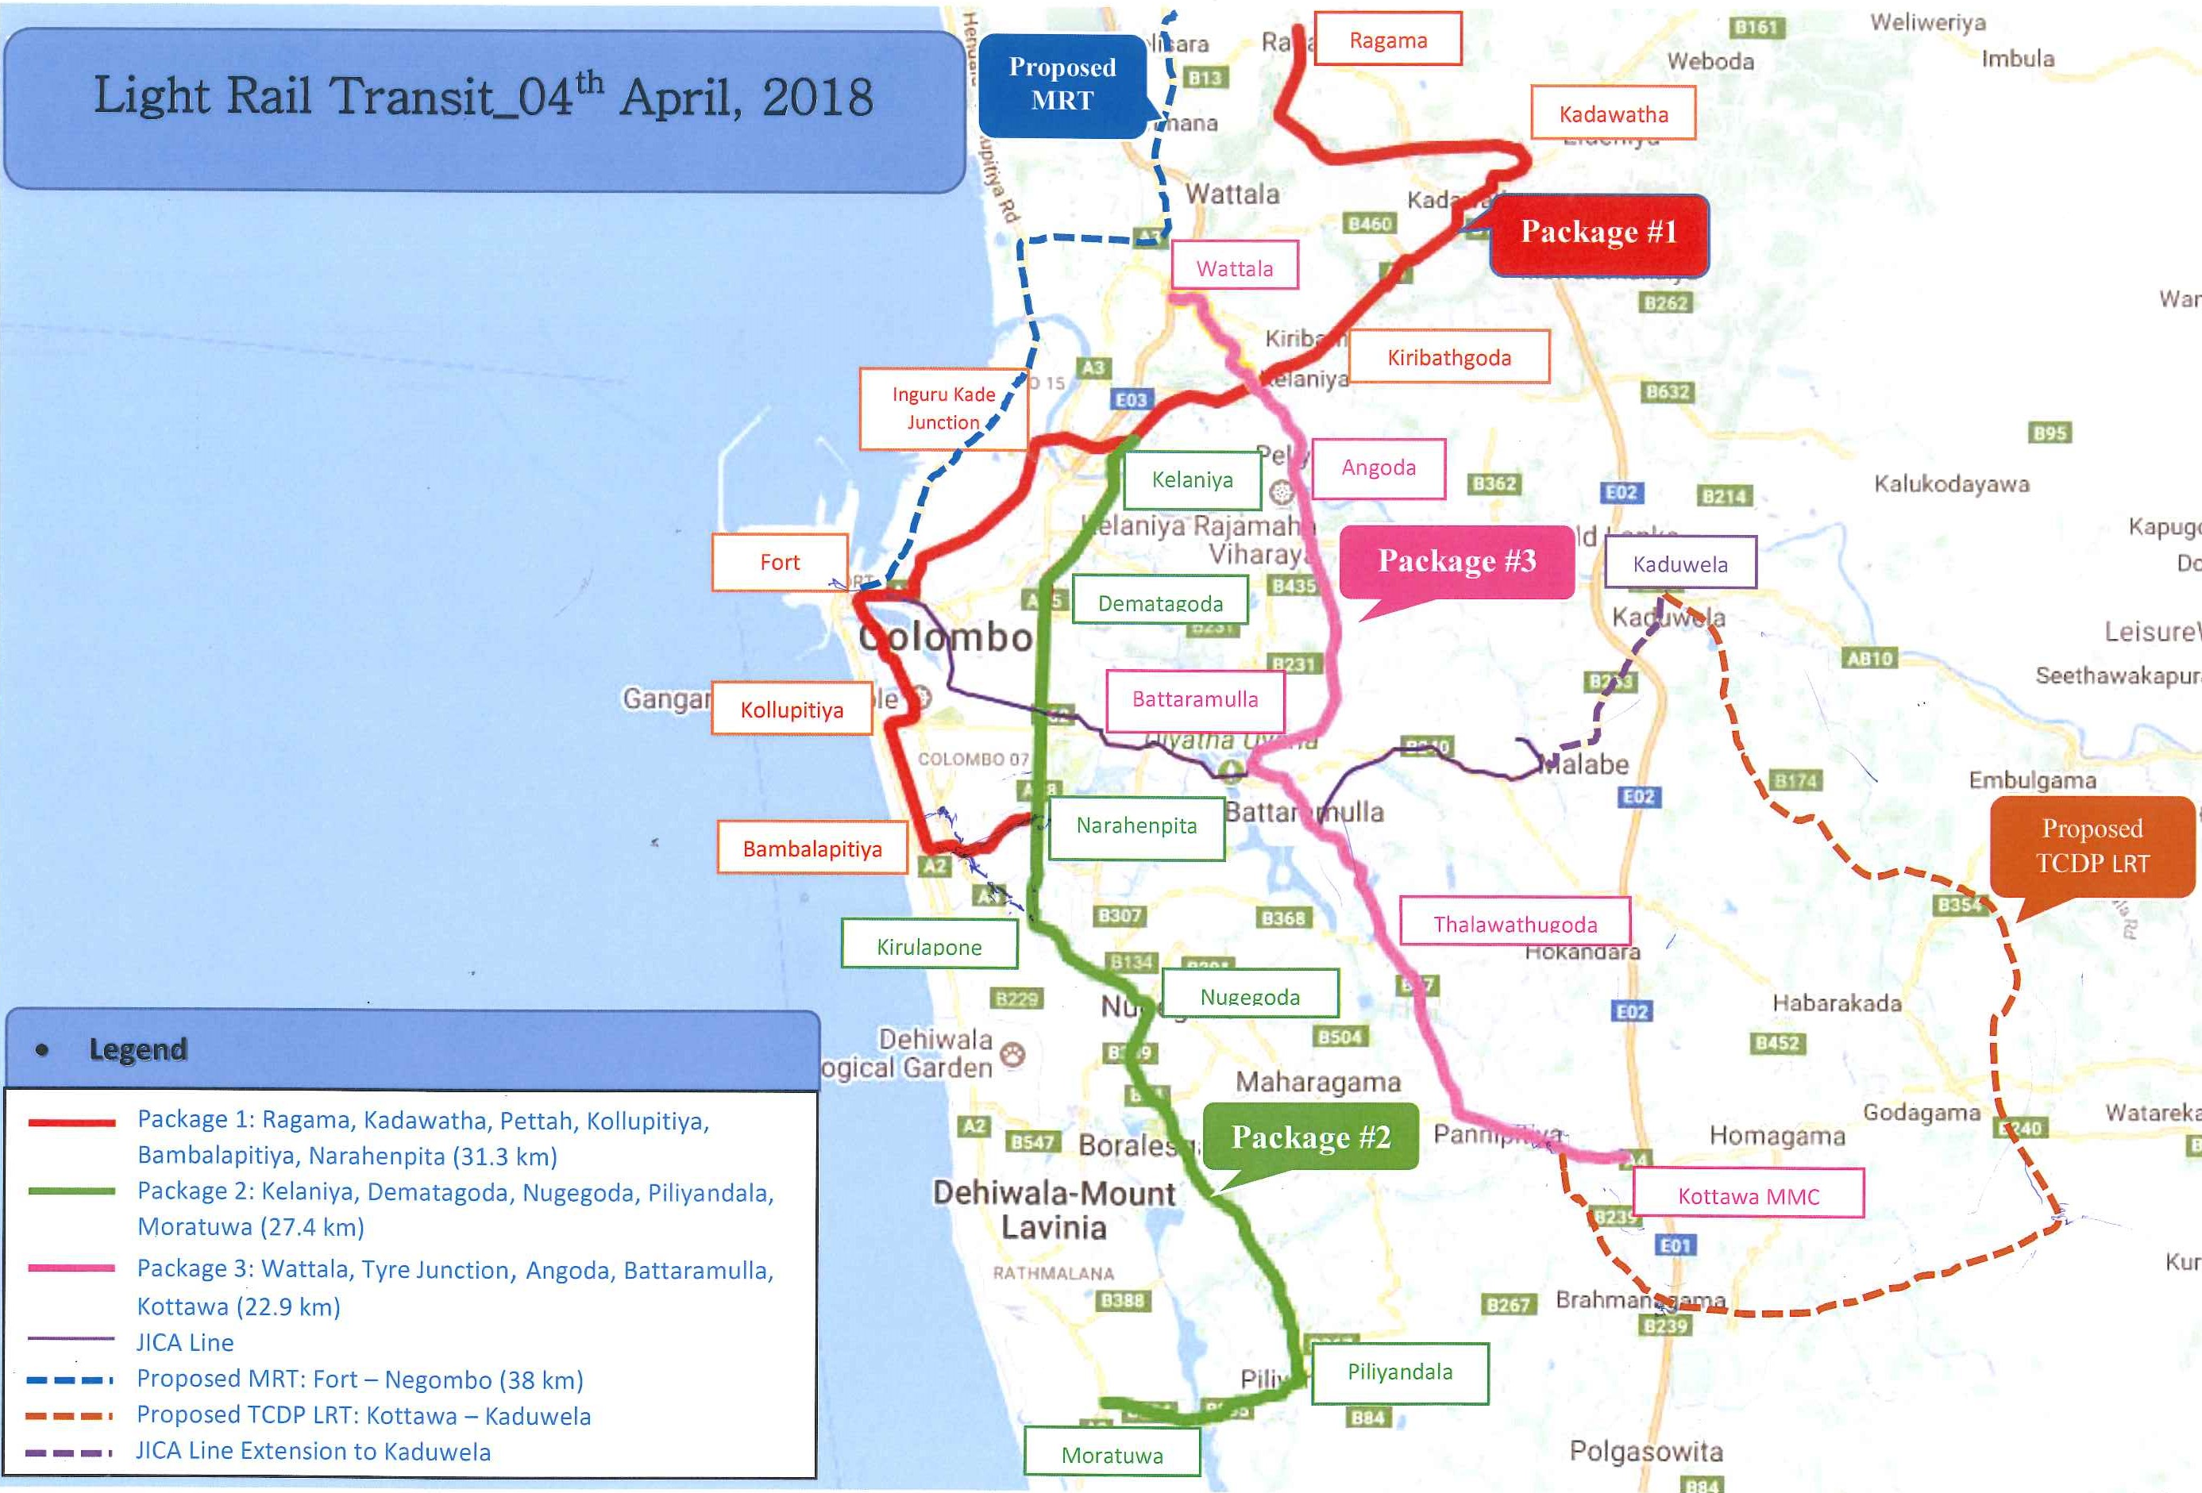
Public Transport Sector – New Light Rail Transit System

Slide 9
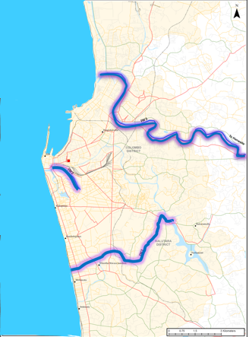
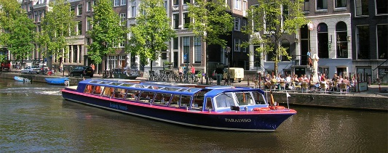
Public Transport Sector - Inland Water Transport
Inland Water Transport
Under Implementation
Wellawatte – Battaramulla (IW1) - 7.2 Km
Fort – Union Place (IW2) – 2.0 Km
Mattakkuliya – Hanwella Line (IW3) – 34.0 Km
Other (Sea / Canal) Lines
Total Estimated Cost of Project is US $ 6 million

Slide 10
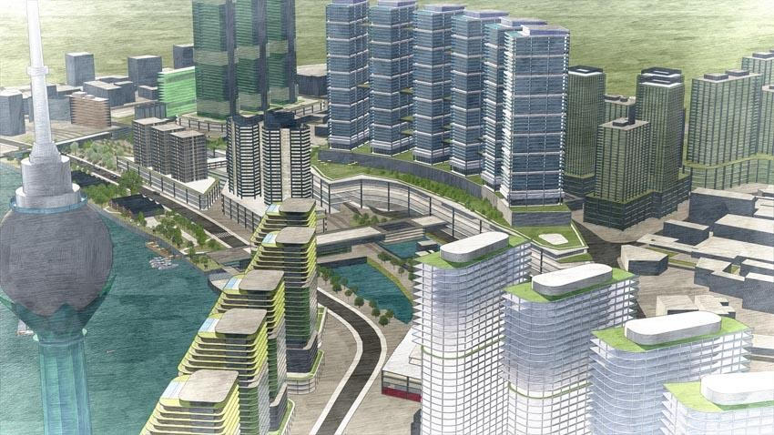
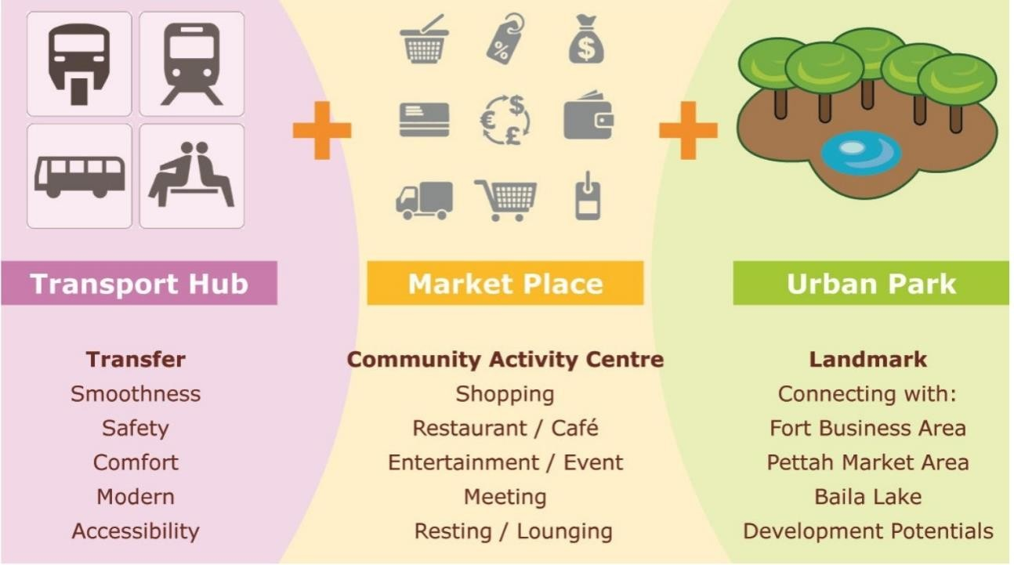
Public Transport Sector – MmTH Colombo - Fort
Multi-Modal Transport Hub Colombo - Fort
Project Components of MMTH
Under Implementation
Railway Station
LRT Station
Bus terminal
Pedestrian Decks
Car Parking
Shopping Mall
Roof garden as a green public place
Access Roads
To improve the connectivity between different transport modes in Western Province.
To accommodate business, accommodation, Office and recreational facilities.

Slide 11
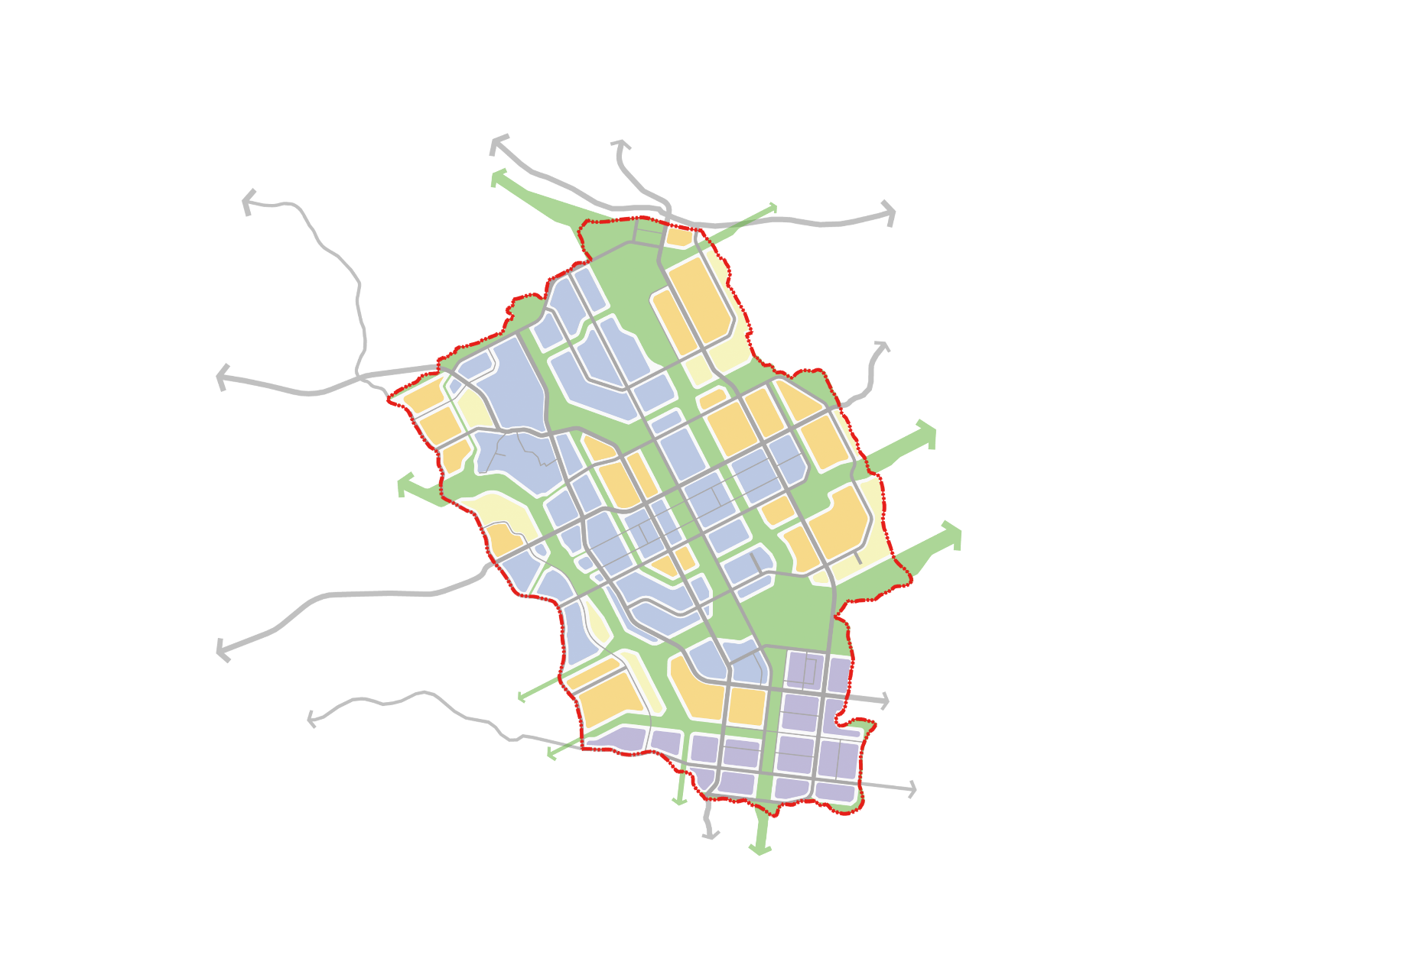
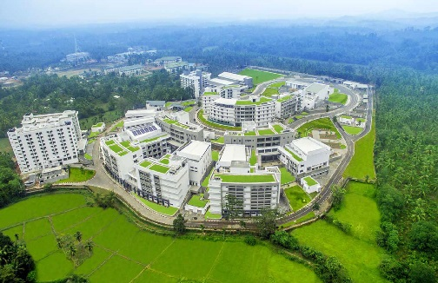
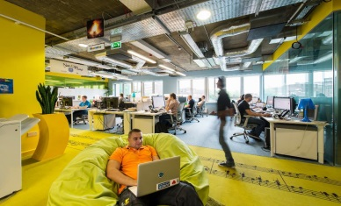
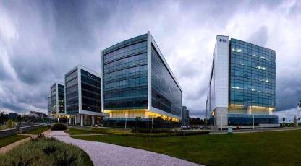
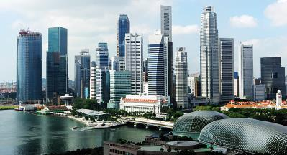
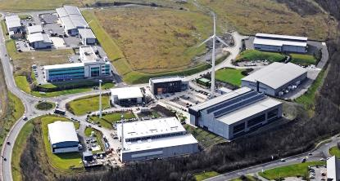
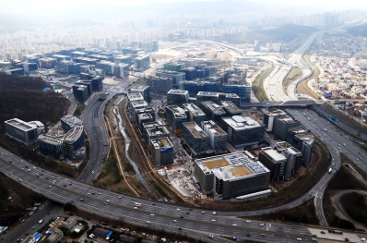
Investment Opportunities in - Tech City
  Science Corridor
Homagama
Meegoda
Railway Station
  International Business Corridor
Multi-Modal
Node
B240
Biz Incubator
Science Node
To B123
To Colombo
To COLOMBO
Science
Node
International Business
Administrative Node
Int’l Biz
Node
Dampe
International Biz
Corridor
Administrative
Node
To COLOMBO
Industrial Node
Science Corridor
Venture Business
Industrial
Node
Residential
Padukka
S&T Programs
Industrial Programme
Green Network
N
Key Node
Arterial Road
To HORANA
Local Road
0
0.5
1
2Km
Railway

Slide 12
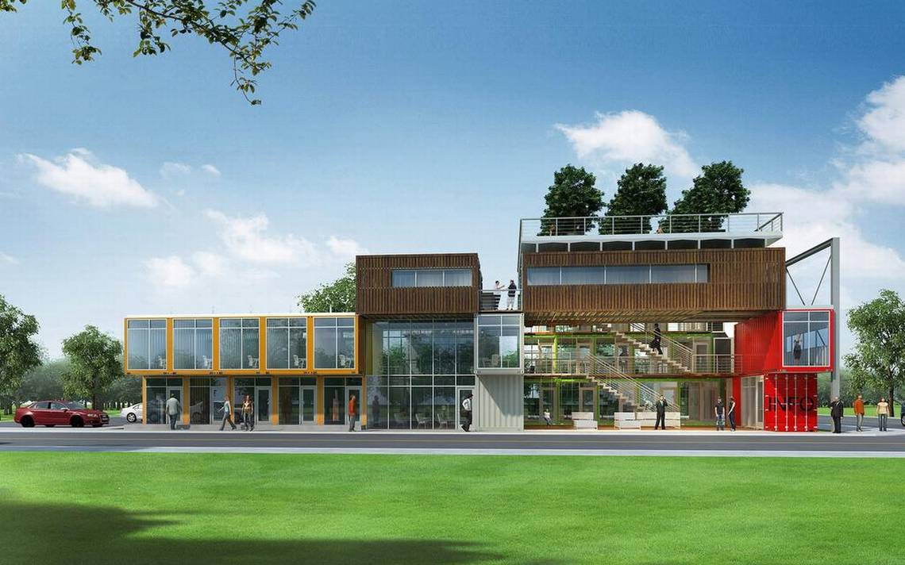
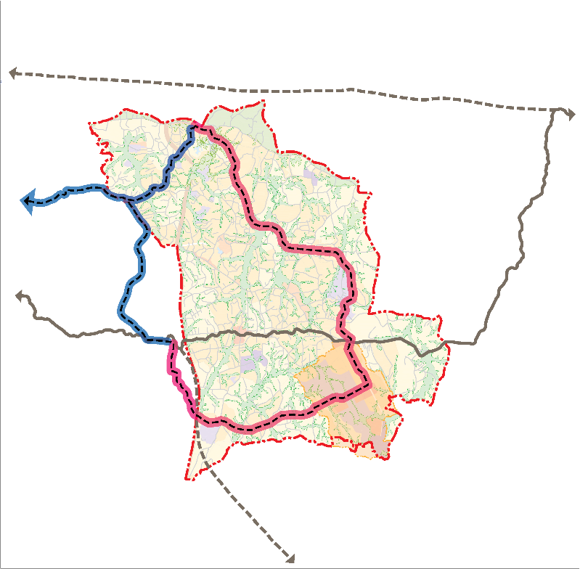

Investment Opportunities– Tech City
  03. Business Corridor:
  Construction of Business Incubating Center
Overview | Location: Pilot project site of Tech City
 | Area: Approx. 14,000㎡
 | Function: Utilizing technology commercialization infrastructure
 | Duration: 3 years
Est. Cost | TEC: USD 15 Mn
  04. Public Transportation :
  New Light Rail Transit Route
Colombo
Avissawella
RL-NR2 (Keleniya-Kosgama)
Harmonized public transportation service network
New Multi-Modal Transport Hub at Meegoda
Colombo/
Kotte
LRT 6
LRT 4
LRT(proposed)
LRT 5
RL-M3 (Kelani Valley Line)
Colombo
Meegoda
Railway Station
Elevated or at grade
Kottawa to Kaduwela via Mahenwatta & Meegoda
LRT Line (planned)
LRT Line (proposed)
Railway (existing)
Railway (proposed)
Multi-Modal Center (planned)
Multi-Modal Center (proposed)
RL-NR1 (Kottawa-Horana)
Horana

Slide 13
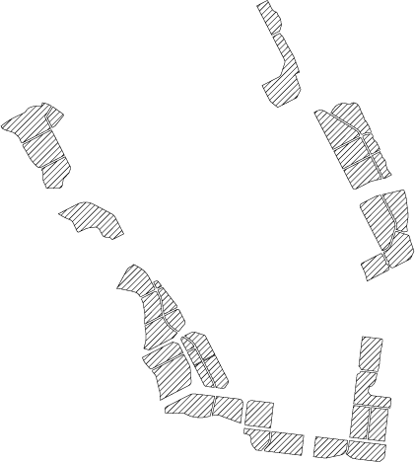
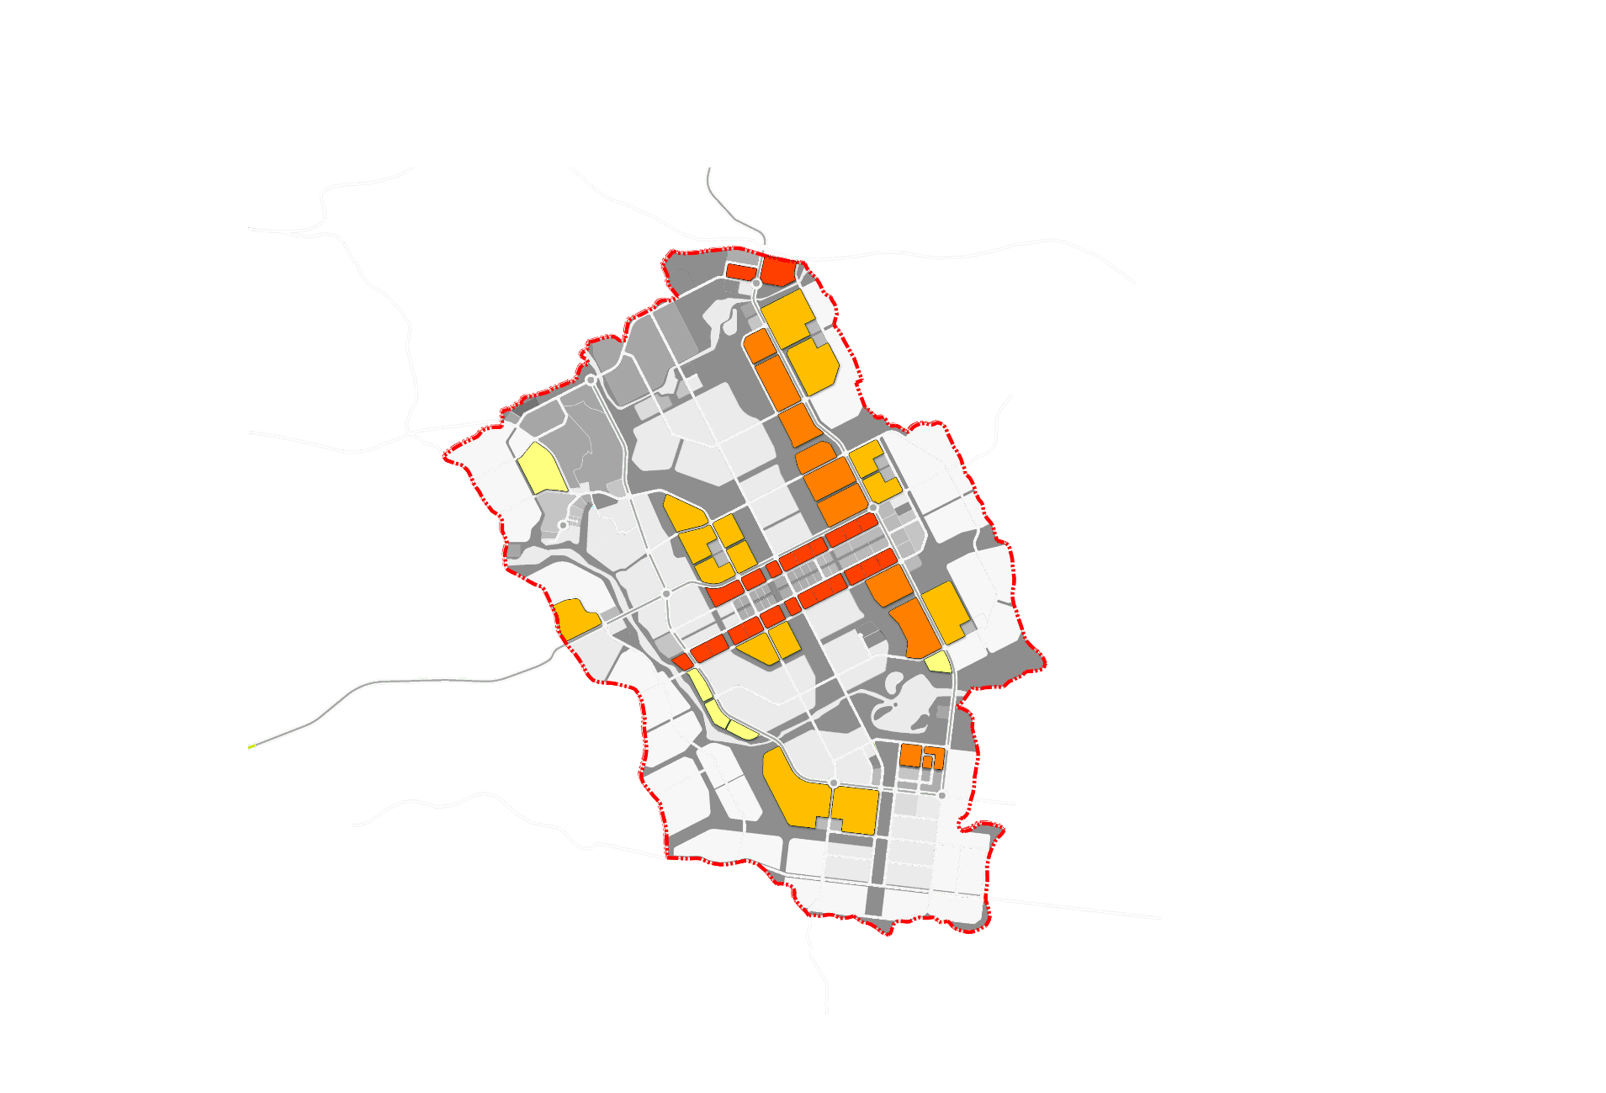
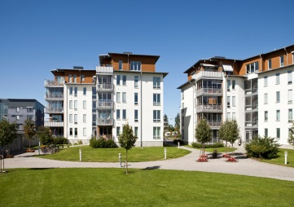
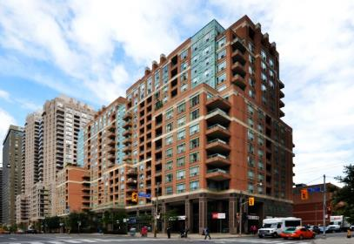
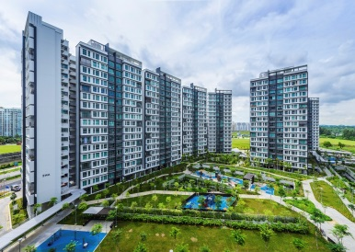
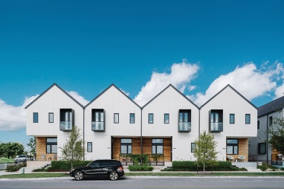
Investment Opportunities– Tech City
  Housing
  Housing Complex Construction Project
- Total Population : 111,000
- Total Number of Unit : 28,500
  High-Density Housing
  Mid-Density Housing
Mid-Rise Apartment
Residential – Commercial Housing
M1
M2
T11
Population
52,500
Number of Unit
13,400
Social Housing
3,300
A1
T12
Population
19,000
Number of Unit
5,000
A2
A3
D1
A4
T13
A5
T14
T2
A6
T3
T4
M6
M7
T6
T5
M5
M14
M3
M4
M12
M13
A7
  Low-Density Housing
T1
M11
A8
T15
High-Rise Apartment
M9
M10
T8
M8
T7
D5
Detached House
D2
D3
Population
38,000
Number of Unit
9,700
D4
A10
Population
1,500
Number of Unit
400
A9
A11
T9
T10
Low-Density D1~D5
Mid-Density T1~T15
High-Density(apartment) A1~A11
High-Density(mixed use) M1~M14
N
Social housing T2, T10, T14

Slide 14
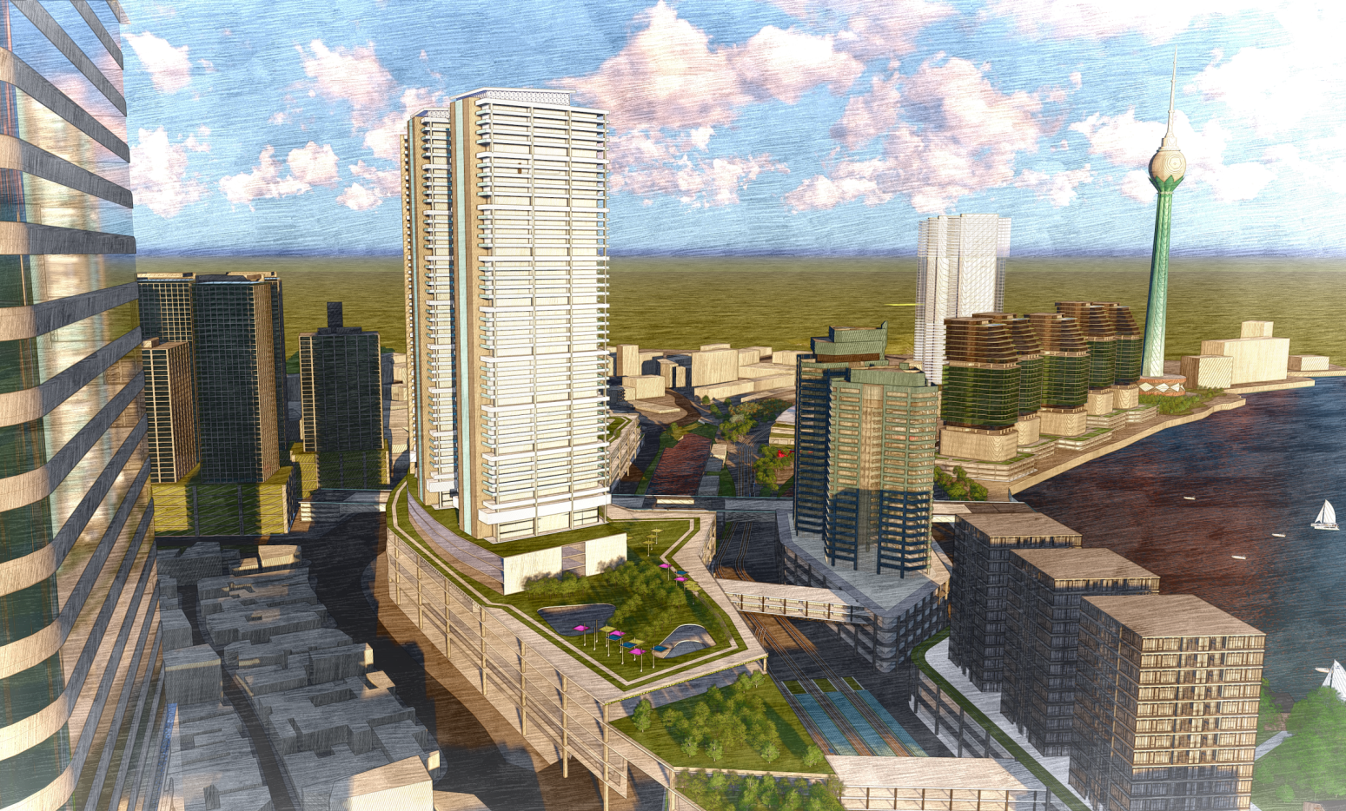
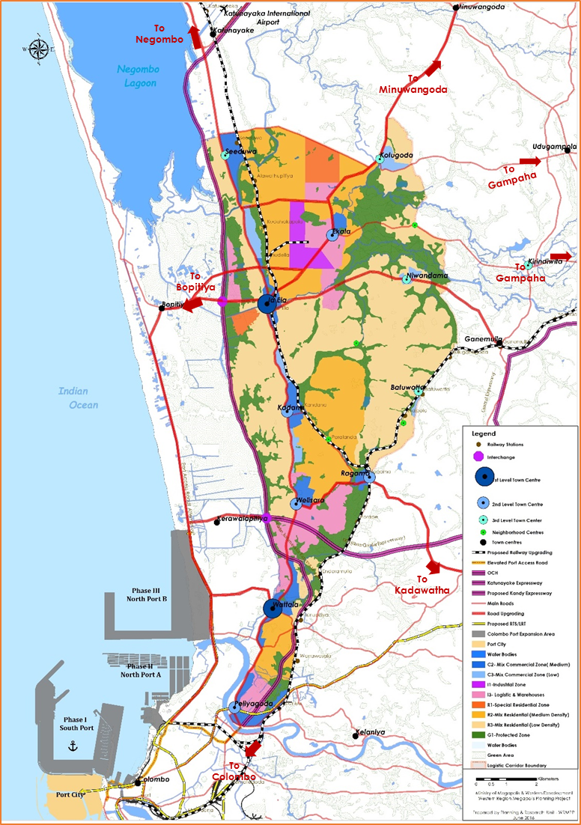
Investment Opportunities – Financial City
  01. Multi-modal Transport Hub / Pettah
Overview | Location: CBD / Pettah
 | Land Area: Approx. 267,093㎡
 | Function: Construction of Commercial Buildings, Housing, Office Spaces, Transport hub (Bus Stand, Railway, Light Rail, Boat Services, Taxi)
 | Duration: 7 years
Est. Cost | TEC: USD 2,300 Mn
  02. Colombo Port Expansion Project (North Port – A / Phase II)
Overview | Location: Port of Colombo
 | Land Area: Approx. 2.5e+6㎡
 | Function: Construct more deep draft container terminals, conventional cargo handling facilities and other essential port facilities
 | Duration: 10 years
Est. Cost | TEC: USD 2,130 Mn

Slide 15
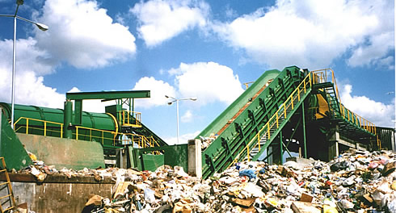
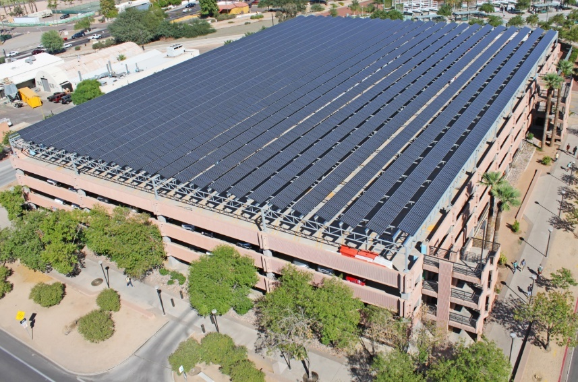
Investment Opportunities – Administrative City
03. Waste to Energy Project
Overview | Location: Kaduwela / Nawagamuwa
 | Land Area: Approx. 20,234.4㎡
 | Function: Solid waste processing plant with incineration and power generation facility
 | Duration: Less than 2 years
 | Capacity: 300 Tons per day
Est. Cost | TEC: USD 8 Mn
04. Generation of Solar Electricity Power
Overview | Location: Battaramulla
 | Land Area: All identified roof tops, car parks of government offices
 | Function: Generation of solar electricity power using roof surfaces and premises of government building at administrative city
 | Duration: 1 year
Est. Cost | TEC: USD 16 Mn

Slide 16
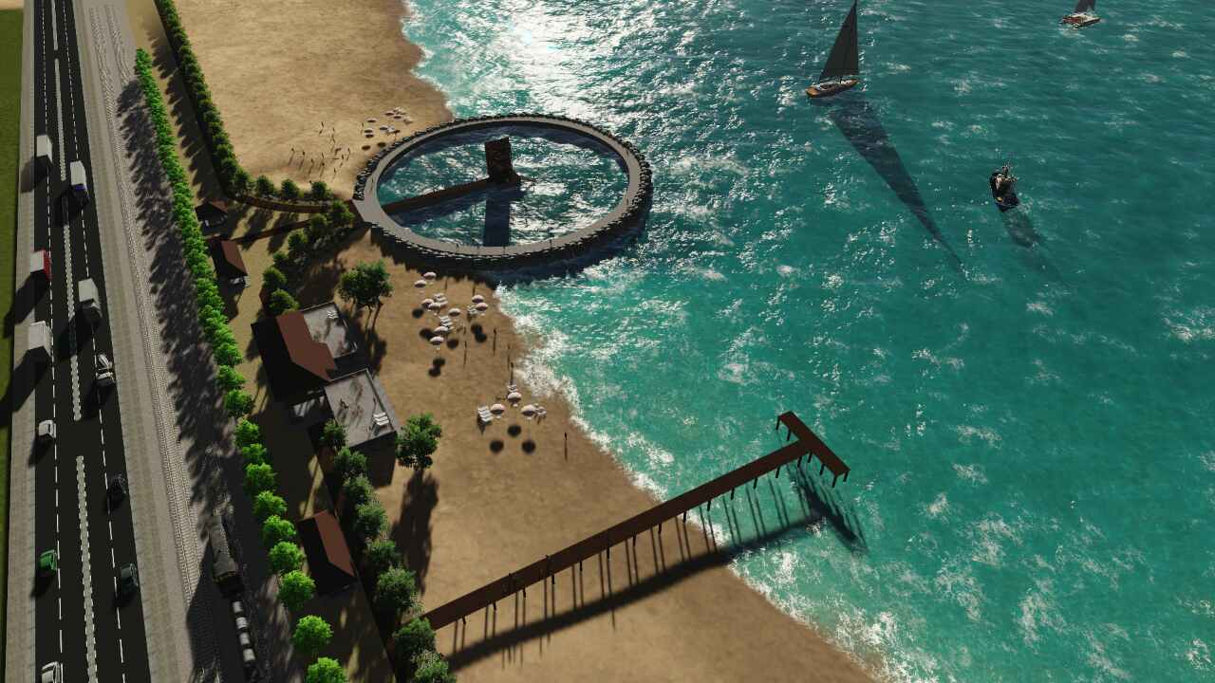
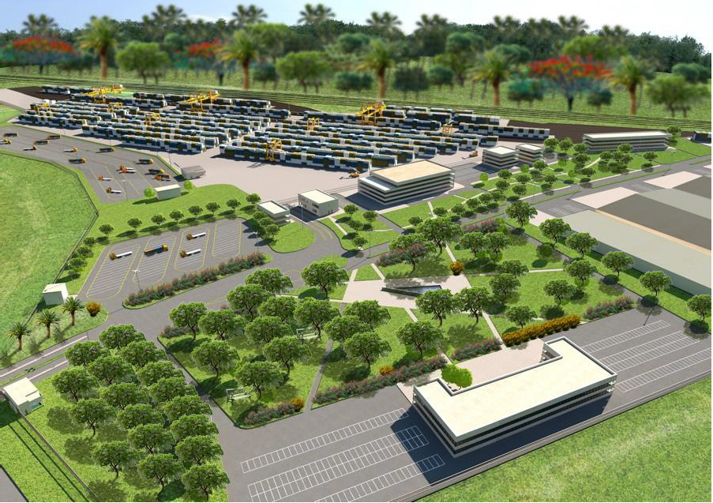
Investment Opportunities – Logistics, Tourism & Marine City
01. Development of Recreational Beach Area/Sea Waterfront from
Colpetty to Dehiwala
Overview | Location: Colpetty to Dehiwala
 | Land Area: Approx. 7km
 | Function: The development of recreational beach area (approx.85 ha) from Colpetty to Dehiwala
 | Duration: 3 years
Est. Cost | TEC: USD 200 Mn
02. Development Of Bloemendhal Area
Overview | Location: Bloemendhal Area
 | Land Area: Approx. 16 Acres
 | Function: Development Of A Logistic Center, Customs Scanning Facility, Urban Recreation Park And Wetland Park In Bloemendhal Area
 | Duration: 5 years
Est. Cost | TEC: USD 61.88 Mn

Slide 17
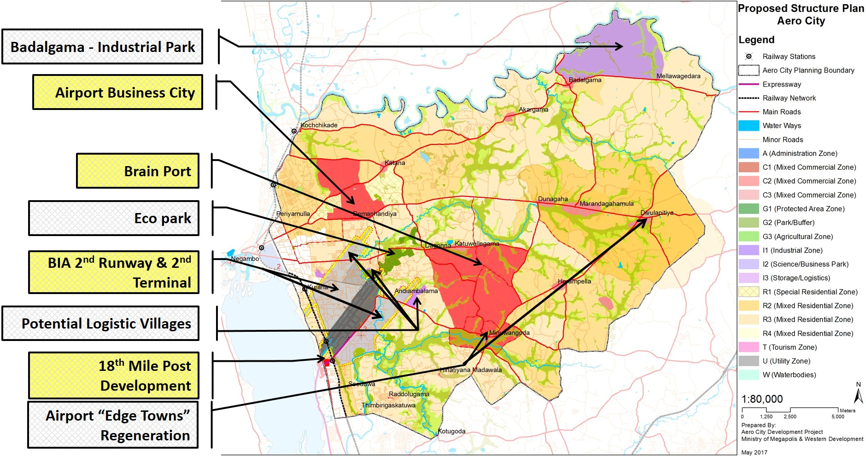
Investment Opportunities– Aero City

Slide 18
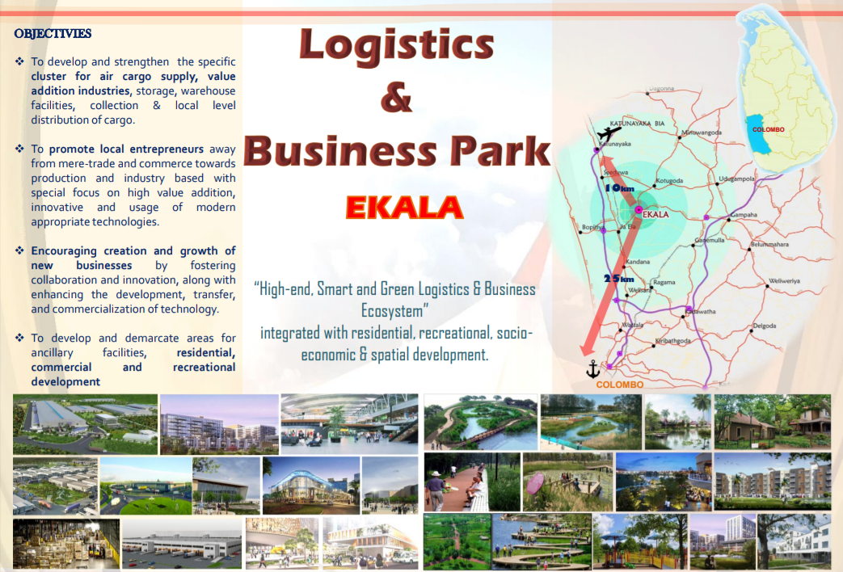
Investment Opportunities– Aero City

Slide 19
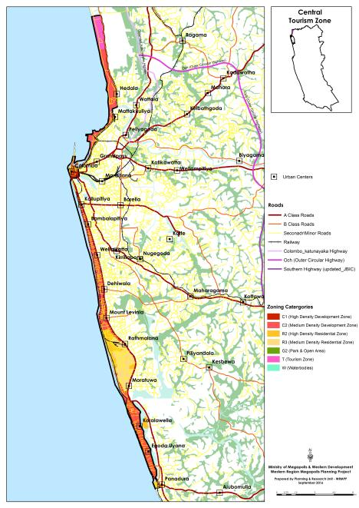
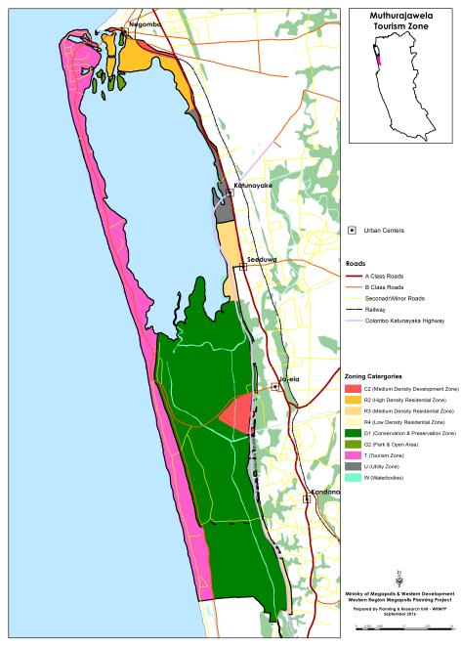
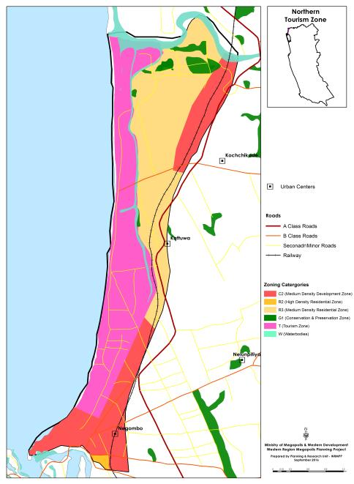
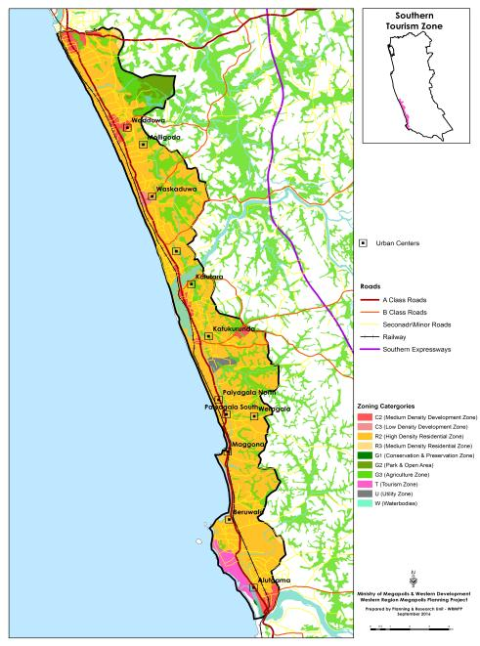
Tourism Development Zones
Central Tourism Zone
Muthurajawela Tourism Zone
Northern Tourism Zone
Sothern Tourism Zone

Slide 20
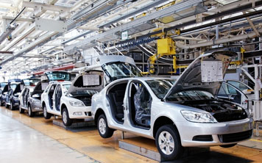

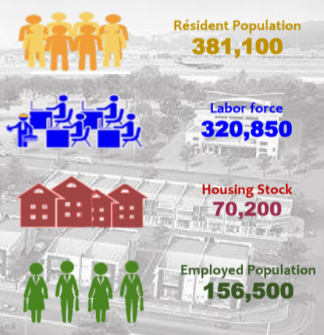
Horana Industrial Township
Develop Five specialized large scale industrial clusters.
    Rubber industries and Mechanical Engineering Cluster
    SME Cluster
    Value added textile and apparel Cluster
    Biotechnology, Pharmaceuticals and Modernized Ayurveda Cluster
    Electrical and Electronic Industries Developing Cluster
Develop Logistics Hub at Horana industrial city center with access from either expressway or railway network.
Use existing wetlands, forest areas and expressways reservation areas as green buffers for the industrial development.
Redevelop the existing Horana town center to cater future demand.
Preserve environmentally sensitive areas through regulation.

Slide 21
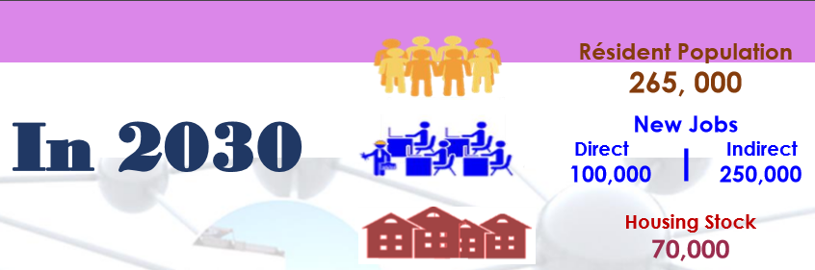
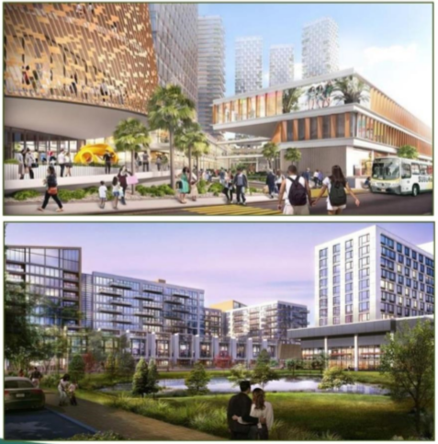
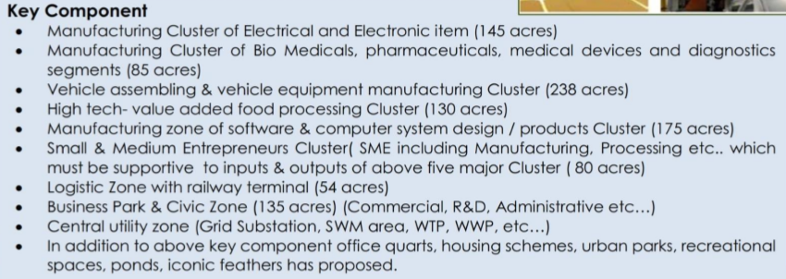
Mirigama Industrial Township
Integrated, Smart & Self Contained Industrial City
Key Components

Slide 22
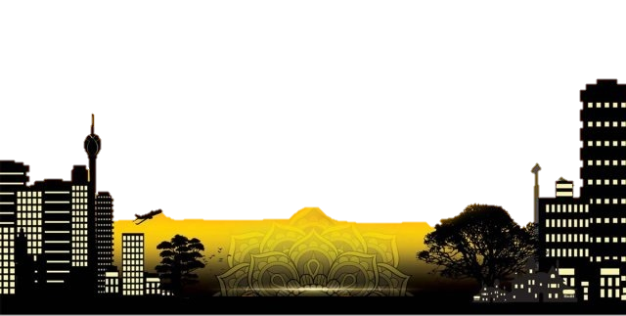
Thank You..

