Slide 1
Learning to Search for Parking like a Human: A Deep Inverse Reinforcement Learning Approach
Shiyu Wang
College of Transportation Engineering
Tongji University
2024.11.07

Slide 2

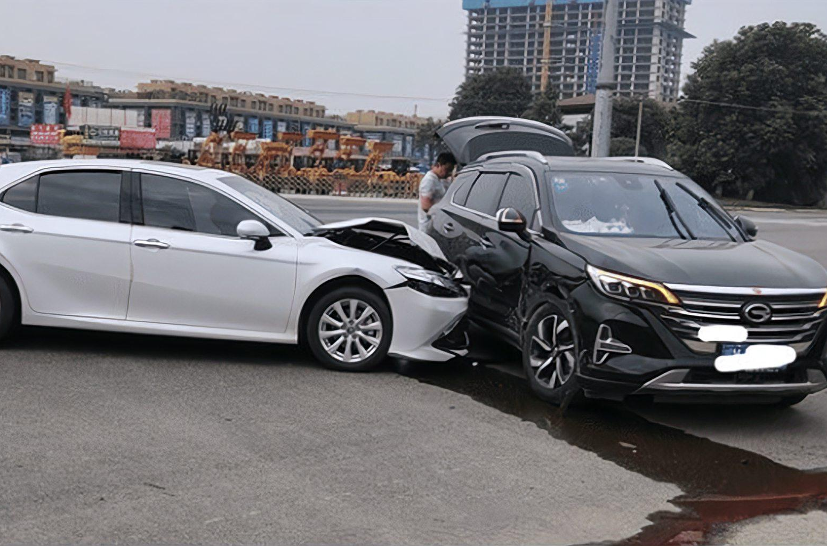
1
BACKGROUND
During peak periods, 30-50% of traffic flow is related to parking.
On average, individuals spend 20 minutes searching for a suitable parking spot.
In France, 70 million hours are spent annually on parking searches, leading to a loss of 700 million euros.
congestion
pollution
collision
Problem: On-street parking search causes congestion, pollution, and collisions.
To address this issue and improve urban transportation services, government agencies need effective parking management measures and traffic policies.

Slide 3
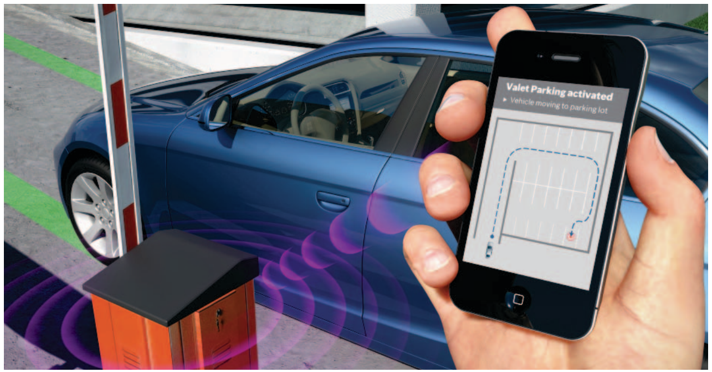
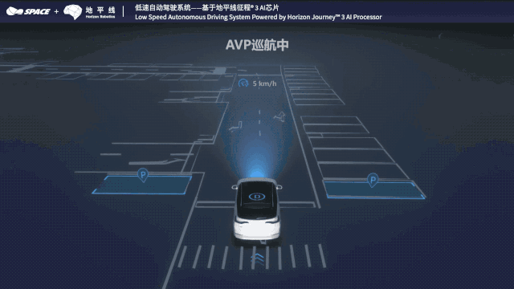
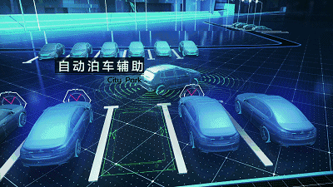
1
BACKGROUND
Importance: Understanding parking search behavior is essential for effective management strategies.
Complexity: Parking search involves sequential decision-making with multiple destination and path choices, influenced by driver preferences and dynamic environments.
Task assign
Search
Park
Start parking now
Where am I going?
How do I park?
Difficult and Challenging ！！

Slide 4
LITERATURE REVIEW
2
Mathematical Modeling Approach
Deep Reinforcement Learning
Arnott and Rowse, 1999
Anderson and De Palma, 2007
Levy et al., 2013
Geroliminis, 2015
Cao et al., 2019
Compared to supervised learning methods, DRL has stronger predictive and generalization capabilities.
Hu et al., 2020
Zhao et al., 2022b
Du et al., 2023
Lu et al., 2024
Limitations: Actual decision-making behavior deviates from the `perfect rationality“ assumption, which undermines the authenticity and reliability of existing parking search models.
Limitations: Designing a feedback function is challenging in practical multi-step reinforcement learning, especially in complex parking search decision-making.
Inverse Reinforcement Learning
Deep Inverse Reinforcement Learning
IRL utilizes extensive human expert decision-making data to reverse-engineer the feedback function and optimize the agent's strategy.
Wulfmeier et al., 2015
Zou et al., 2021
Nan et al., 2023
Ji et al., 2024
Nan et al., 2024
Levine et al., 2011
Ng et al., 2000
Fernando et al., 2020
Limitations: IRL cannot directly map states to actions; it requires learning the reward functions that lead to specific driving behaviors from driving data.
DIRL provides human-like decisions based on learned strategies, comprehensively understanding and reconstructing driver parking decisions to facilitate high-fidelity traffic simulations

Slide 5
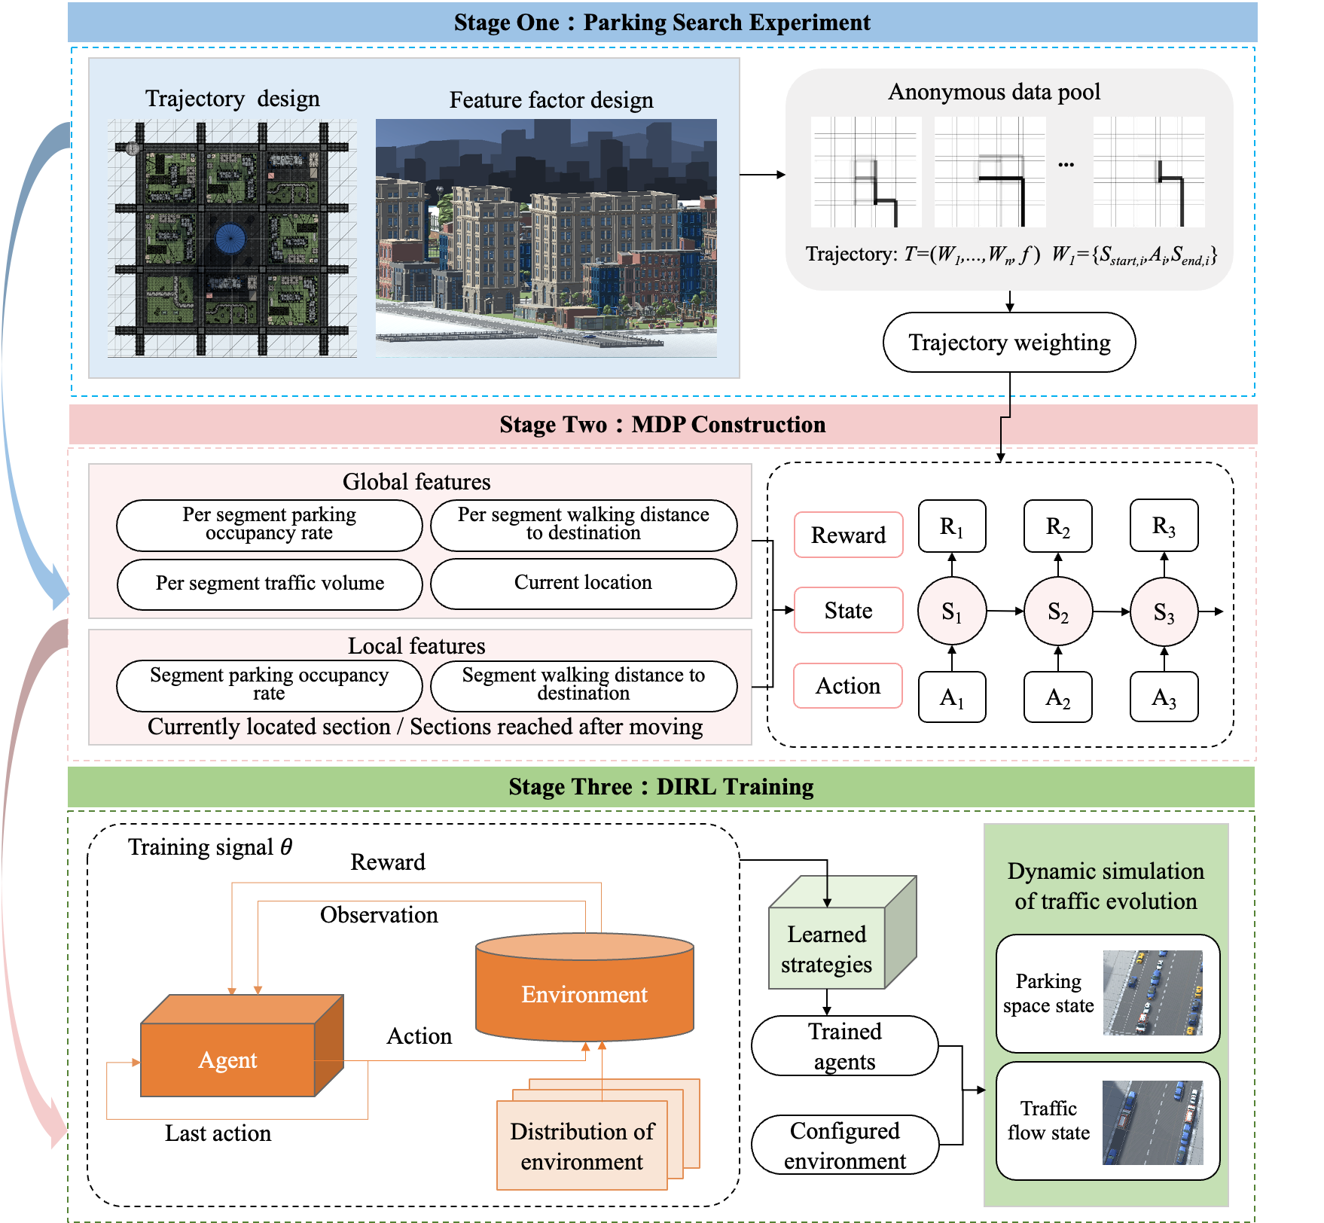
FRAMEWORK DESIGN
3
Parking Search Experiment
Constructed using Unity3D to collect trajectory data.
Data integrated into an anonymous driver data pool.
MDP Construction
Parking search process modeled as a Markov Decision Process (MDP) with global and local features.
DIRL Traning
DIRL algorithm utilized to learn the reward function and develop behavioral strategies for parking routes.
Simulated urban on-street parking scenario to observe changes in traffic and parking system states.

Slide 6
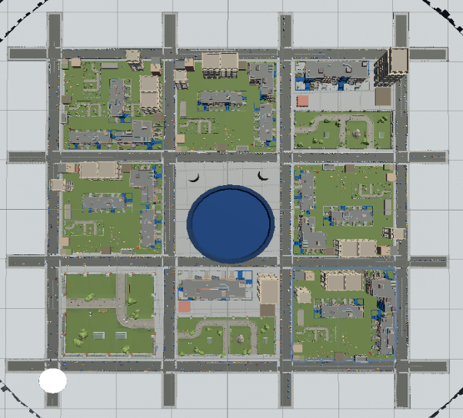
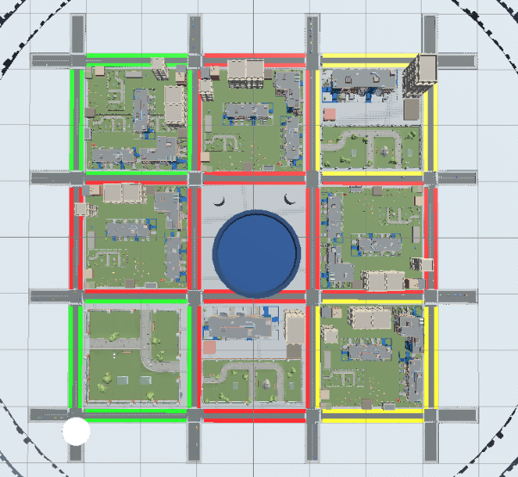
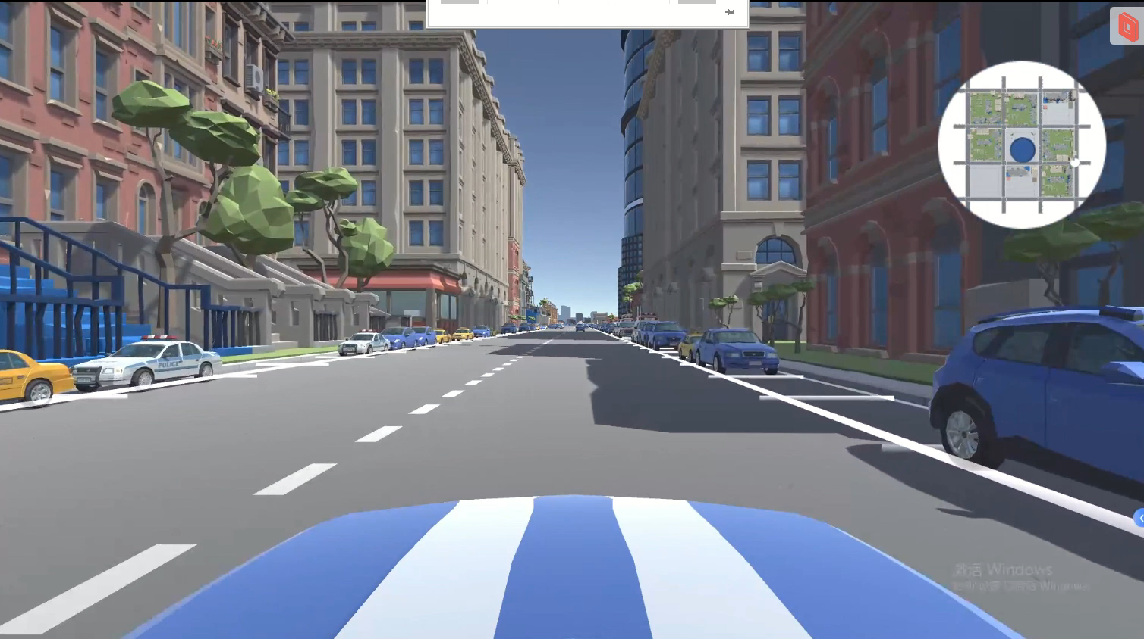
SIMULATION SETUP
4
Using Unity3D to build a complete urban traffic network model, comprising the urban traffic system, roadside parking system, navigation map system, and simulation driving system.
Parametric Configuration of Traffic Flow States and On-Street Parking States
3D Scene Modeling of Urban Road Networks
The model includes a vehicle driving system that mimics real vehicle engines, allowing participants to control the vehicle freely with smooth turns and reversing.

Slide 7
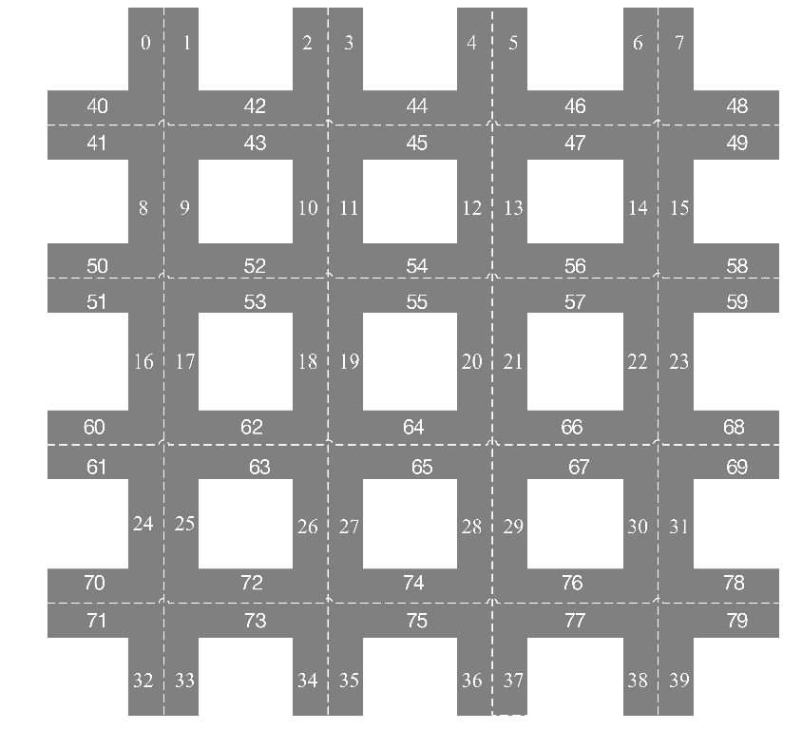
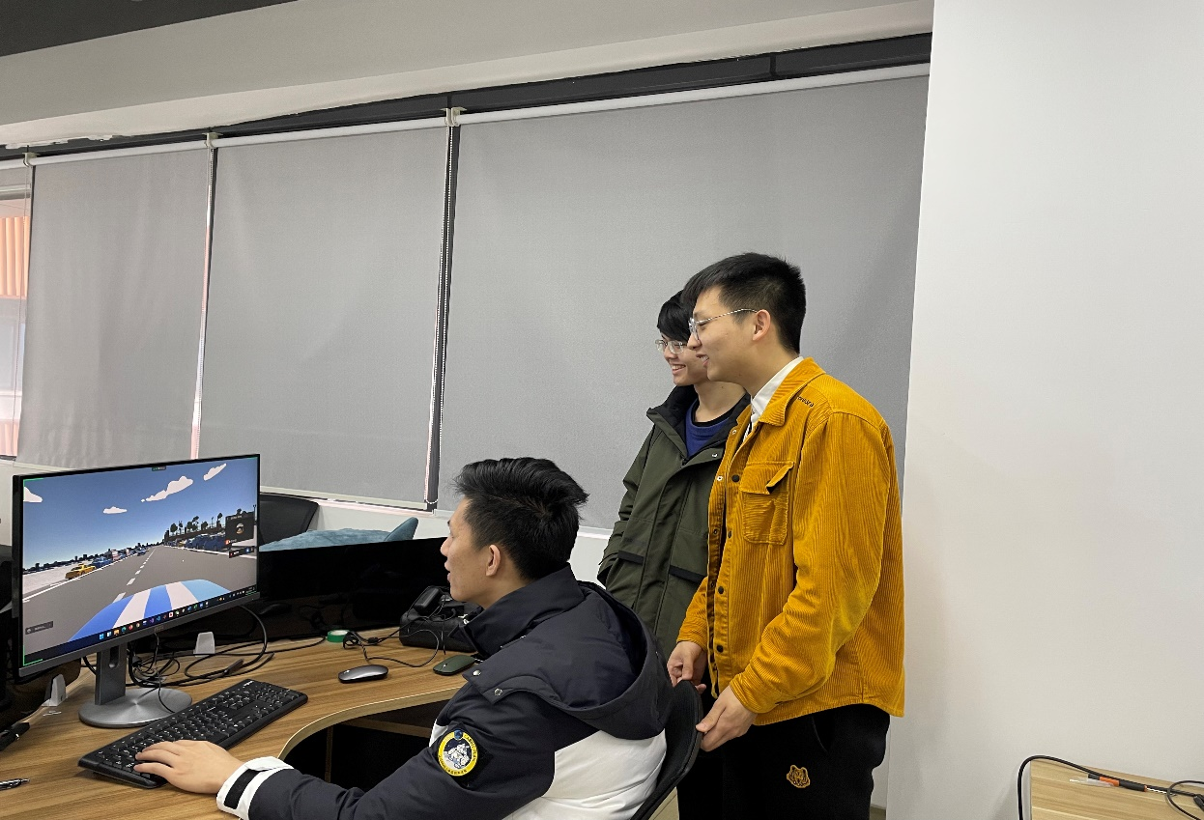
SIMULATION SETUP
4
Road Network Model
Overall view of the road network model
A map of the road network and its section numbers
Developed a high-fidelity parking simulation platform using Unity3D. Conducted 30 hours of experiments with 33 experienced drivers.
Collected 987 valid trajectories.
The network comprises 9 blocks and 80 road sections, with most sections offering on-street parking spaces, except for roads on the periphery

Slide 8
MODELLING
5
Parking search trajectory consists of state-action pairs, termed paces. Each pace represents an action $A_{i}$ from one road section $S_{i}$ to another. The driver's trajectory can be expressed as follows:
$$T=\left(W_{1},⋯,W_{n},f\right). W_{i}=\{S_{start,i},A_{i},S_{end,i}\}$$
T represents the trajectory, W denotes a pace. Each pace is ordered: $S_{start,i}$: current state of pace $W_{i}; A_{i}:$current action; $S_{end,i}$: subsequent state after action $A_{i}$ at $W_{i}$; f: professionalism level of the trajectory
c
To analyze and model parking search behavior, we identify key influencing factors and collect four types of user data
  traffic volume surrounding the driver's current location,
  occupancy information of nearby parking spaces,
  Manhattan distance between the driver's current location and the destination,
  duration of the driver's parking search.
Notes:
The parking search trajectory comprises state-action pairs, referred to as paces. Each pace represents the execution of an action 𝐴_i from one road section 𝑆_i to another section 𝑆_i

Slide 9

5
MODELLING
Use Markov Decision Process (MDP) and DIRL algorithm to model and identify the reward function.
MDP Model Definition
Tuple: < S, A, T, R, $ρ_{0}$, gamma >
  S: Set of states (each road segment is a state)
  A: Set of actions (continue driving or park)
  T: Transition function (probability distribution of next state given current state and action)
  R: Reward function (based on driver preferences)
  gamma: Discount factor
c
MDP Value Definitions
Action:
  Choose to continue driving or park. Parking ends the parking search process.
State:
  Each road segment is an individual state. Features: traffic volume, parking occupancy, Manhattan distance.
Reward Function:
  Assigns rewards based on driver preferences. Popular states receive higher rewards.
Feature Inputs
Global Features: Citywide traffic volume, parking occupancy, and current location.
Local Features: Parking availability and walking distance from the current road segment.

Slide 10
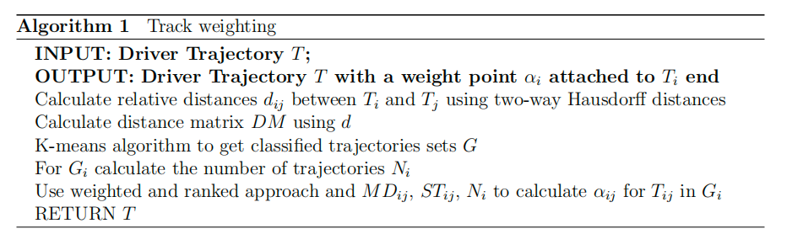
5
MODELLING
Trajectory Pre-processing and Weighting
To better align the parking search model with real-life incentives and mitigate the discrepancies introduced by the virtual experiments, we conducted post-experiment interviews with the drivers.
Based on the insights gained from these interviews, we processed the experimental data accordingly.
Influencing factors:
(1) Manhattan distance from the parking space to the destination (MD),
(2) searching time (ST), and (3) the number of similar trajectories (N).
Notes:
To weigh different trajectories, the following key influencing factors are considered: (1) Manhattan distance from the parking space to the destination (MD), (2) searching time (ST), and (3) the number of similar trajectories (N). The objective is to identify trajectories that exhibit a relatively small Manhattan distance, short searching time, and have a higher number of similar trajectories.
Adjust the data and increase the weight

Slide 11
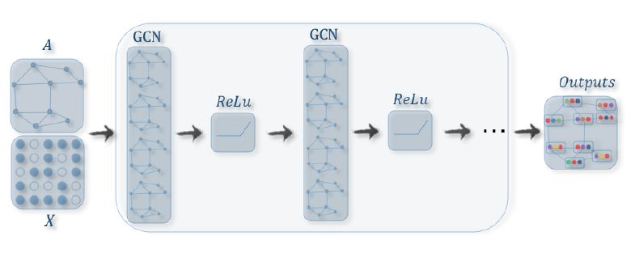
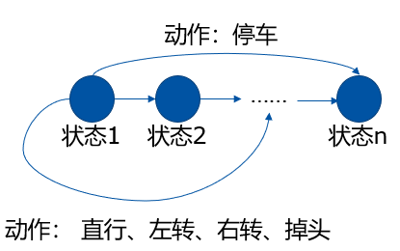
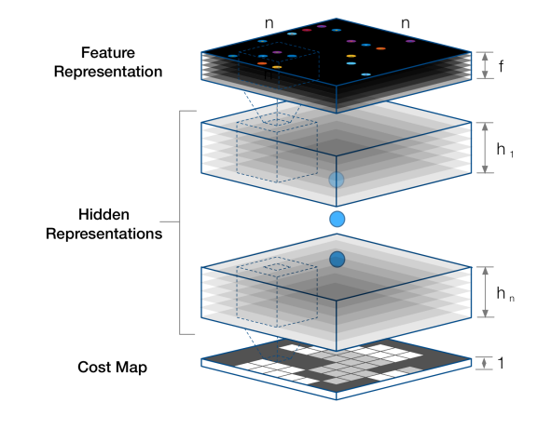
5
MODELLING
Action: Parking
State 1
State 2
State n
Action: Go straight, Turn left, Turn right, Make a U-turn
Deep inverse reinforcement learning
Feature matrix
Trajectory data
Construct urban road network state space
Construct state-feature matrix
Process simulation data
Build expert trajectory set
Divide into training and test sets
Build neural network based on MDP state features
Approximate feedback function
Notes:
Slide 1: Construct urban road network state space / Construct state feature matrix
"First, we start by constructing the state space for the urban road network, which helps us represent the different states of the system. Along with that, we build the state feature matrix, which captures the key characteristics that define each state."
Slide 2: Process simulation data
"Next, we process the simulation data. This data will be essential for training and testing our models, ensuring that the system can learn from real-world scenarios."
Slide 3: Build expert trajectory set
"Then, we gather expert trajectories—these are the paths followed by experienced drivers. This set of trajectories acts as the foundation for our model to learn the right decision-making patterns."
Slide 4: Divide into training and test sets
"Afterward, we split the data into training and test sets. This helps us train the model effectively while ensuring we can evaluate its performance on unseen data."
Slide 5: Build neural network based on MDP state features
"With the data ready, we proceed to build a neural network. This network is designed to process the state features based on a Markov Decision Process (MDP), allowing the model to make decisions in different traffic scenarios."
Slide 6: Approximate feedback function
"Finally, the neural network is used to approximate the feedback function, which helps the system learn the optimal actions to take in each state, ensuring better performance in real-time traffic situations."

Slide 12
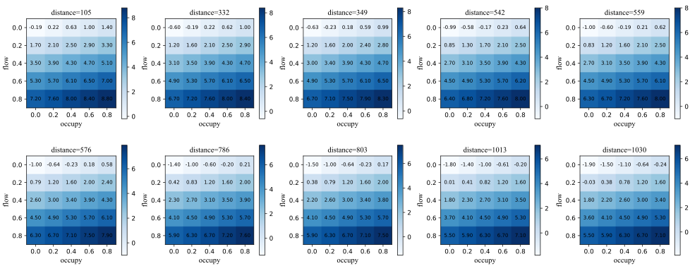
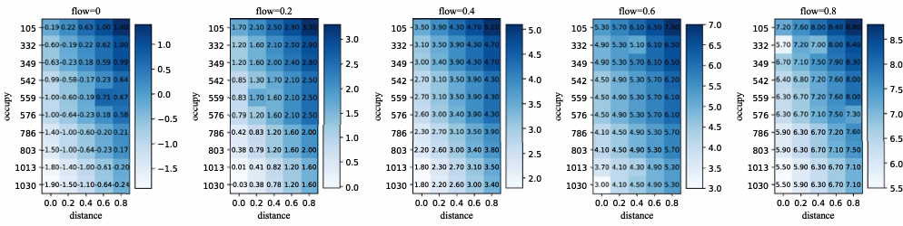
Research results
6
The structure of the feedback function obtained through DIRL
Comparison of model learning performance
 | P_destination | P_path
Maximum entropy IRL | 65.2% | 63.5%
Maximum entropy DIRL | 77.6% | 72.1%
Improvement | 19.0% | 13.5%
(a) feedback function value matrix for fixed walking distance feature with parking occupancy rate and traffic flow volume
(c) feedback function value matrix for fixed parking occupancy rate feature with walking distance and traffic flow rate
(b) feedback function value matrix for fixed traffic flow feature with walking distance and parking occupancy rate
Notes:
Our results show that the new approach can accurately model the entire parking search process. This includes both the search paths and the final parking space selection. By integrating these well-trained parking search models with traditional traffic simulation systems, we can effectively analyze the interactions between parking search behavior and the evolution of the traffic state. Ultimately, this provides a robust tool for developing strategies to alleviate parking issues and improve overall traffic management. Thank you.

Slide 13
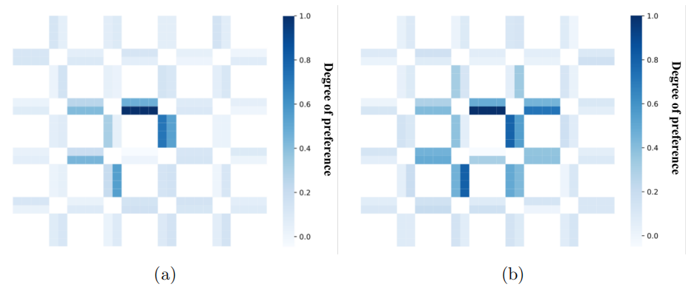
Research results
6
Comparisons in different traffic scenarios
We constructed two distinct traffic scenarios: the stable period and the peak period, distinguished primarily by varying feature values.
(a) the matrix of reward function values during the smooth period
(b) the matrix of reward function values during the peak period
Ranking based on reward | Road No. | Reward value
1 | 55 | 1.0
2 | 20 | 0.6937
3 | 63 | 0.5538
4 | 21 | 0.5074
5 | 27 | 0.4820
Ranking based on reward | Road No. | Reward value
1 | 55 | 1.0
2 | 20 | 0.5880
3 | 63 | 0.5829
4 | 27 | 0.5795
5 | 53 | 0.5769
Figure: The training result for parking search behavior based on maximum entropy DIRL.
Notes:
Fig. 7 presents the experimental results
411 obtained from our study

Slide 14
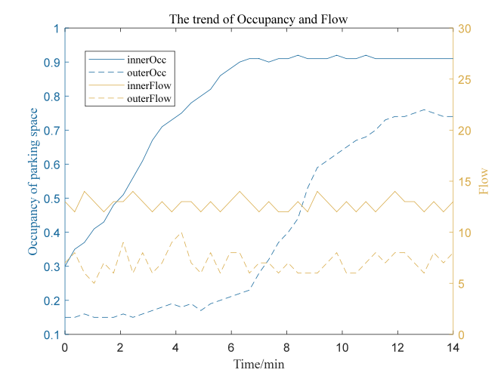
Research results
6
Integrated simulation of parking search and road traffic
Integrated the trained parking search model into the urban road network simulation, treating each vehicle as an independent agent.
Results:
Parking behavior adapts to changes in traffic conditions and parking availability.
Traffic volume remains stable.
Parking occupancy gradually increases.
Key Insight:
Drivers initially prefer parking closer to their destination.
As inner circle parking fills, drivers shift to outer areas.
InnerOccupancy means the occupancy trend of the inner circle
InnerVolume means the volume of the inner circle
OuterOccupancy means the occupancy trend of the outer circle
OuterVolume means the volume of the outer circle
Notes:
Result:
Observed how parking behavior adapts to traffic conditions and parking availability, with traffic volume remaining stable and parking occupancy gradually increasing.
Key Insight:
Drivers initially preferred parking closer to their destination, shifting to outer areas as parking in the inner circle became constrained.

Slide 15
THANK YOU
FOR LISTENING
Notes:
That's all for today's presentation, thank you for listening

