Slide 1
The Local Travel Characteristics and Difficulties of the Elderly in Workers’ Neighborhood
——Case Study in Anshan Xincun Shanghai
Huan Dong, Haixiao Pan*, Zhendong Wang, Kun Li
Speaker: Dong Huan
Tongji University
Urban Mobility Institute

Slide 2

01 Introduction
02 Questionnaire & Sample
03 Method & Result
04 Conclusion & Discussion

Slide 3
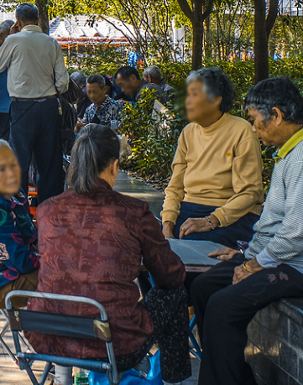
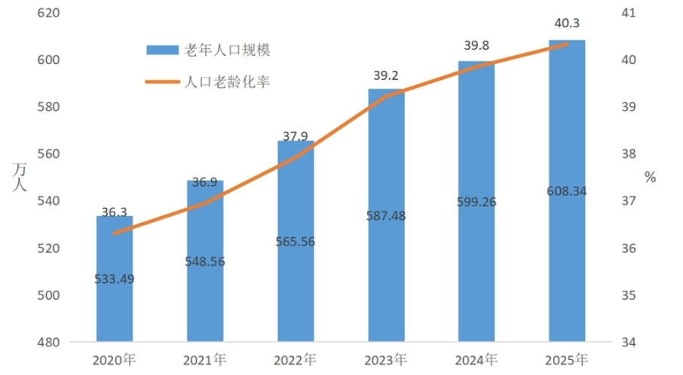
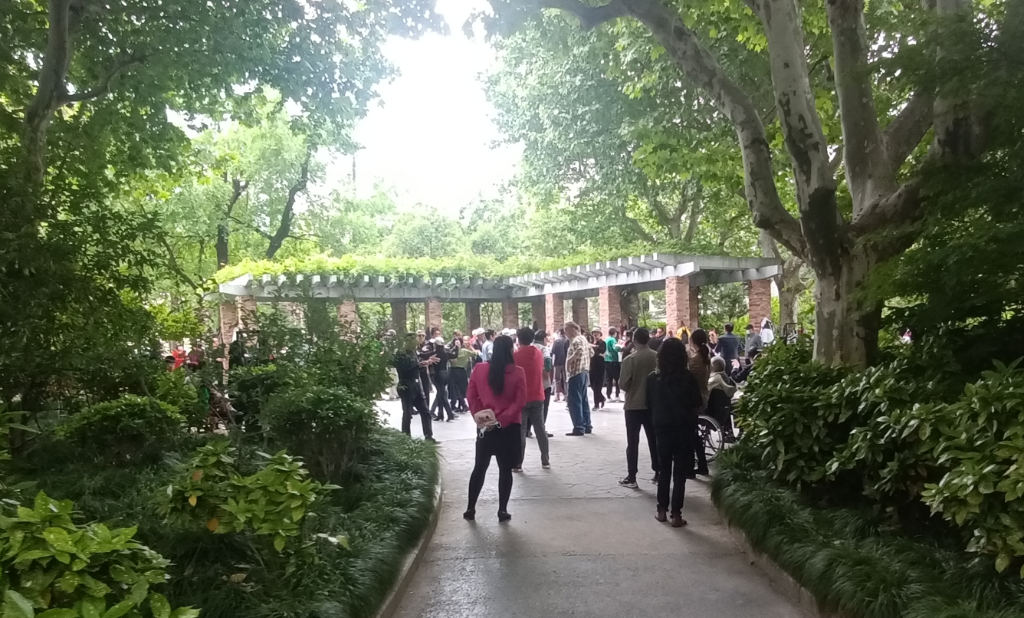
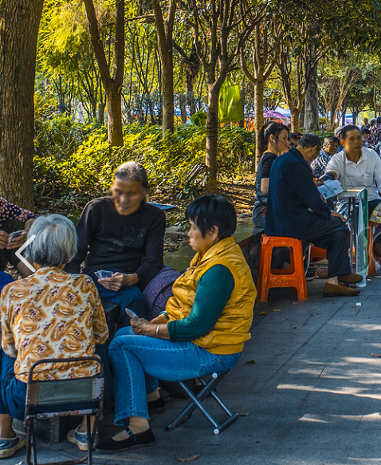
Introduction
Introduction
Topic: Rapid aging
Topic: Mobility of the elderly
The mobility of the elderly declines, with a corresponding reduction in social interaction and quality of life.
However, the elderly still need to go out to ensure that they are able to carry out all kinds of affairs and social interactions in a normal manner.
The increased mobility of the elderly is not only beneficial to their own physical and mental health, but also reduces the burden of their families, which is conducive to social equity.
Population
Topic: The built environment
Unlike in Western countries, the majority of Chinese seniors live in urban centers.
In Shanghai, for example, the city center area shows a high-density and mixed construction pattern, which is related to the social development in the past.
Elderly people live in complex residential areas with mixed functions that allow them to accomplish their affairs in a small area, but there are also some difficulties in traveling.
2020
2021
2022
2023
2024
2025
Year
Shanghai, a major city experiencing population decline, exhibits a particularly pronounced aging demographic.
In 2023, the number of Shanghai residents over 60 years old reached 5,680,500, accounting for 37.4%. The proportion of people over 65 years of age was 28.8% .

Slide 4
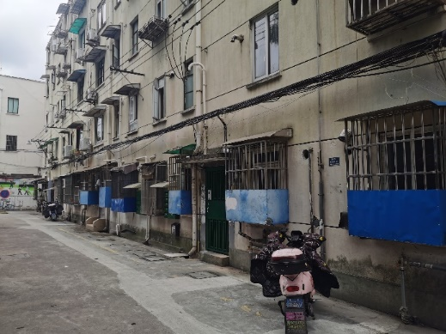
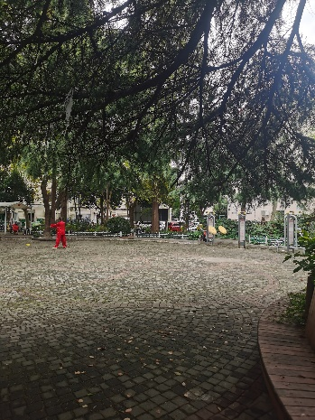
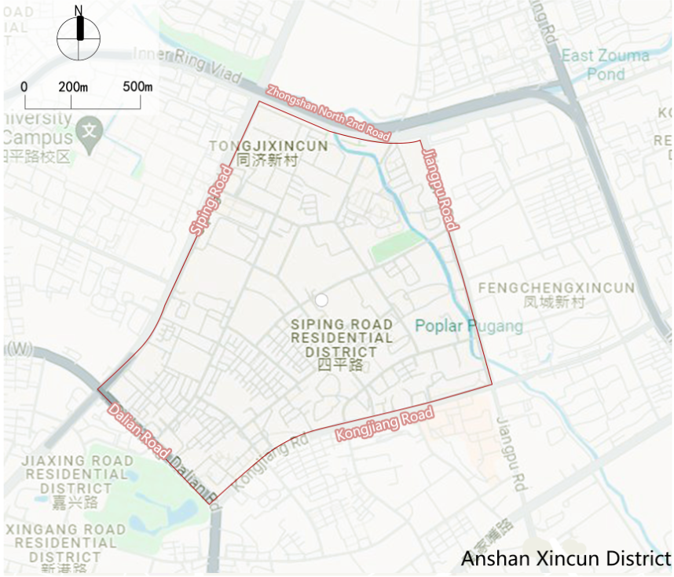
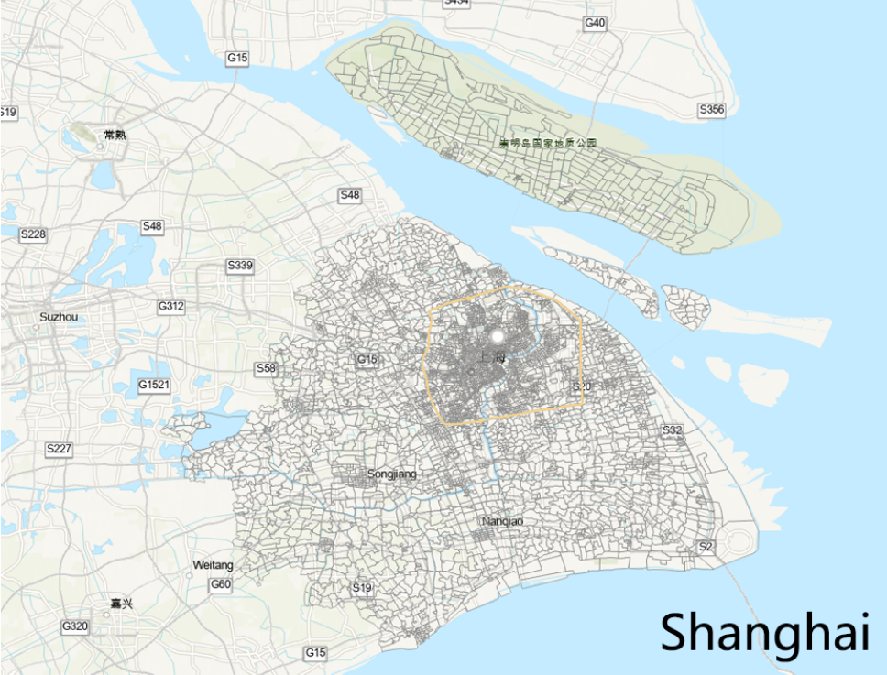
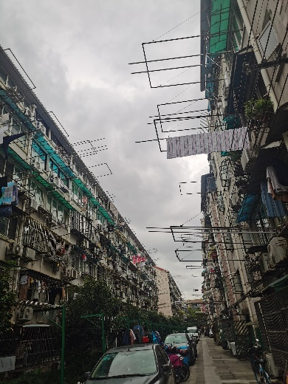
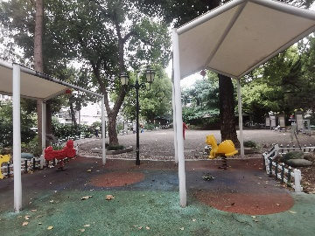
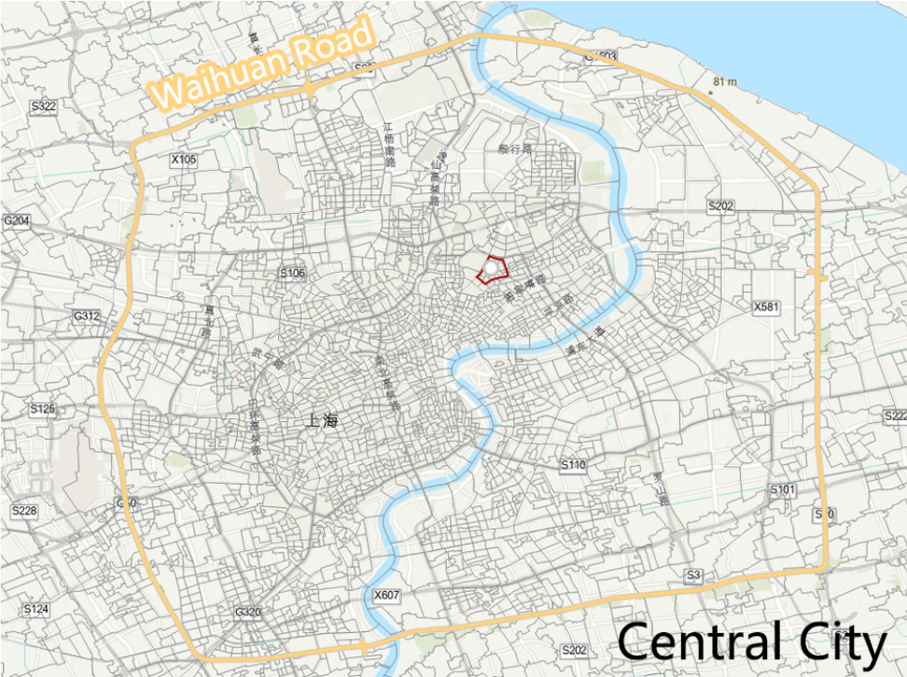
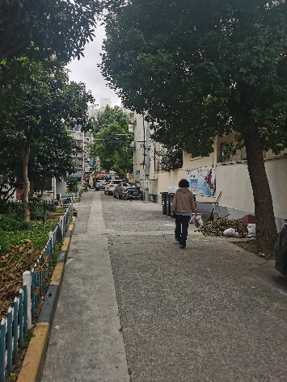
Research Area
Research Area
Workers’ Neighborhood: Anshan Xincun

Slide 5
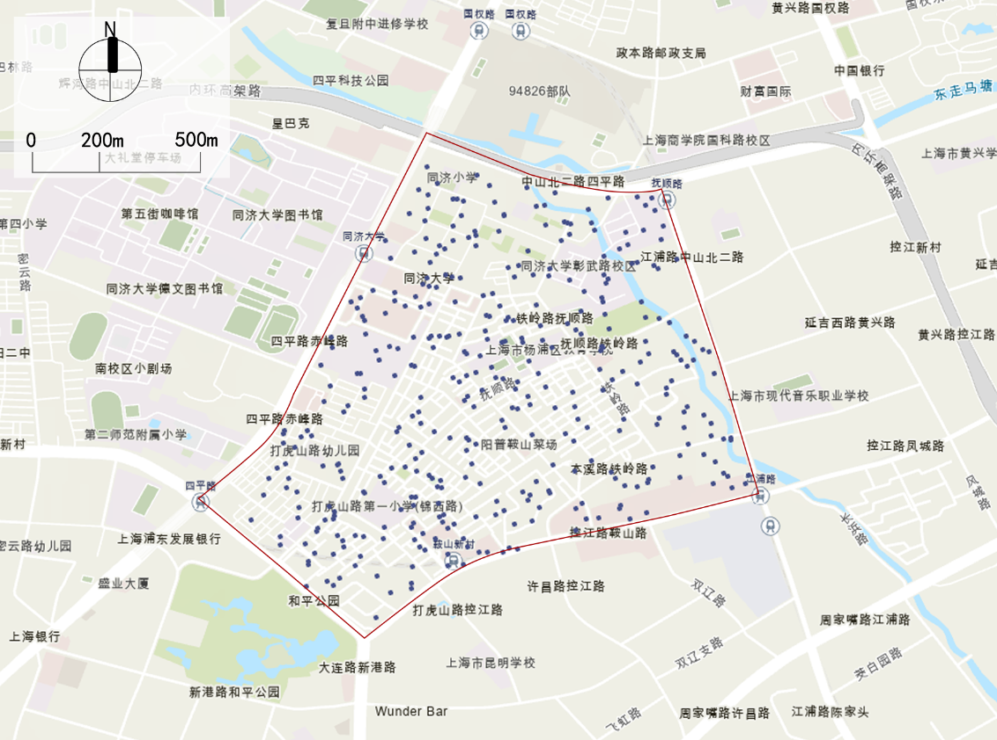
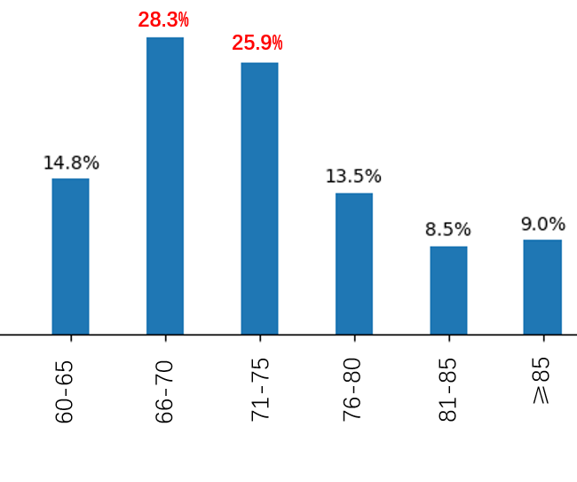
Basic information
Travel characteristics
Travel problems
Questionnaire &Sample
Questionnaire results
Basic information of respondents
Age
Sex

Slide 6
Basic information
Travel characteristics
Travel problems
Questionnaire &Sample
Questionnaire results
Basic information of respondents
Age
Sex

Slide 7
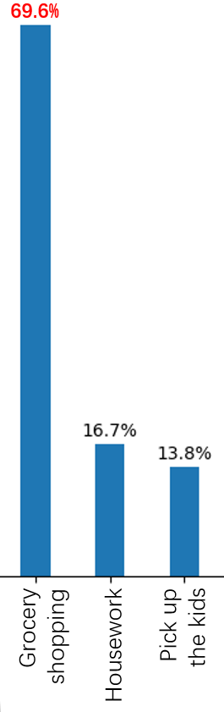
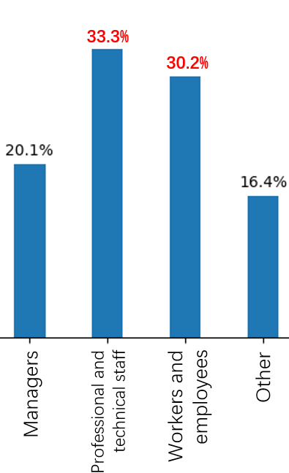
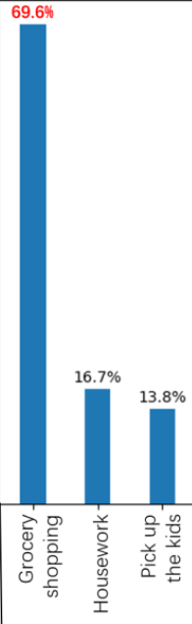
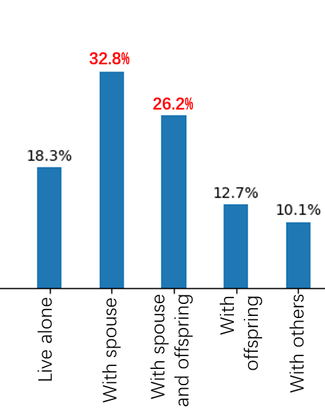
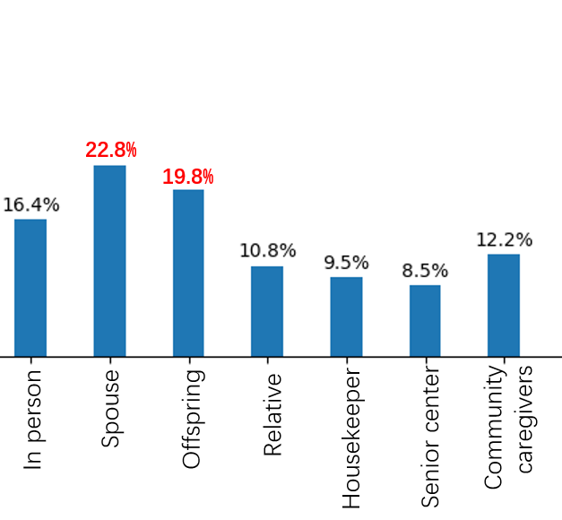
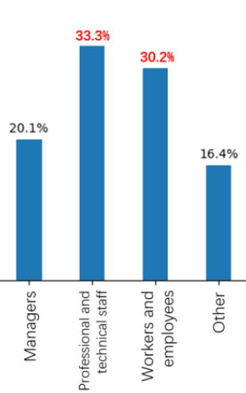
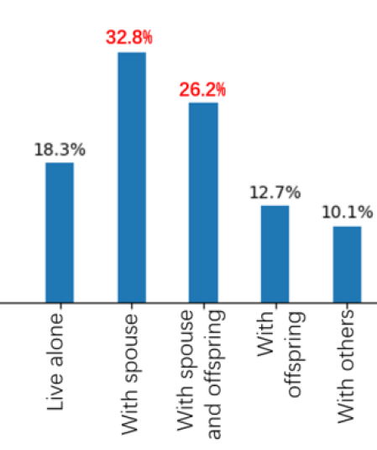
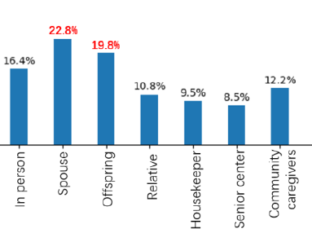
Basic information
Travel characteristics
Travel problems
Questionnaire &Sample
Basic information of respondents
Occupation before retirement
Family composition
Primary responsibility
Head of household

Slide 8
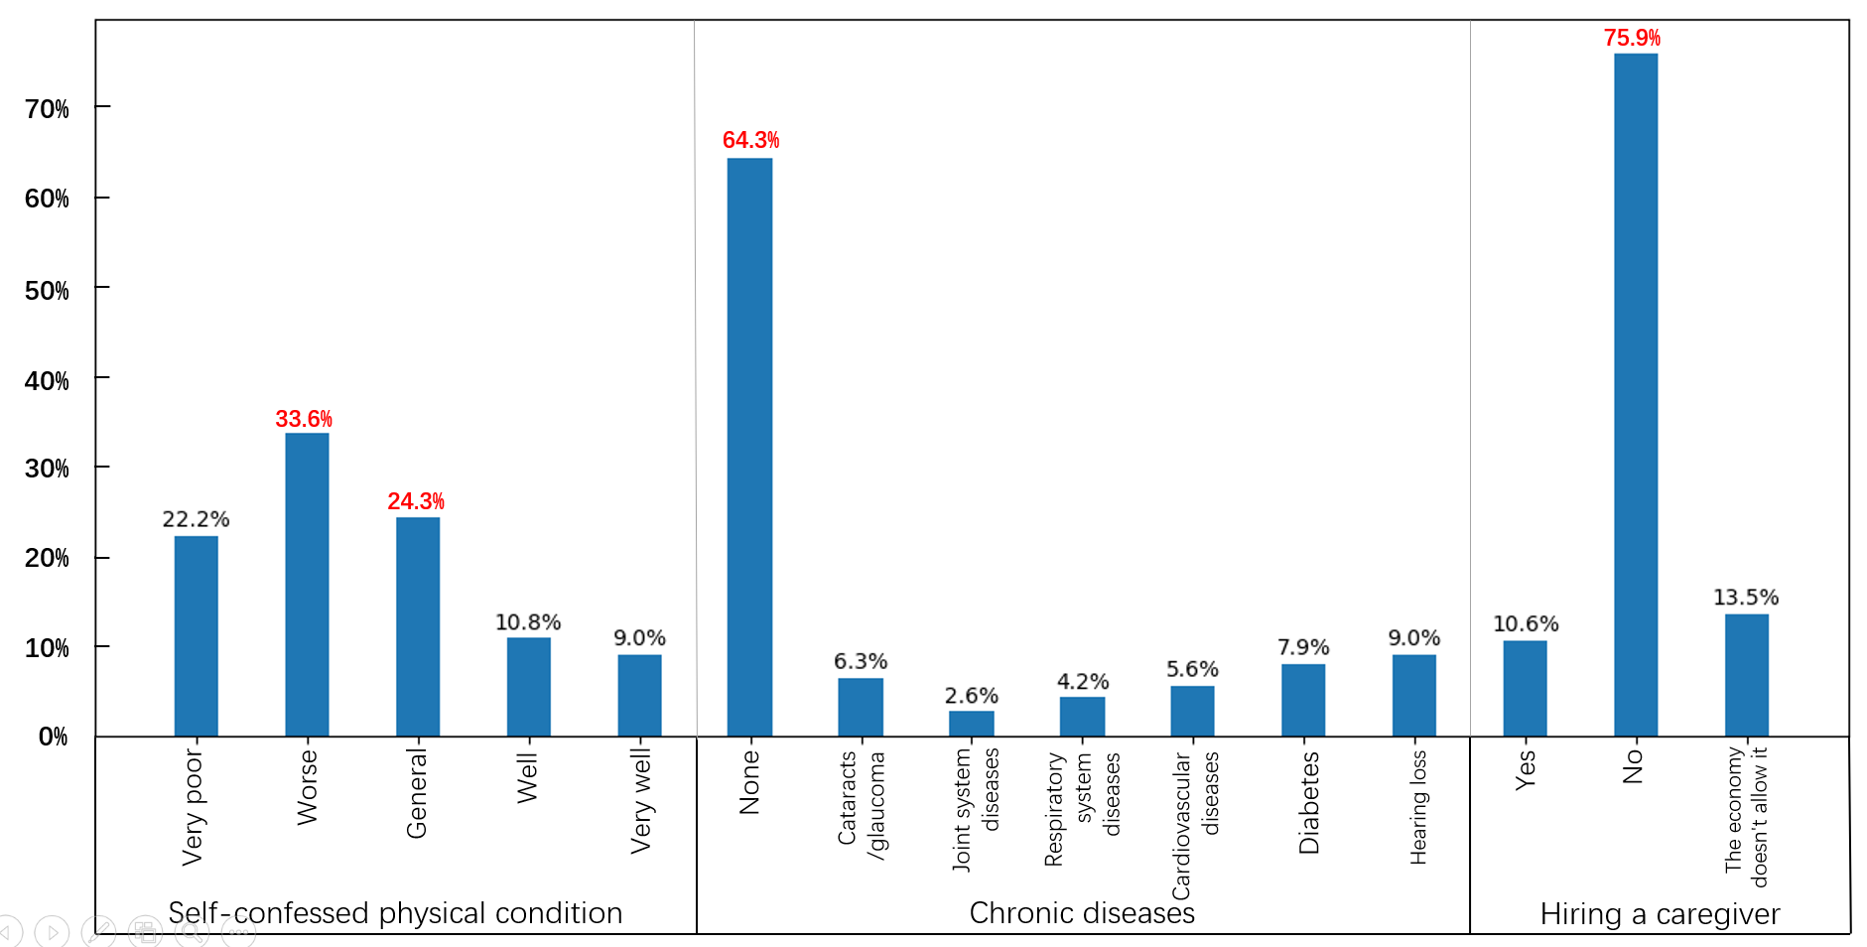
Basic information
Travel characteristics
Travel problems
Questionnaire &Sample
Health status
Travel characteristics

Slide 9
Basic information
Travel characteristics
Travel problems
Questionnaire &Sample
Health status
Travel characteristics

Slide 10
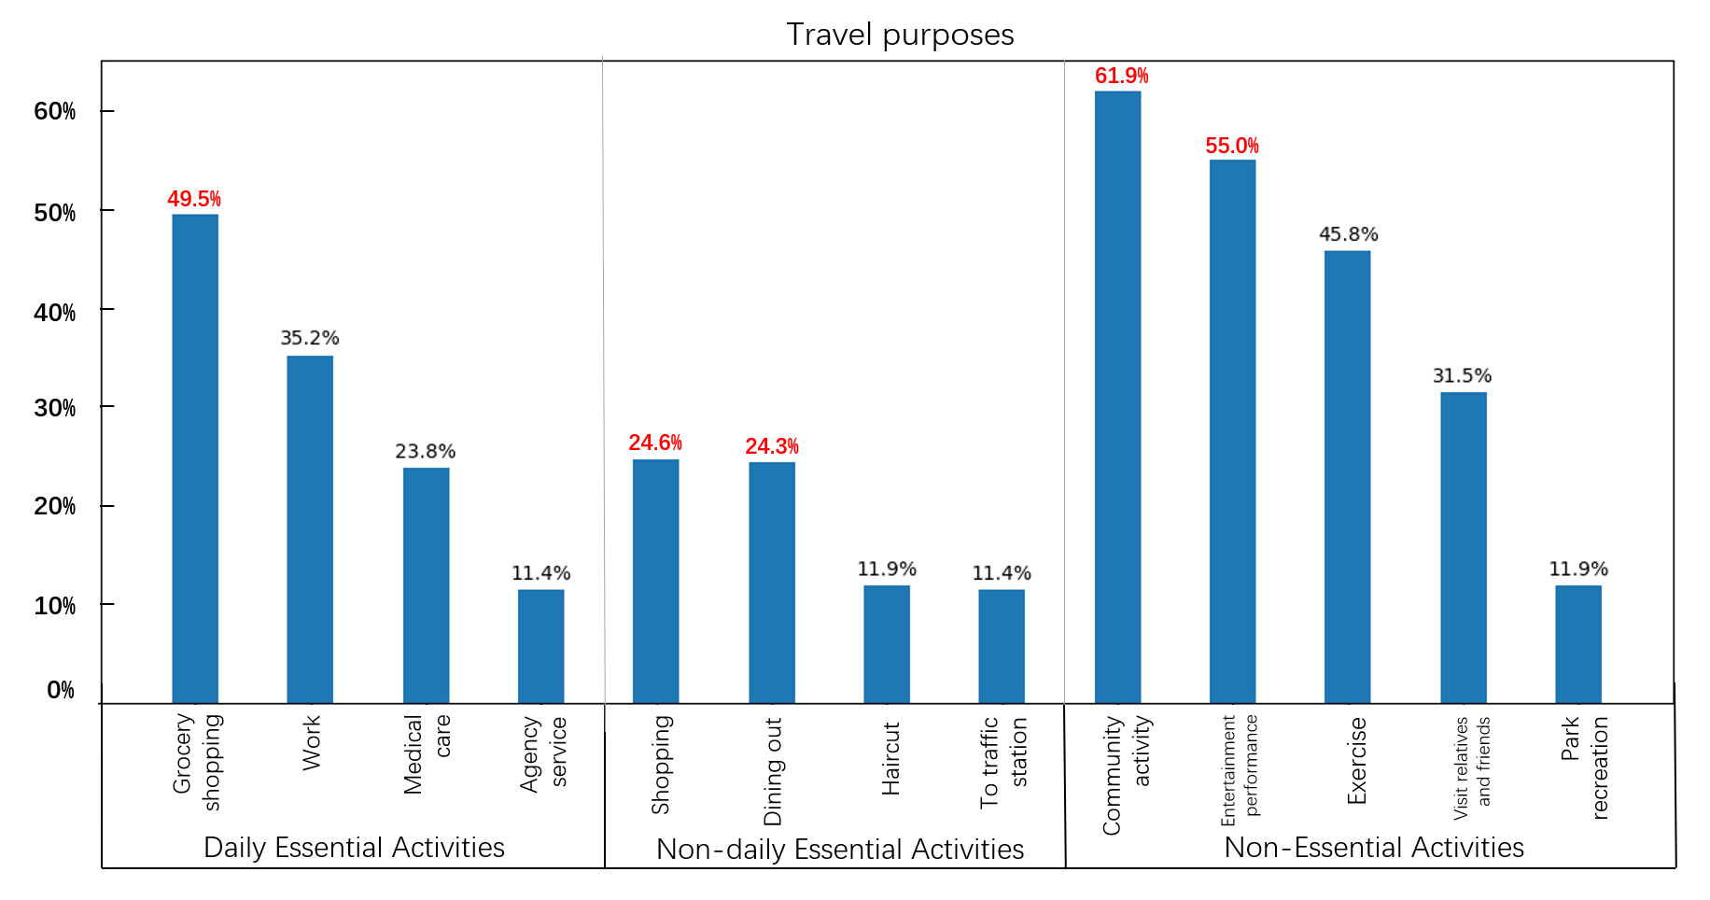
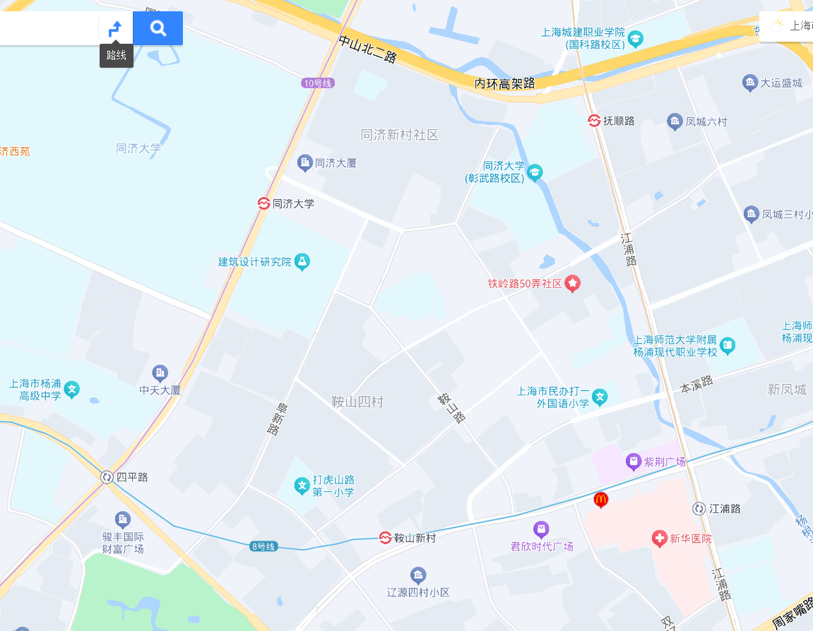
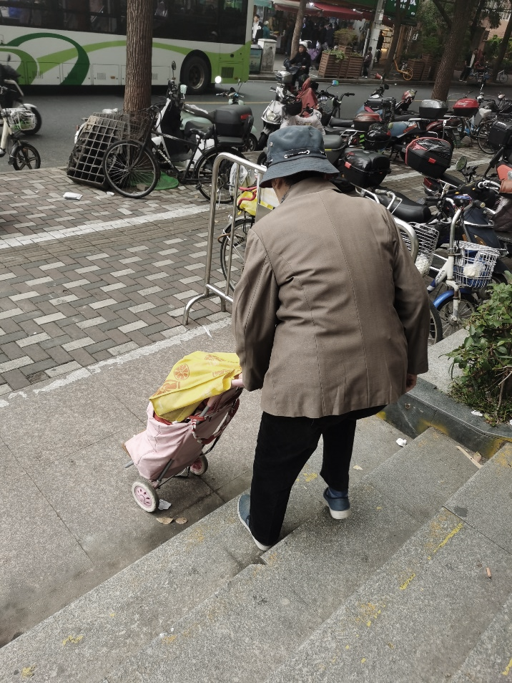
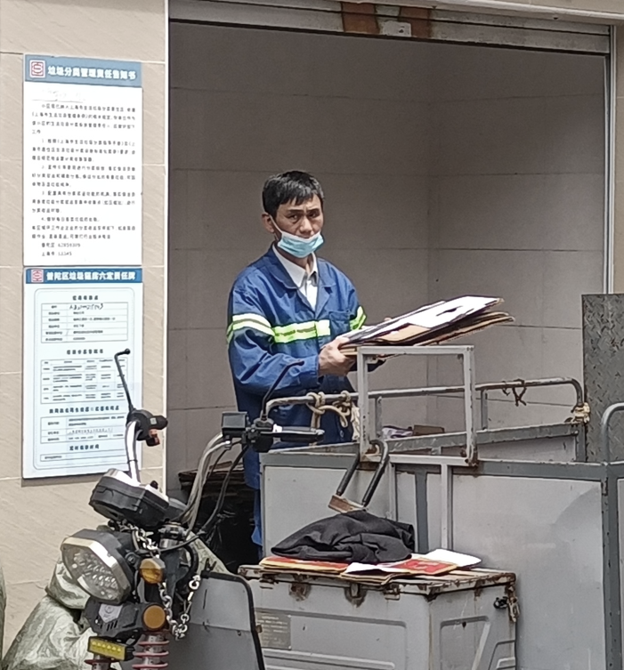
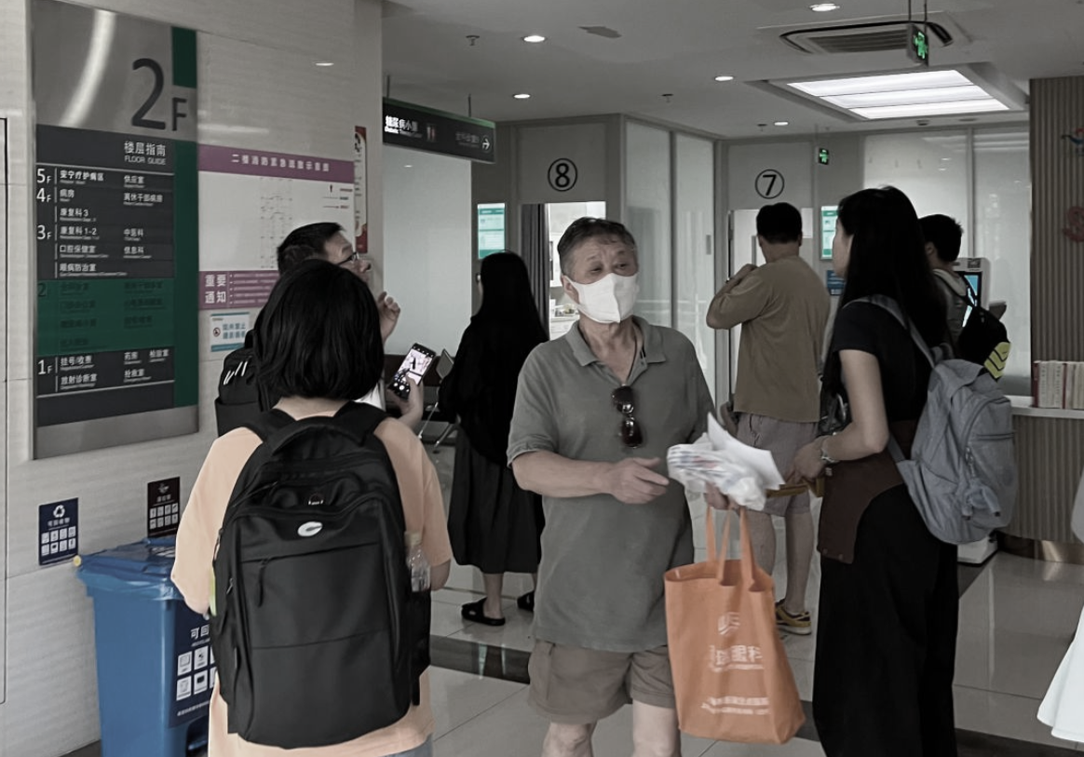
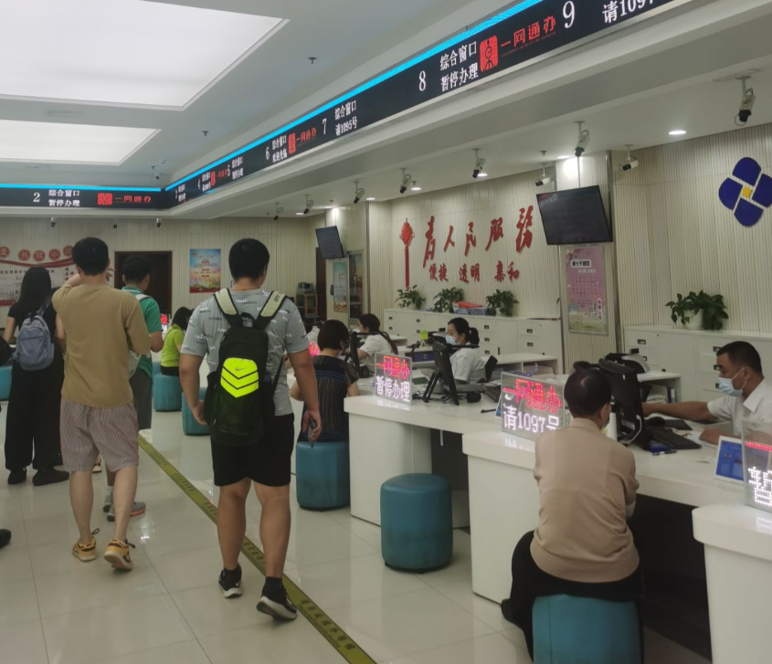
Basic information
Travel characteristics
Travel problems
Questionnaire &Sample
Travel characteristics
Bus station
Barbers
。。。
Community canteens
Shopping mall
Shopping mall
Metro

Slide 11

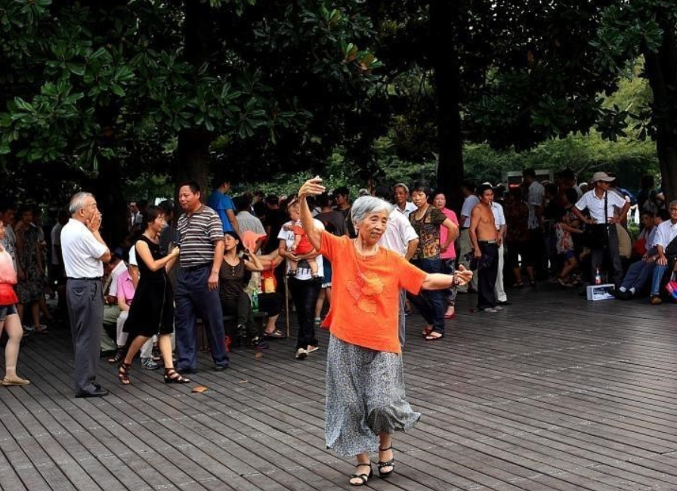
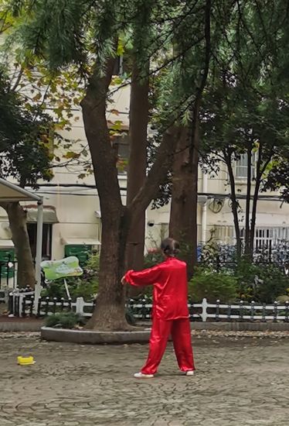
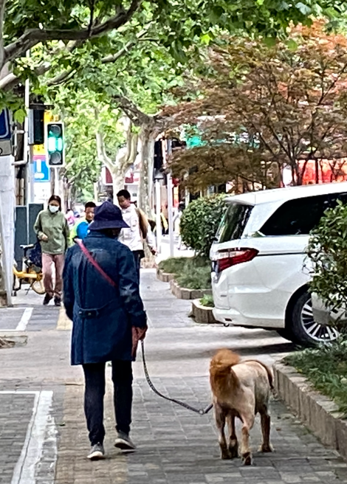
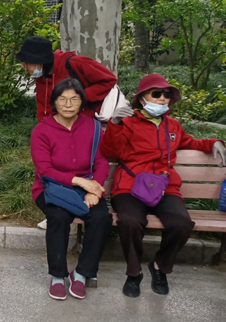
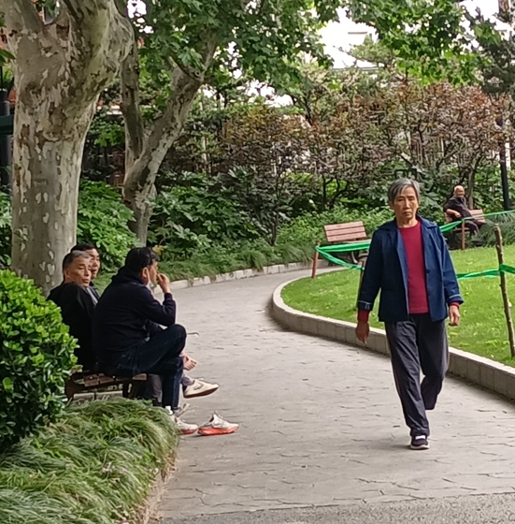
Basic information
Travel characteristics
Travel problems
Questionnaire &Sample
Travel characteristics
62%
55%
32%
12%
46%
Community activity
Performance
Other activities
Exercise
Social
Park activity

Slide 12
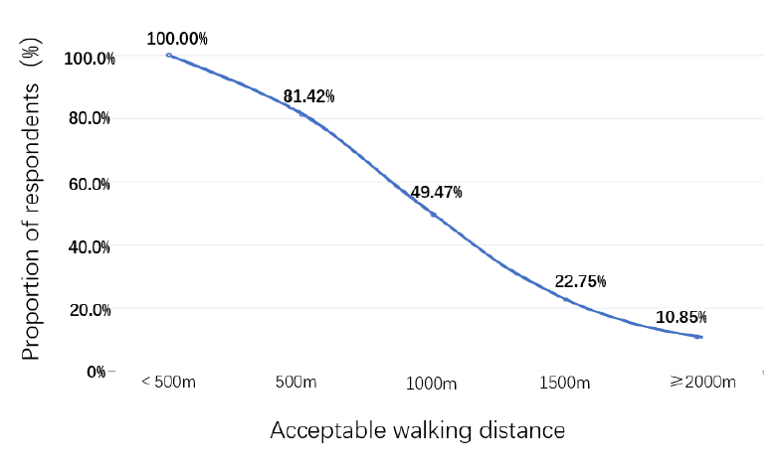
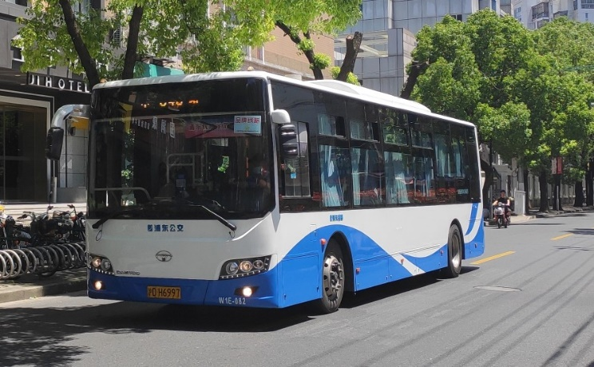
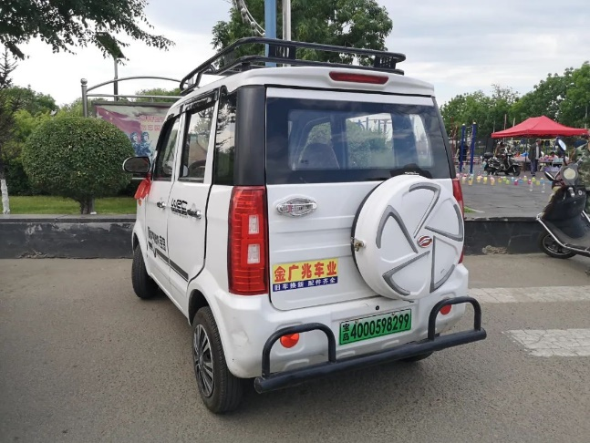
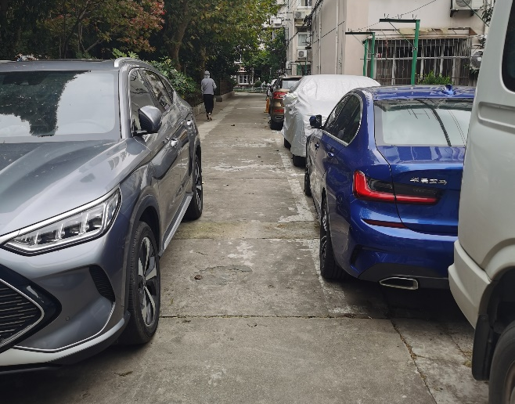
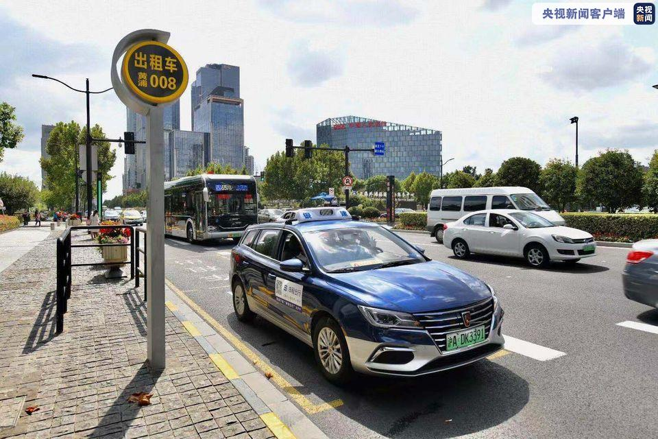
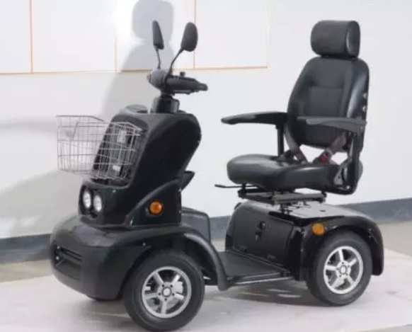
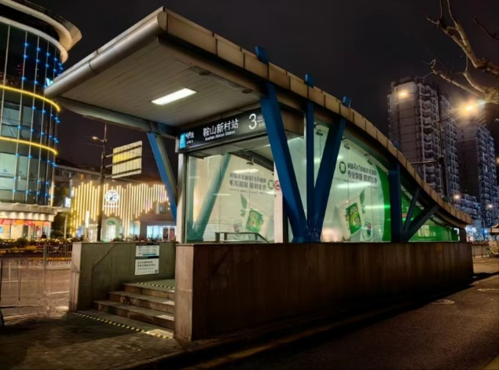

Basic information
Travel characteristics
Travel problems
Questionnaire &Sample
Travel characteristics
Electric bicycle & Scooter (for the elderly)
Taxi
Bus & Metro
Private car
Short-distance travel
Long-distance travel

Slide 13
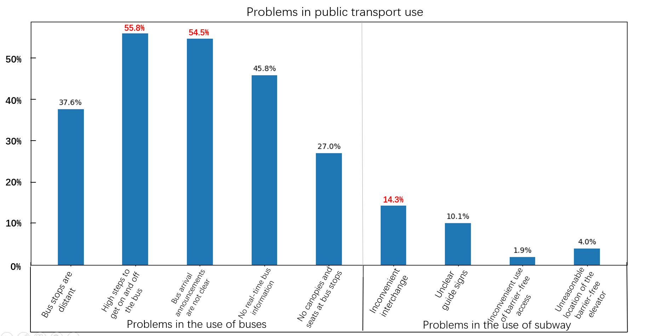
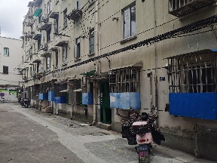
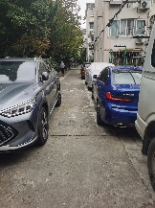
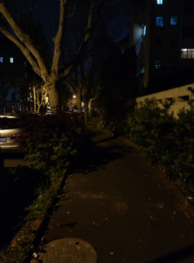
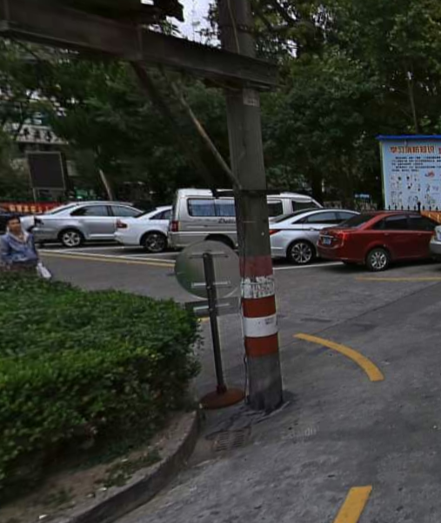
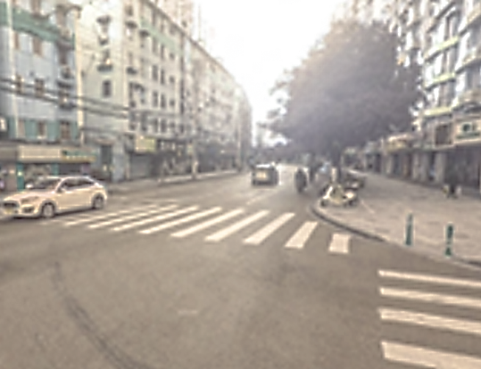
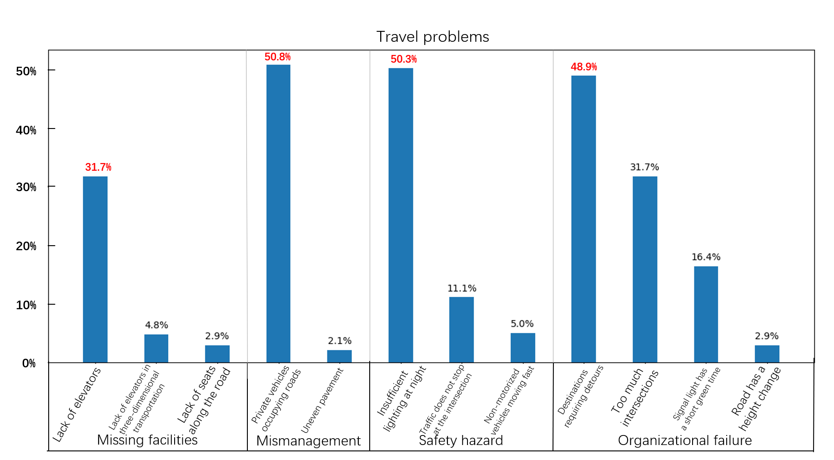
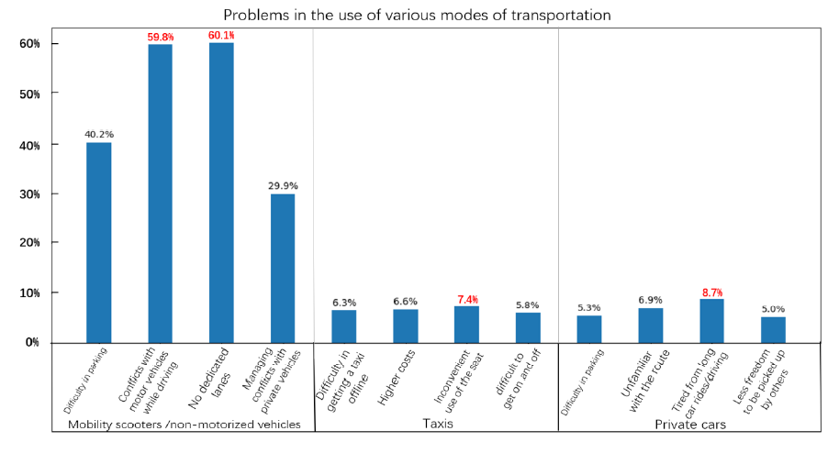
Basic information
Travel characteristics
Travel problems
Questionnaire &Sample
Travel problems
Missing facilities
Mismanagement
Safety hazard
Organizational failure

Slide 14
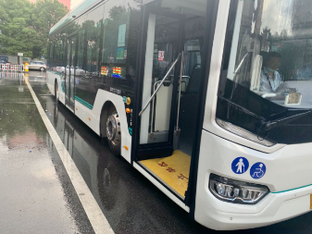





Basic information
Travel characteristics
Travel problems
Questionnaire &Sample
Travel problems
Problems in the use of buses
Problems in the use of metro

Slide 15





Basic information
Travel characteristics
Travel problems
Questionnaire &Sample
Travel problems
Scooters /non-motorized vehicles
Taxis
Private cars

Slide 16






Method
Method
Model-GBDT
This study employs the Gradient Boosting Decision Trees (GBDT) model.
GBDT is a machine learning technique, enhances model prediction accuracy by combining multiple weak learners into a single strong learner.
It approximates the true value by minimizing the loss function through gradient descent.
Compared to ordinary linear regression methods, the method offers higher accuracy and can handle various types of explanatory variables simultaneously.
Furthermore, the GBDT model is robust to multicollinearity among independent variables.

Slide 17
Method
Method
Variables
Class | Variables
Socio-economic Attributes | Age
 | Sex
 | Monthly household income
 | Educational attainment
 | Head of household
 | Occupation before retirement
 | Living alone (or not)
 | Still working (or not)
Travel Characteristics | Acceptable walking distance
 | Number of trips per day
 | Number of trips per week for daily essential activities (DEA)
 | Number of trips per week for non-daily essential activities (NDEA)
 | Types of leisure activities
Long-distance Travel Modes and Frequency | Transportation modes for long-distance travel
 | Frequency of bus and subway use
 | Frequency of mobility scooter use
 | Frequency of use of taxis
 | Frequency of use of private cars
Short-distance Travel Problems | Number of travel problems
 | Number of problems of missing facilities
 | Number of problems of management
 | Number of problems of safety
 | Number of problems of organization
Physical Health Status | Self-reported physical condition
 | Independent travel (or not)
 | Number of chronic diseases
 | Hiring a caregiver (or not)
Built Environment | Demographic | Population of the seven generalizations in the neighborhood committee
 | Building density
 | Floor area ratio
 | Road density | Density of road network within 300m of the survey unit (km/km² )
 | Number of POIs | The sum of POIs within 800m of the neighborhood
 | POI diversity index | POI Shannon Diversity Index for the neighborhood
 | Number of intersections | Number of intersections within 800m of residence
 | Distance to nearest bus stop | Distance from residence to nearest bus stop (m)
Long-distance Travel Problems | Number of mobility scooter travel problems
 | Number of bus travel problems
 | Number of subway travel problems
 | Number of taxi travel problems
 | Number of private car travel problems

Slide 18


Result
Result
Key variables of travel times
15.18%
Number of intersections
8.35%
Self-reported physical condition
6.22%
Educational attainment
5.81%
Acceptable walking distance
5% of importance

Slide 19





Result
Result
Key variables of travel times (of daily essential activities)
49.55%
15.59%
7.81%
7.59%
5% of importance
Use of public transportation
Frequency of bus and metro use
Use of scooters
Frequency of scooter use

Slide 20





Result
Result
Key variables of travel times (of non-daily essential activities)
37.44%
Age
7.43%
Demographic
6.29%
Income
6.08%
Number of intersections
5.93%
Use of private cars
5.70%
Educational attainment
5% of importance

Slide 21


Result
Result
Key variables of acceptable walking distance
10.78%
Number of POIs
10.04%
Number of intersections
8.48%
POI diversity index
7.44%
Frequency of use of private cars
6.32%
Number of bus travel problems
5% of importance

Slide 22
Result
Result
Key variables of travel mode & travel problems
01
The number of travel problems is strongly correlated with the built environment, travel preferences and the age of the respondent.
Increased road density reduces the number of travel problems; a dense road network reduces unnecessary crossing or detouring, significantly reduces travel time consumed, and reduces walking risk.
Increased POI diversity led to an increase in the number of travel problems, possibly because the increased of facilities makes the built environment more complex, thus creating more safety hazards
It may not make common sense that the more times go out each day, the fewer travel problems encounter. But put it another way, is it possible that people are less inclined to go out when they encounter more problems?
The number of travel problems cited by respondents older than 83 is significantly higher.
What Influences Transportation Choices ?
As the number of trips for essential activities increases, the elderly people are more likely to choose public transportation.
This is contrary to the findings of many studies, but similar to the findings of some studies in China, suggesting that transportation mode usage habits are more likely to be related to social context.
An overall increase in the number of trips for non-daily essential activities stimulates elderly' choice of public transportation, but inhibits the willingness to choose taxis and scooters.
Respondents' willingness to choose private car to travel is highest when the number of trips for non-daily essential activities reaches about 15 per week.
02
What affects the number of travel problems ?

Slide 23

Conclusion & Discussion
Conclusion
Conclusion
The travel behavior of the elderly is characterized by frequent, short-distance trips. Even the elderly who require assistance do not exhibit a reduced frequency of travel.
The frequency of daily trips among the elderly is influenced by the built environment of their community and their personal characteristics. For DEA, travel preferences have the most significant impact, whereas NDEA are influenced by a broader range of variables.
As the frequency of DEA trips increases, there is a greater inclination to choose public transportation.
1
1
2
2
The acceptable walking distance for the elderly is more significantly influenced by the built environment and travel preference.
3
However, age can markedly affect the number of travel problems experienced by the elderly.
Travel problems faced by the elderly are not only related to the availability of facilities but also to the quality of related services and the effectiveness of information dissemination.

Slide 24


Conclusion & Discussion
Discussion
Suggestion
Future study
In the context of an aging population, providing a safer, more comfortable, and convenient travel environment for the elderly is crucial for promoting inclusive urban development.
Developing communities that facilitate elderly mobility can significantly improve their quality of life, encourage daily travel, and enhance social equity.
We have done some exploratory analysis of the data collected to get a general idea of the travel preferences of the elderly in this type of older neighborhood and their concerns about travel difficulties.
The next steps we will take are:
Adding more empirical analysis to the exploratory analysis above
From an urban planning perspective, creating life circles should include elderly-friendly modifications. Some of the strategies that can be used for older neighborhoods like the case are:
Adding elevators to residential buildings
Checking the nighttime lighting in the neighborhood
Optimizing existing spontaneous gathering places for the elderly into recreational public spaces
……
From the perspective of urban transportation, the elderly population(in China) remains heavily reliant on public transportation. Some of the strategies that can be used are:
Adoption of larger font sizes and more visible announcements of vehicle information at bus stops
Improved bus accessories to make boarding and alighting easier for the elderly
……
Optimize existing models and variables
Increase the sample of the survey and use the real movement trajectories of the elderly people

Slide 25

2024.11.07

