Slide 1



Engineering-adaptive Pavement Maintenance Decision-making Model: a Reinforcement Learning Approach from Expert Feedback
同济大学交通学院
COLLEGE OF TRANSPORTATION
TONGJI UNIVERSITY
Author: Wenyuan Cai
Advisor: Pro. Yuchuan Du
Tongji university

Slide 2
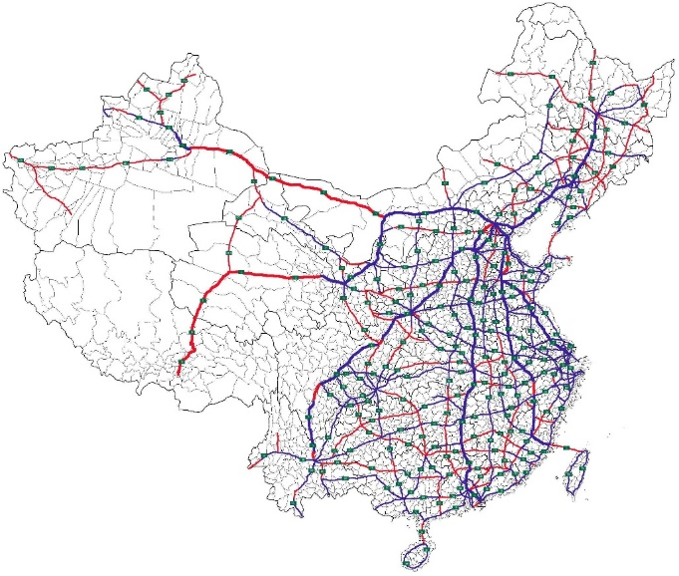
Background
Highway network is developing rapidly in China
Road maintenance requires a huge amount of investment every year
Investment in road industry
In 2022, China's road operation and maintenance fund will reach 95.5 billion yuan, and the proportion of road operation and maintenance will reach 99.4%
The amount of highway
The amount of road
Million-kilometer road network maintenance
>160,000KM
5,198,000KM
The top 1 of the world
The top 2 of the world
Notes:
Firstly, let’s see why we need to study this problem about deciding when and how to repair the road. Highway network is developing rapidly in China, and the amount of road is more than 5 million kilometers, which is the top of the world . As the service time of infrastructure increases and the existing road network continues to expand, the demand and pressure for pavement maintenance have been increasing rapidly. Consequently, pavement maintenance expenditures have been rising, putting significant economic pressure on transportation authorities. In 2022, the fund on road operation and maintenance reached almost 100 billion yuan.

Slide 3
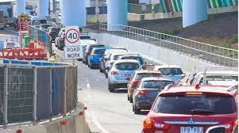
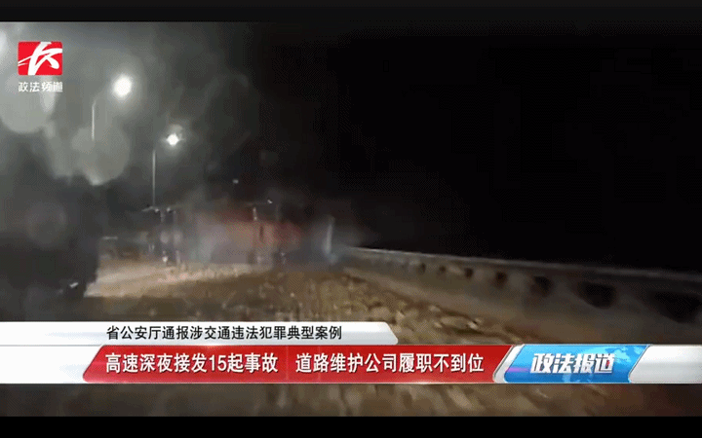
Background
The maintenance of massive road infrastructure faces great challenges
Rough and non-targeted road infrastructure maintenance strategies are palliative, and it is difficult to play a huge maintenance fund benefit.
Aged roads
Huge investment,
limited effects.
Minimum guaranteed
maintenance strategy
Expressway in Shanghai
The annual maintenance cost reached 1.2 billion yuan, but there were still 18,000 traffic accidents
In 2015, Yan 'an East Road Tunnel was closed for 10 months
Max Service year : 30
Average service year：25
Highway in Shanghai
Max Service year : 35
Average service year: 22
The overhaul affected 11 million vehicles in 286 days
Scientific maintenance strategy is the guarantee of safety and effectiveness
Notes:
Because of such huge amount of existing road infrastructure and fund requirement, the maintenance of massive road infrastructure faces great challenges. Rough and non-targeted road infrastructure maintenance strategies used in current engineering are palliative, and it is difficult to play a huge maintenance fund benefit. Most roads are aged, for example, Max Service years of expressways and highways in shanghai are more than 30 years and they are in a fast deteriorated condition. Though the government spent a huge amount of money, that the annual maintenance cost reached 1.2 billion yuan, there were still 18,000 traffic accidents. It is because the current maintenance strategy is minimum guaranteed instead of optimal. Therefore, we need to make scientific strategy to guarantee the safety and effectiveness of maintenance.

Slide 4
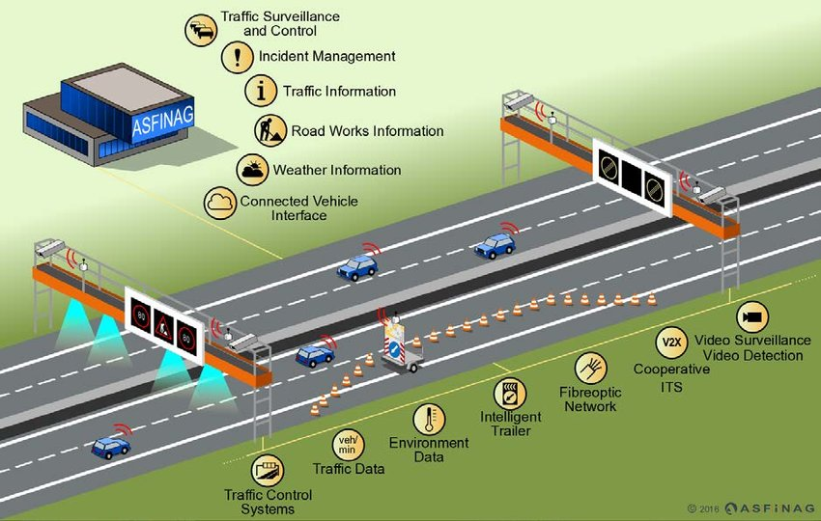
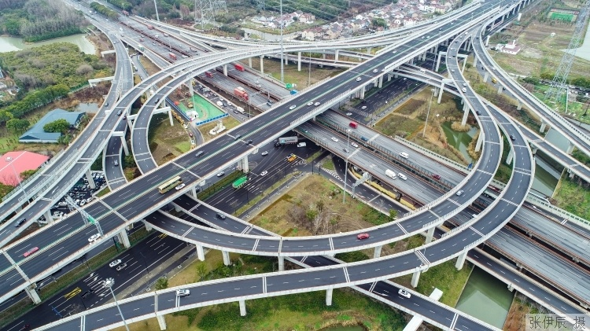
Problem
「 Difficulties」
Complex scenarios: Road operation and maintenance involve numerous elements and encompass a wide range of scenarios.
Numerous elements
Various scenarios
「Key problem」:How to predict infrastructure serviceability performance and make decisions in complex scenarios and under fuzzy conditions
Notes:
To address this issue, it is essential to establish a maintenance strategy model to optimize the cost-benefit objectives. Generating cost-effective maintenance strategies faces the following challenges due to the need for comprehensive road environment consideration and susceptibility to local economic, policy, and geographical influences. The first one is complex scenarios. Road operation and maintenance involve numerous elements and encompass a wide range of scenarios. The core subject of concern, road performance, is influenced by multiple factors such as environment, traffic dynamics, and incidents, making the decision making process highly complex and a social endeavor. Additionally, an accurate prediction model for pavement performance is crucial for making scientifically informed decisions, but such models are affected by multiple coupling factors.

Slide 5
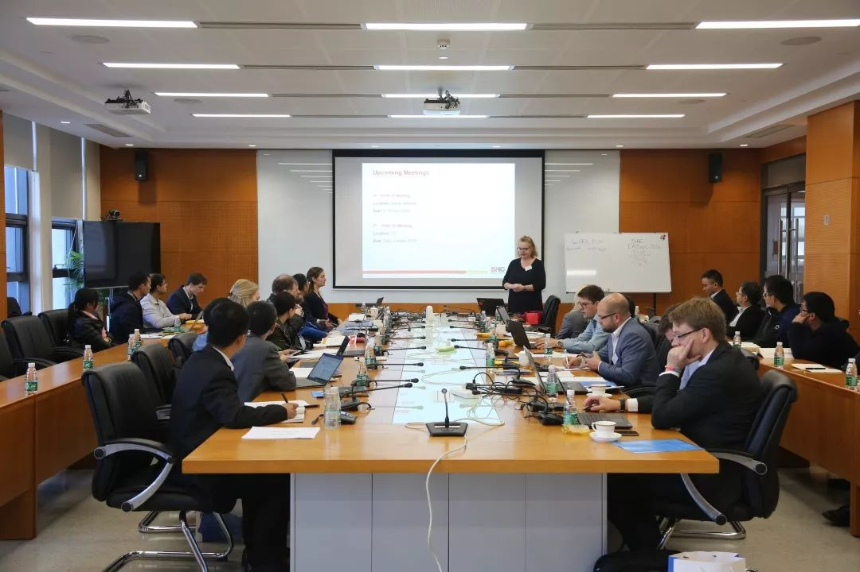


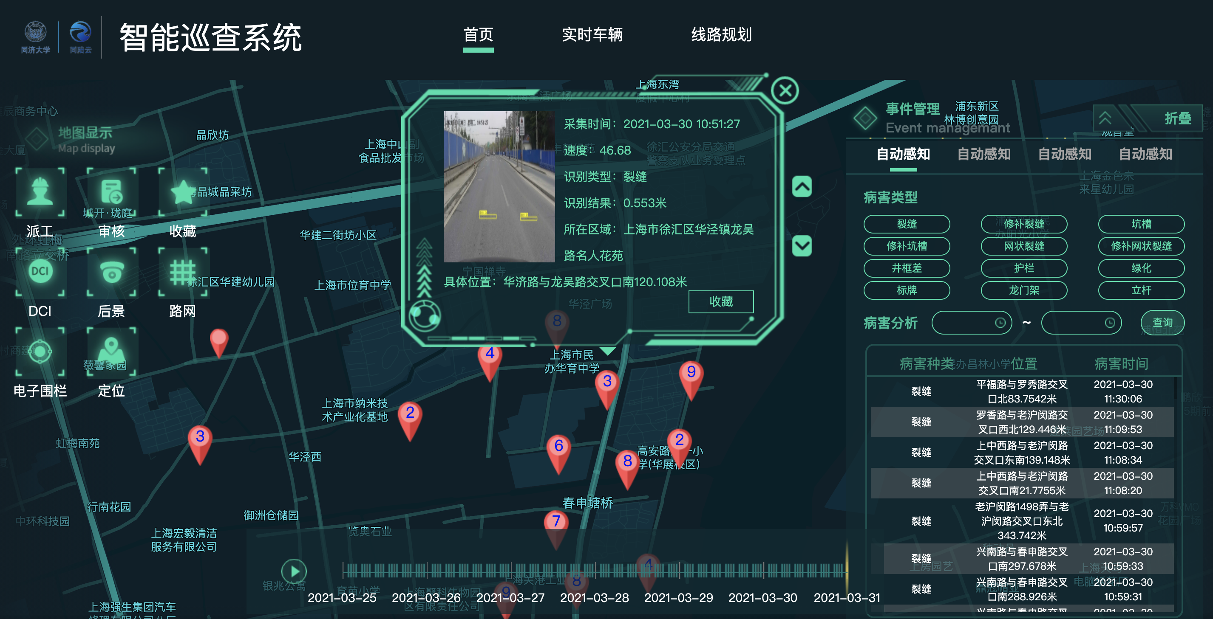
Problem
「 Difficulties」
Fuzzy conditions: Maintenance decision rules are sometimes vague and exhibit local characteristics.
Subjectivity
Experts of different levels
Fuzzy rules
Process high-dimension data
「Key problem」:How to predict infrastructure serviceability performance and make decisions under complex scenarios and fuzzy conditions
Notes:
Another difficulty is fuzzy conditions. Maintenance decision rules are sometimes vague and exhibit local characteristics. For example, within the same road segment, there may be distresses of varying severity, leading to different strategies in different regions. Some regions may only address distresses with a severity higher than a threshold, while others may adopt an intensive approach to repair all nearby damages.
Thus, the key problem is How to predict infrastructure serviceability performance and make decisions in complex scenarios and under fuzzy conditions

Slide 6
Leap Forward
Self-adaptiveness
Interpretability
Artificial
Intelligence
Implementation
Quasi-human Intelligence
Generalization
Human Intelligence
Self-growth
Pertinency
Explore a method that combines expert experience and digital technology
6
Notes:
That's where artificial intelligence comes in. The field of road maintenance is also exploring the method model of using artificial intelligence to replace human operation. However, complete artificial intelligence is not achieved in one move and a great leap forward, and the existing data model is difficult to all model many fuzzy factors that can be considered by human operation. Therefore, we explore a decision-making method that combines expert experience and digital technology to absorb the advantages of both to achieve human-like decision-making.

Slide 7
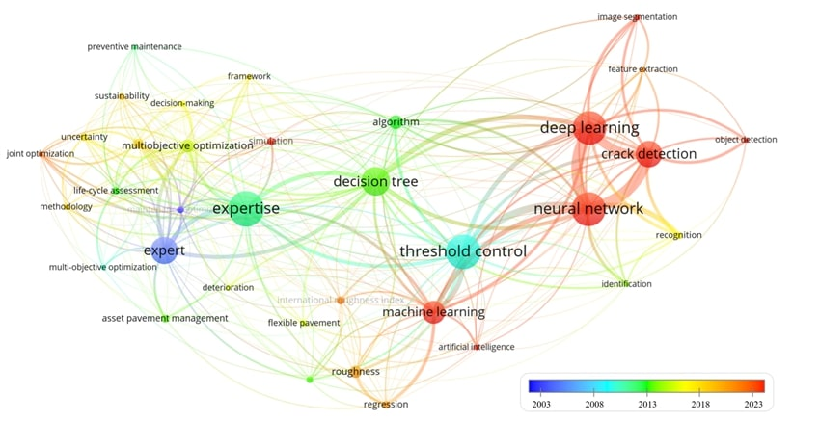
Related works
The common approaches for optimizing maintenance decisions include threshold triggering, optimization modeling and deep learning methods.
Threshold triggering
Optimization modeling
Deep
Learning
Notes:
To review the existing methodology of maintenance decision-making, we collect articles related to the topic and analyze keyword distribution. As shown in figure, "expert", "threshold", "optimization" and "neural network" are the keywords with the highest frequency in recent years. Road maintenance decision-making mainly relies on expert knowledge systems in the early stage, while recent research focuses more on threshold triggering, optimization modeling and deep learning methods.

Slide 8
Related works
The common approaches for optimizing maintenance decisions include threshold triggering, optimization modeling and deep learning methods.
Method | Research | Technical Features
Threshold triggering | Cost effectiveness and optimal timing of crack sealing in asphalt concrete overlays（Mousa, et al.） Monte Carlo simulation is used to establish the function curve of cost benefit and trigger threshold（Khurshid） The hybrid model describes the threshold triggering maintenance decision process（Chu, et al.） The trigger threshold optimization model is constructed based on the deterministic user equilibrium model（Ouyang, et al.） | To ensure the lower limit of pavement function, the essence of the strategy is to "guaranteed" rather than "optimize". The threshold is determined by experts or historical trends. Engineering applications are simple.
Optimizati-on | The multi-objective optimization model balances the expenditure of environmental impact, pavement performance and cost(Yu, et al.) | Multi-dimensional variables and objectives are allowed in modeling. The modeling is ideal, but it is difficult to realize in engineering application.
Deep Learning | An M&R project Prioritization Method Based on an Ann model(Janani , et al.) ANN learns domain expert maintenance strategy selection(Abdelrahim, et al.、Hafez, et al.) Reinforcement learning model modeling maintenance decision optimization(Yao, et al.)
The threshold trigger method is difficult to construct fine-grained and complex conditions, and the data model is difficult to model fuzzy decision rules.
Notes:
Threshold triggering is to ensure the lower limit of pavement function, the essence of the strategy is to "guaranteed" rather than "optimize". And the threshold is determined by experts or historical trends. While the advantage is that their Engineering applications are simple.
Data modeling methods are in popular after digital transformation of infrastructures. It allows variables and objectives in modeling. But it is too ideal to used in practice.
To sum up, the threshold trigger method is difficult to construct fine and complex conditions, and the data model is difficult to model fuzzy decision rules.

Slide 9
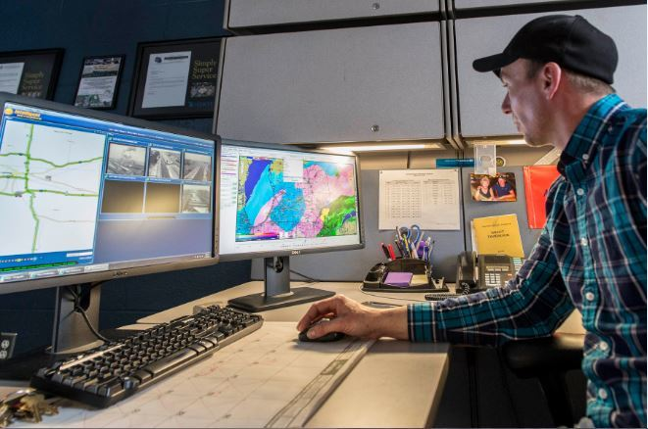
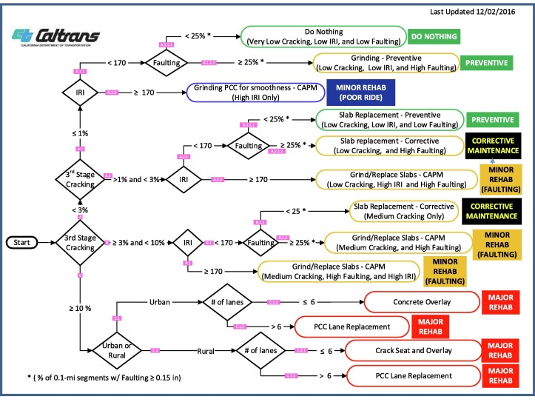
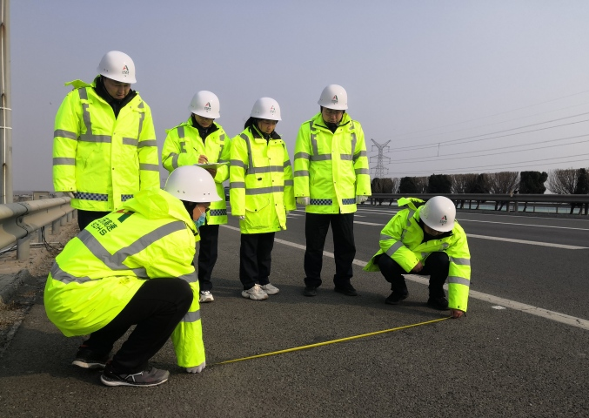
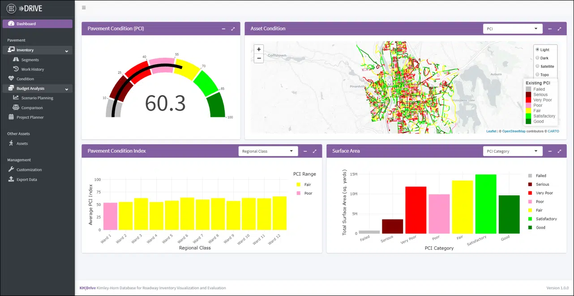
Related works
Expert experience method
Data modeling method
Mainstream method , simply used; based on experience
Interpretable, hard used in practice and bad adaptiveness
Strong assumptions
Poor practicality
Minimum Guaranteed
Ununiform rules
Subjectivity
Data models can provide basic rules
Expert knowledge can provide empirical optimization
Explore a method that combines expert experience and digital technology
Notes:
In engineering practice, mainstream method is making decision by experts. It is a simple and straightforward method, but it leads to subjectivity and ununiform standards due to differences between experts’ levels and capacity. As for data modeling methods, they have been used but are still rarely applied in practice because they base on strong assumptions and can hardly adapt to various scenes. However, data models can provide basic rules for decision while expert knowledge can provide empirical optimization. SO, we try to explore a method that combines expert experience and digital technology. How to learn from each other and integrate knowledge and data in maintenance decision-making is what we want to solve.

Slide 10
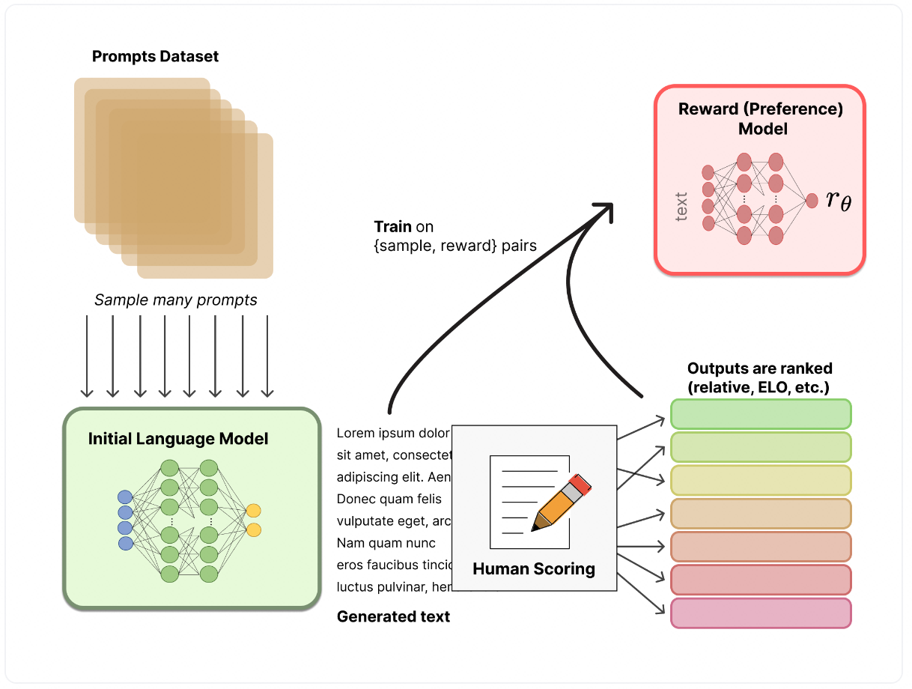




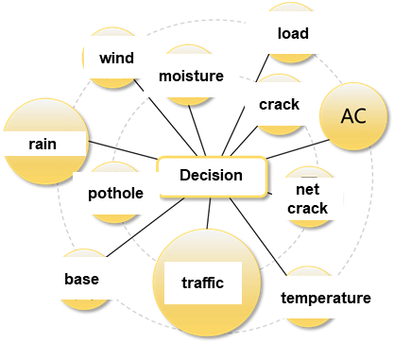
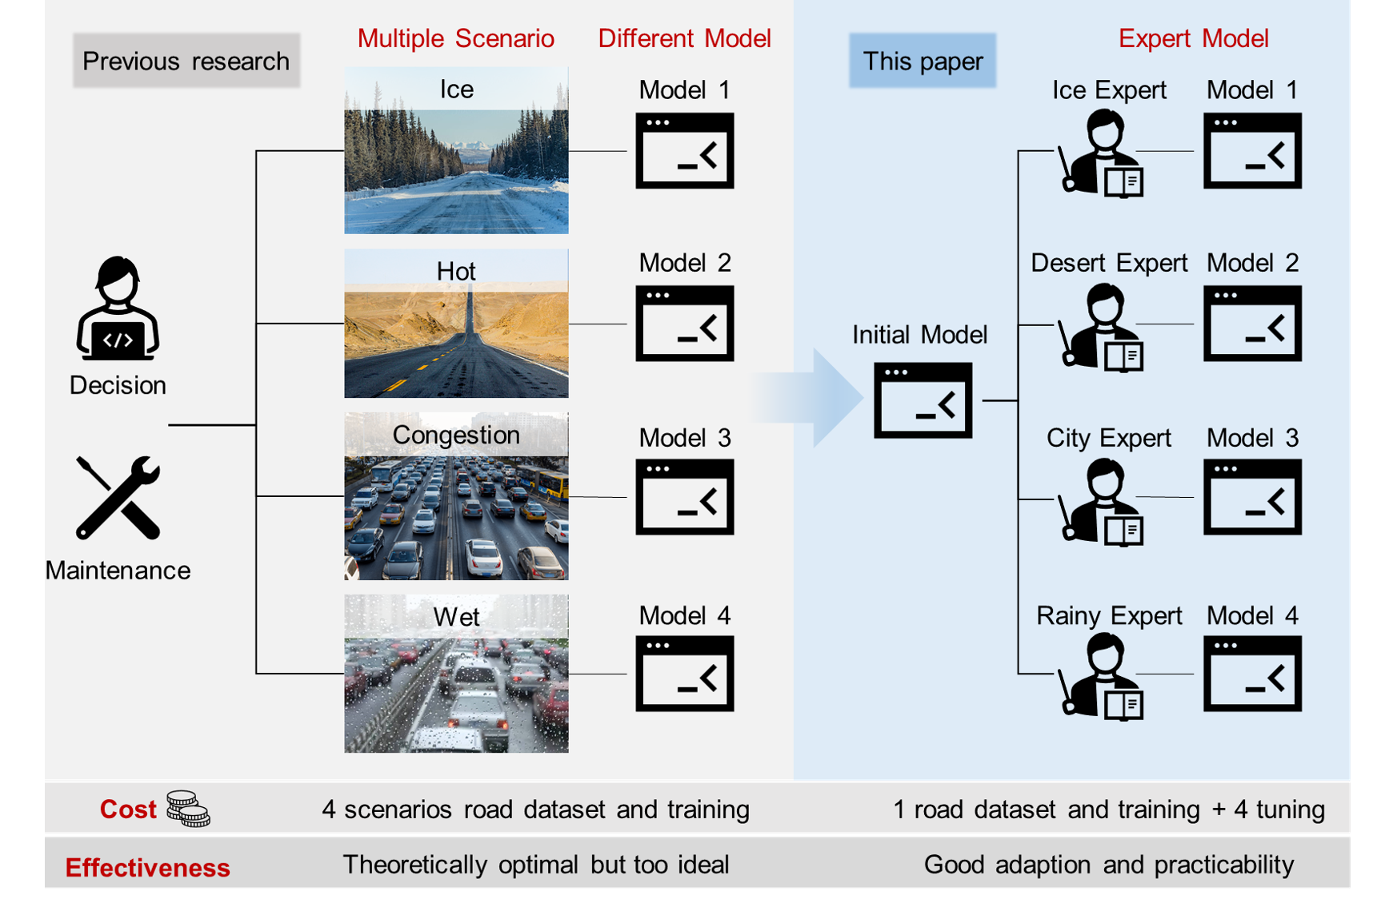




Research Vision
Generative AI brings new possibilities to decision making
ChatGPT, created by OpenAI, attracts a lot of attention. One of its key technique RLHF can not only learn from dataset, but also from user preference, which inspires us.
LLM（SFT）
Generative Artificial Intelligence
+
RLHF
=
ChatGPT
Decide Like a Human
Data driven decision model
+
RLEF
=
Expert
AI
The fuzzy expert experience is introduced into data models to realize the humanized decision
Notes:
Generative AI brings new possibilities to decision making, ChatGPT, created by OpenAI, attracts a lot of attention. One of its key technique reinforcement learning from human feedback can not only learn from dataset, but also from user preference, which inspires us. The large language model combining with rlhf can realize the generative artificial intelligence like chatgpt, so we want to apply the similar minde that integrating the data-driven decision model and reinforcement learning from expert feedback to propose the model for maintenance decision which can think like a human. The fuzzy expert experience which is hard to model is introduced into the data model to realize the humanized decision

Slide 11
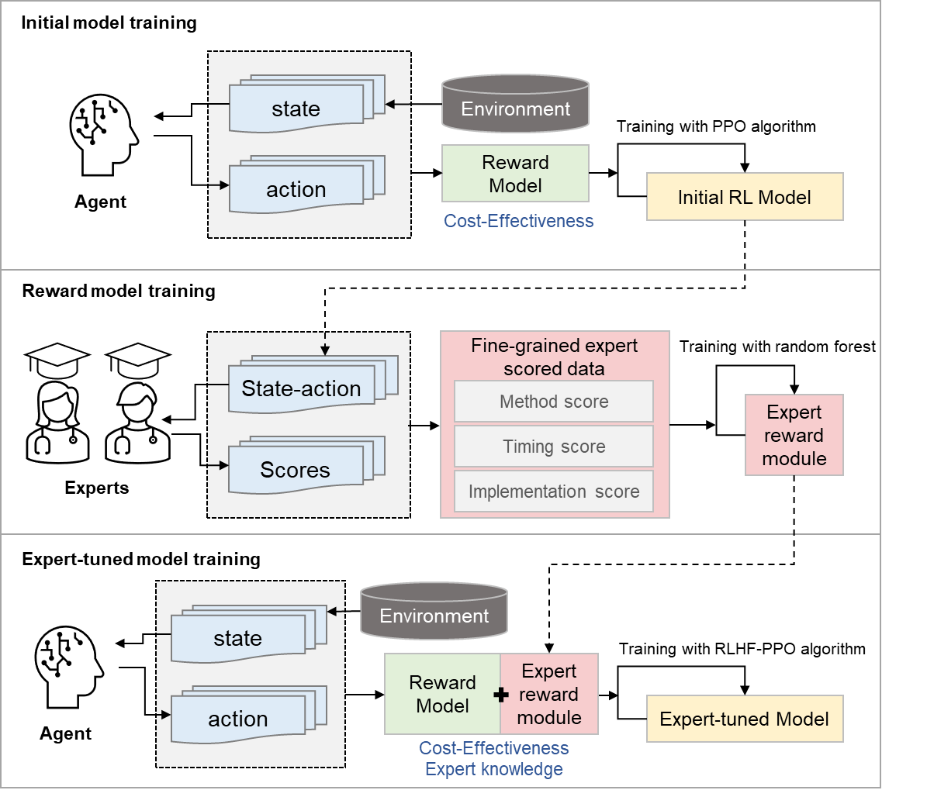
Methodology
Framework
STEP 1
STEP 2
STEP 3
Notes:
基于此，我们建立了基于人类反馈强化学习的道路运维类人决策系统, 高频采集密集道路数据并评估道路的性能状况，并建立起基于环境变量和运维策略的道路性能预测模型，以此为环境，通过优化方法和强化学习搭建基础的养护决策模型。然后我们邀请专家基于他们的经验对基础模型的做的决策进行打分，排序的结果训练成奖励模型加入到人类反馈强化学习方法建立的决策模型中，最终实现在数据模型中引入难建模的模糊专家经验，做到类人化决策。

Slide 12
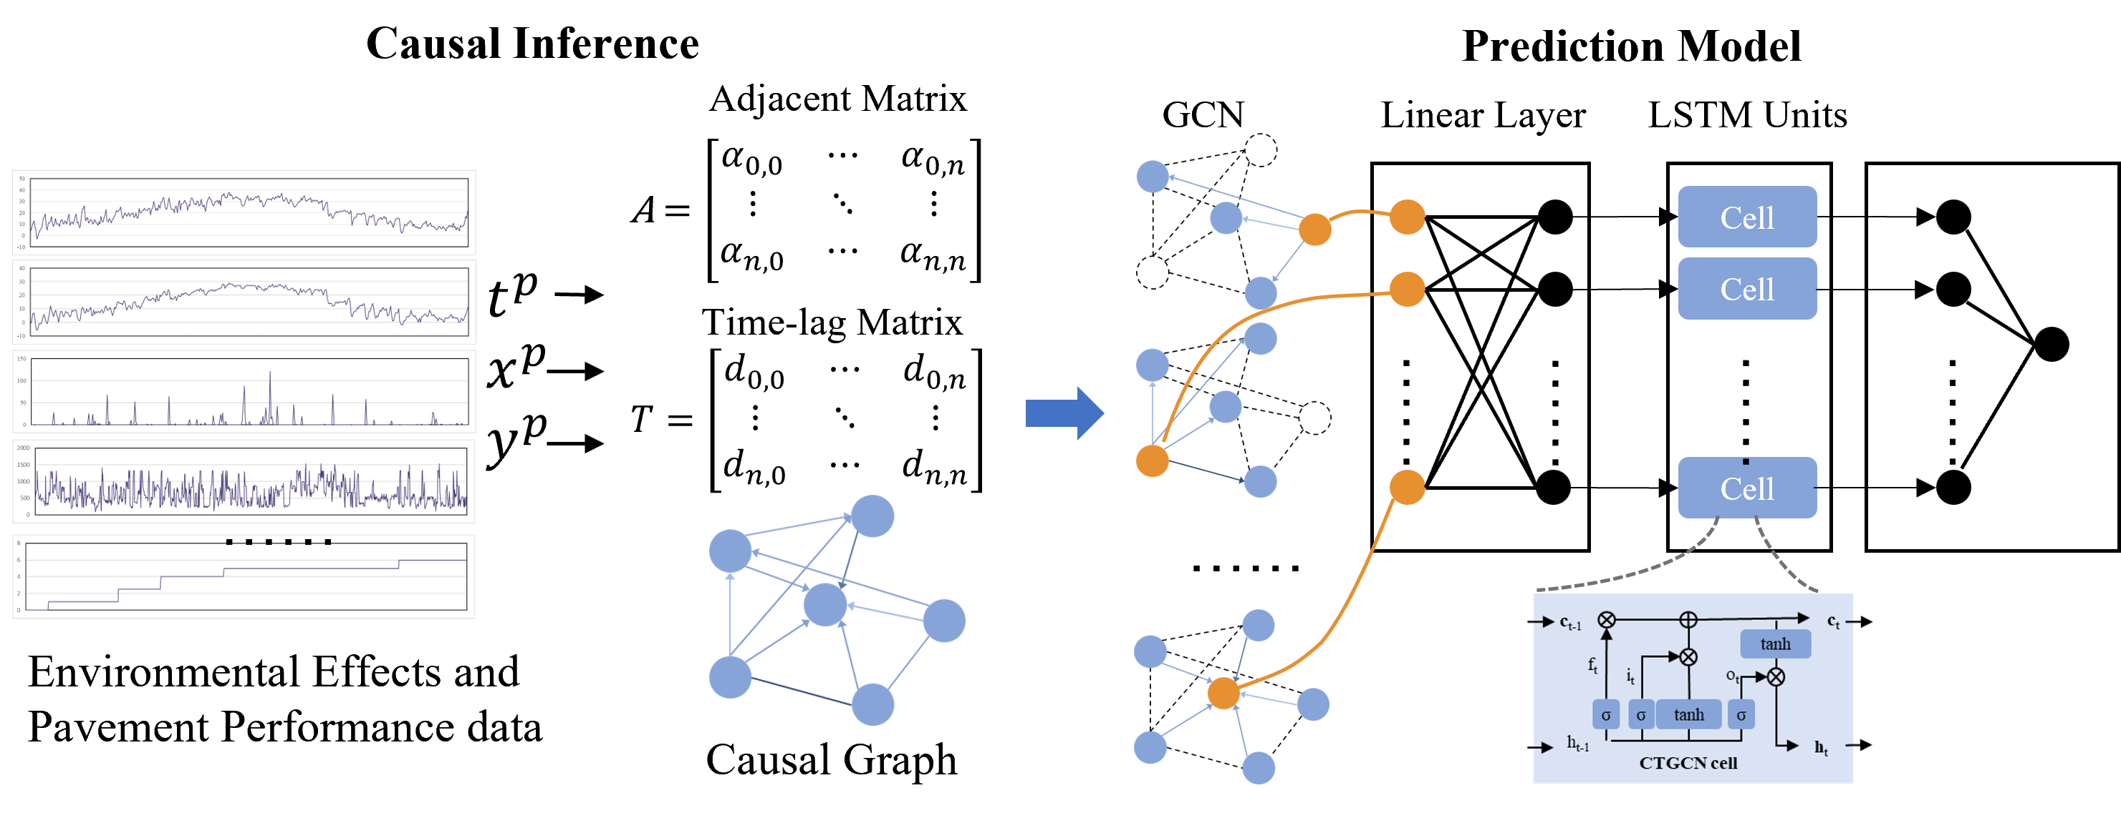
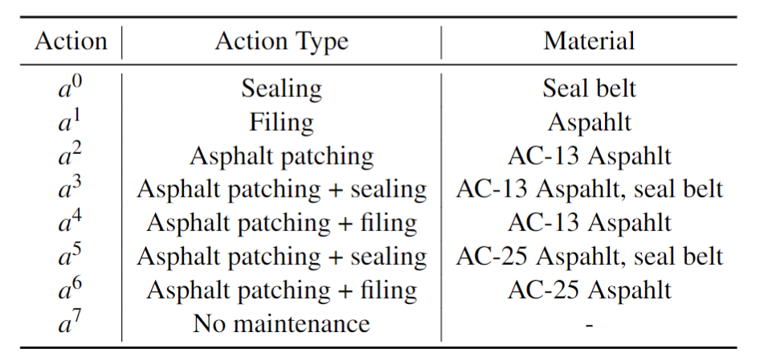
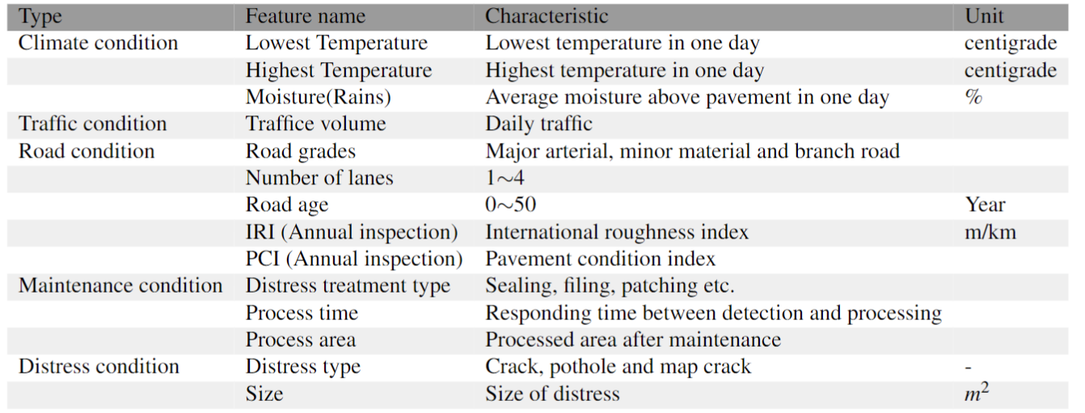
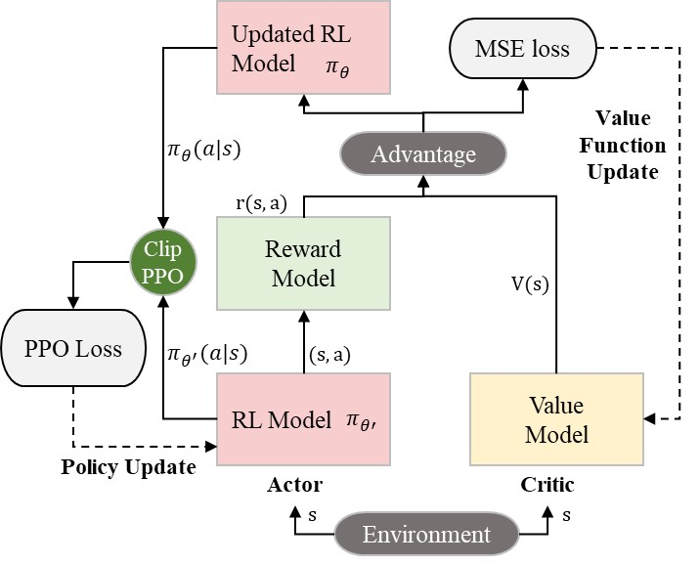
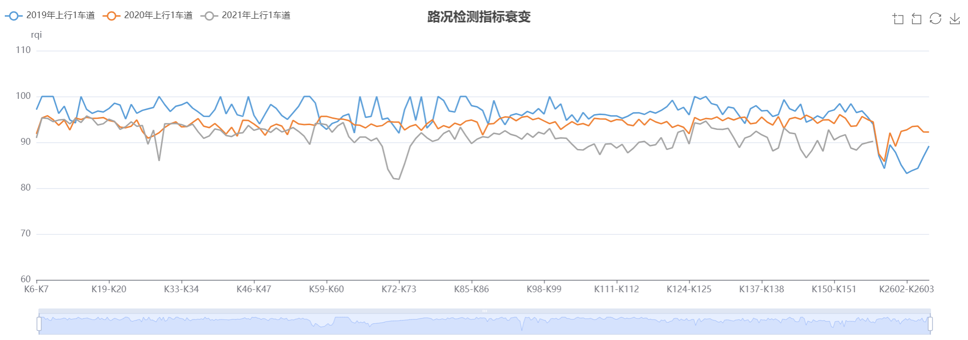
Methodology
Basic model establishment
Environment
Action
Action Space: Timing*Method
100*8: When and How
Pavement performance prediction model
State
Reward
Model
Cost-Effectiveness
Reward Model
Climate, Traffic, Maintenance, Pavement performance, etc.
RL model
Notes:
Firstly, we establish a initial decision model for maintenance based on reinforcement learning. The environment of the RL model is a pavement performance prediction model which could use multiple time series environmental data to predict the variation of pavement performance such as the distress changes of types and numbers. aNd the action is maintenance timing and method which is to decide when and how to do maintenance. The state we used is 50-step time series data of 12 features including climate, traffic, maintenance projects, pavement performance, road information, etc.(and so on) finally, the reward model is to optimize the cost and effectiveness or say future performance of maintenance. Based on these, we use ppo algorithm to train the reinforcement learning and realize the optimal decision making.

Slide 13
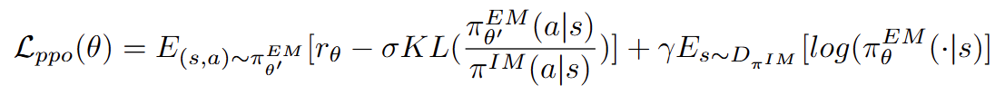
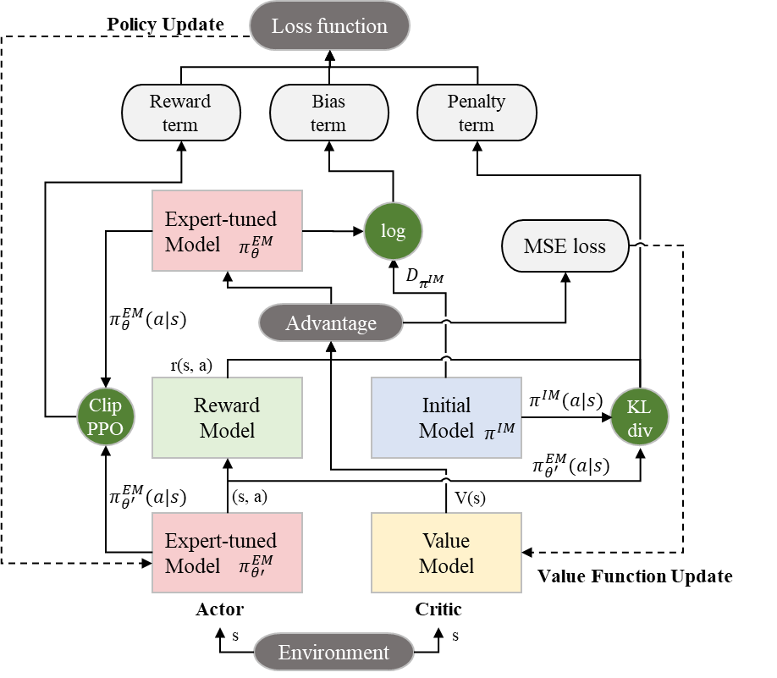
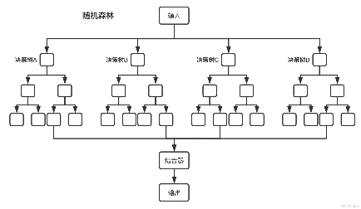
Methodology
RLEF model establishment
Loss function
Reward part
Training penalty
Similarity with initial strategy
Expert Ranking
Reward model
Initial model
Notes:
After setting up the basic model, we input some practical data in the decision model randomly and attain the maintenance decision results. The results are evaluated by engineering experts invited and then we form a dataset about scored decision results. Furthermore, we use random forest method to establish a reward model based on scored decision results dataset to learn experts’ experience. Combing the experts’ reward model and the cost-effectiveness objects to form a new reward model and use it in the updated reinforcement learning from expert feedback model. Then, the combination of data and knowledge of maintenance is realized. In this process, we specially design a loss function considering reward loss, similarity initial model policy and RLEF model policy , as well as similarity between old policy and new policy, so we can better improve the integration of the model.

Slide 14
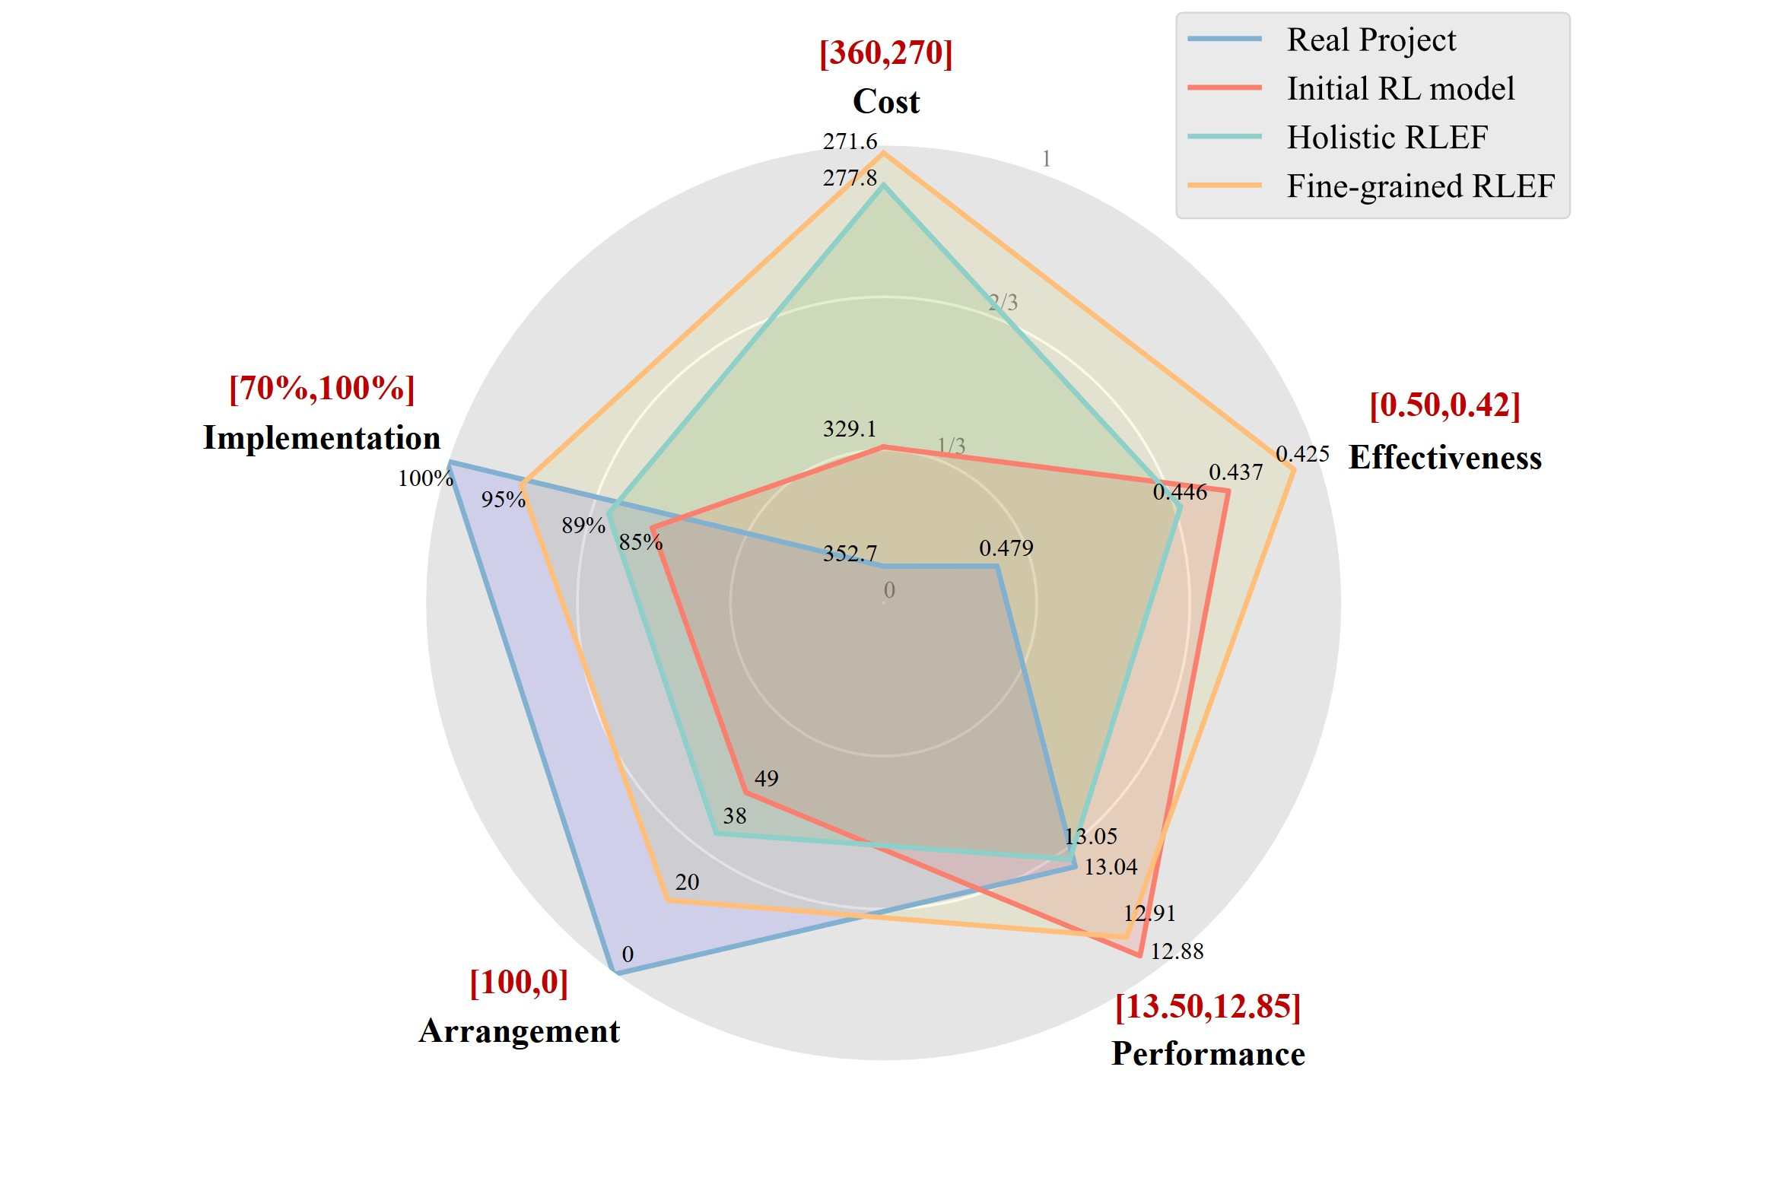
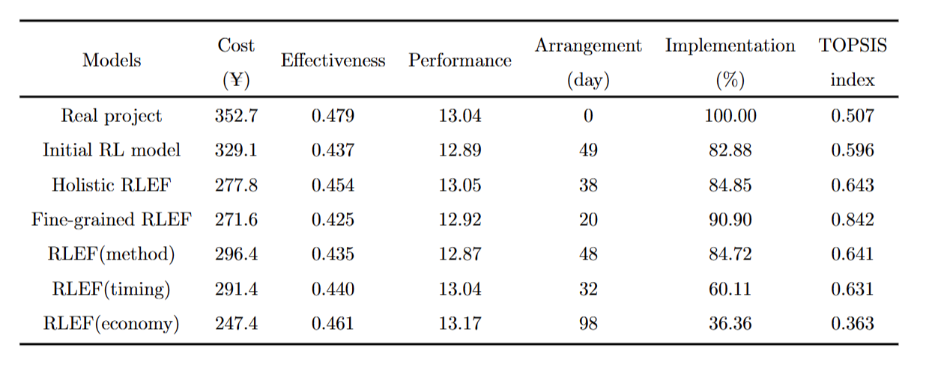
Experiment
Experiment Result
Cost-effective advantage
Fine-grained RLEF has advantages in both cost control and maintenance effectiveness.
Implementation Improvement
Fine-grained RLEF model achieves the best performance in arrangement and implementation rate.
Comprehensive performance
Fine-grained RLEF model has a significant advantage in comprehensive scores over the other experimental groups.
Notes:
For the case study, maintenance work order data from Xuhui District in Shanghai is used as a control group. The dataset contained 1,043 records with maintenance strategies and response times that were determined by practical maintenance staff. All models use the same decision points with initial states from the 1043 real projects as test samples to generate strategy.
We use five metrics to evaluate the performance of decision-making models, which are cost, effectiveness, traffic performance, projects arrangement and implementation rate. In addition, a comprehensive index is calculated (TOPSIS) to represent the multi-criteria evaluation of model performance.
To validate the model‘s performance, We use a fixed randomly sampled dataset generated from the environment for testing, including 1043 decision points. Six models are tested in the experiment: the real projects ，initial RL model, holistic RLEF model use holistic expert feedback for reward model , fine-grained RLEF model} use fine-grained expert feedback from three aspects for reward model training, and three other models only focus on one of the aspects(method, timing and economy.
The experiment results are shown in table and a radar graph. We can see our model have three advantages: cost-effective advantage, implementation improvement and comprehensive performance.

Slide 15
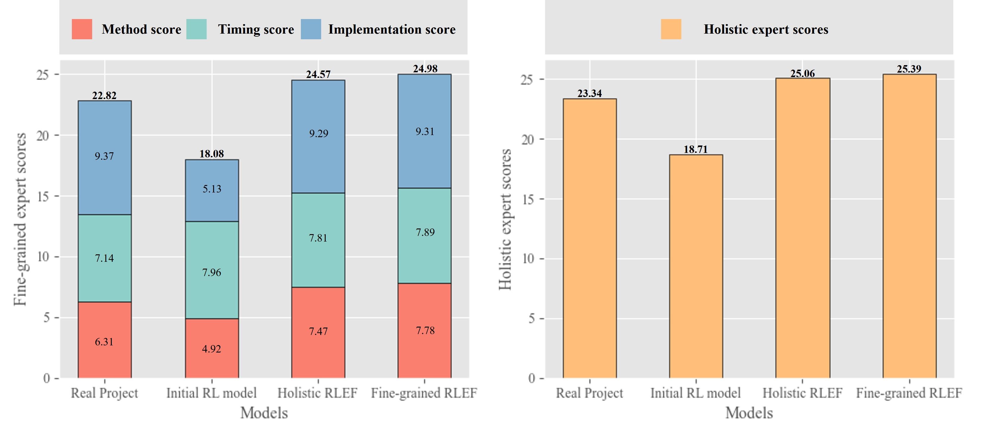
Experiment
Ablation Study
Expert reward can enhance decision-making models
Multi-dimensional data and fine-grained prediction for decision optimization are effective
Fine-grained feedback is important for improving model performance
Multi-dimensional expert feedback can help achieve reward balance and avoid falling into local optima
An overall feedback of a strategy is more effective for model improvement than only considering from a single dimension.
Notes:
We also do the ablation study to find which parts of the model make sense.
(a)Compared to the initial RL model, other data-driven models (3)-(7) that incorporate the expert reward module have shown significant improvements in both comprehensive score and engineering capability, except for model (7) which fell into local optimization and had poor performance. This validates the effectiveness of expert reward in enhancing decision-making models.
(b)Compared to real project data, all data-driven models have shown improvements in the three cost-effectiveness-related metrics. This validates the effectiveness of multi-dimensional data and fine-grained prediction for decision optimization.
(c)Under the same expert feedback improvement, the fine-grained RLEF model outperforms the holistic one in all aspects, demonstrating the importance of fine-grained feedback.
(d)Models (5)-(7) that apply single-dimensional expert feedback rewards perform well only in the direction they are optimized for. Model (7) even experiences a severe decline in other metrics. This validates the necessity to utilize multi-dimensional and comprehensive expert feedback to achieve reward balance and avoid falling into local optima, in addition to improving specific dimensions of the strategy.
(e)The holistic RLEF model outperforms models (5)-(7) in overall performance. This indicates that considering the overall pros and cons of a strategy is more effective for model improvement than only considering from a single dimension.

Slide 16
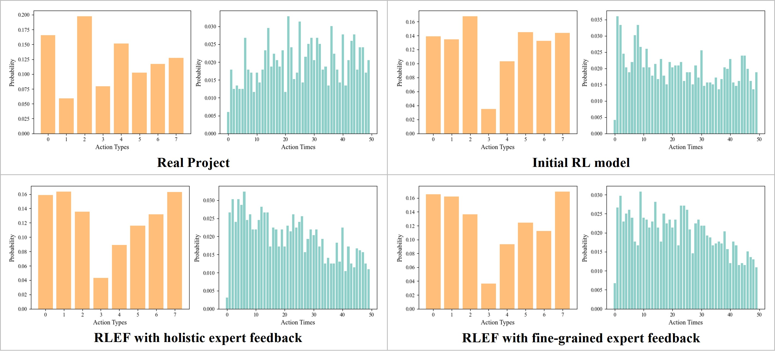
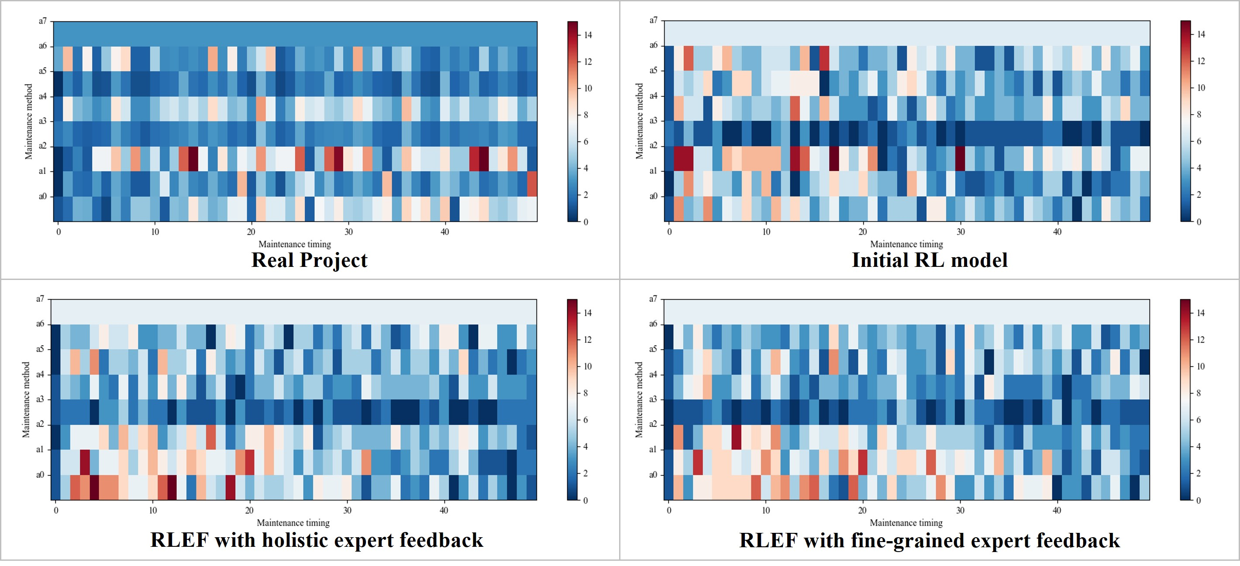
Experiment
Action Distribution Analysis
Compared to real projects, data-driven models use lighter maintenance methods.
The timing distribution of real projects is the most reasonable, followed by the fine-grained RLEF model.
The action distribution of the fine-grained model is more balanced than that of the other two RL models.
Notes:
The two graphs illustrate the distributions and two-dimensional distributions heatmap of the real project, initial RL model, holistic RLEF model and fine-grained RLEF model's strategies generated from test samples.
Compared to real projects, data-driven models use more light maintenance methods. This is because in actual engineering, there may be a tendency to use more severe maintenance methods to ensure that the pavement quality after maintenance can pass the acceptance test and avoid rework, without giving priority to cost considerations.
The timing distribution of real projects is the most reasonable, followed by the fine-grained RLEF model. The initial RL model has a clear tendency to perform maintenance in advance, leading to the model allocating too many projects to earlier time steps.
The action distribution of the fine-grained model is more balanced than that of the other two RL models, which reduces the occurrence of the maintenance project volume exceeding the threshold at the same timing.

Slide 17
Conclusion
In summary, we proposed a fine-grained Reinforcement Learning from Expert Feedback (RLEF) model for pavement maintenance decision-making, which overcomes two challenges: the difficulty of simulating the complex maintenance scenarios and the lack of engineering implementation considerations.
Comparisons with data-driven reinforcement learning models and real projects revealed that the fine-grained RLEF model achieved superior long-term benefits while optimizing cost-effectiveness.
It exhibited a trend towards early maintenance and light methods such as sealing and filing, leading to improved overall pavement performance.
Notes:
In summary, we proposed a fine-grained Reinforcement Learning from Expert Feedback (RLEF) model for pavement maintenance decision-making, which overcomes two challenges: the difficulty of simulating the complex maintenance scenarios and the lack of engineering implementation considerations. In more detail, we design a knowledge-data-driven decision-making model incorporating a fine-grained prediction model to model complex road scenarios. In addition, the RLEF model includes expert experience as a reward for decision-making, which breaks through the limitations of traditional rule-based approaches that fail to account for real engineering conditions.
Furthermore, building the environment of RLEF model with real-world road data and training with engineering expert feedback ensured the incorporation of practical constraints and preferences. Comparisons with data-driven reinforcement learning models and real projects revealed that the fine-grained RLEF model achieved superior long-term benefits while optimizing cost-effectiveness. It exhibited a trend towards early maintenance and light methods, aligning with expert preferences, and effectively utilized cost-effective methods such as sealing and filing, leading to improved overall pavement performance.

Slide 18
Contributions
1. The paper establishes a fine-grained pavement performance prediction model based on real data, predicting variations in road distress considering multiple influencing factors. This model provides an accurate and practically meaningful environment for reinforcement learning.
2. Based on the fine-grained road performance prediction model, we build a reinforcement learning-based maintenance strategy generation model, targeting multiple interdependent influencing factors. This model generates daily maintenance strategies for short-term, fine-grained road performance variation and optimizes the cost-effectiveness objectives to reduce maintenance costs and enhance maintenance efficiency.
3. The paper introduces an expert rating reward module, using expert feedback on the initial decision model’s outcomes to guide the preferences in reinforcement learning strategy generation. This integration of maintenance strategies with engineering experience provides higher practical relevance and enables rapid localized adjustments to strategies, enhancing their application efficacy across different scenarios.

Slide 19
Future research
Future Objective
Uniform
Normalized
Scene-adaptive
Notes:
It is essential to acknowledge that the RLEF model operates under relatively ideal conditions. Real-world engineering decisions face uncertainties and constraints, including extreme weather, limited resources, and equipment failures. The performance of the RLEF model may be affected in situations where data dimensions and collection frequencies are insufficient. Future research may involve expanding the expert dataset, establishing the normalized feedback process, and incorporating various road scenarios to further enhance the model's performance in real-world engineering contexts. Continued efforts in these areas can lead to more robust and reliable decision-making solutions for pavement maintenance management.

Slide 20


Thanks for attention
Wechat
wenyuan4@tongji.edu.cn; 14lcl_tj@tongji.edu.cn
https://github.com/wowocai
Any questions and discussions are welcome!

