Slide 1



Impact of Turbulent Flow underneath the Rear Cowcatcher on the Flow Field of Bogie Region and Aerodynamic Noise Characteristics of
High-Speed Train
(Authors: Guanda CHENG, Jiabin PANG)
PhD. Candidate Guanda CHENG
delta_cheng@tongji.edu.cn
Nov 7th , 2024
School of Automotive Studies
Tongji University
Notes:
Ladies and gentlemen, good morning!
It’s a great honor for me to be here, participating in this forum and introduce my academic research with you.
First, let me introduce myself to you. My name is Cheng Guanda, also, you can call me Delta for convenience. I’m a present doctor from the School of Automotive Studies and Shanghai Automotive Wind Tunnel Center, both of which belong to Tongji university. Currently, I’m following my research field from my master’s program and further pursuing studies in vehicle aerodynamics and aeroacoustics under the guidance of Prof. PANG.
As what you can see from this page, today’s topic will primally concern about the Impact of Turbulent Flow underneath the Rear Snowplough on the Flow Field of Bogie Region and Aerodynamic Noise Characteristics of High-Speed Train. Also,

Slide 2

Contents
Impact of Turbulent Flow underneath the Rear Cowcatcher on the Flow Field of
Bogie Region and Aerodynamic Noise Characteristics of High-Speed Train
Research Background and Problem Statement
Research Content and Methodology
Main Results and Conclusions
Q&A
Notes:
my presentation will be in four parts.

Slide 3
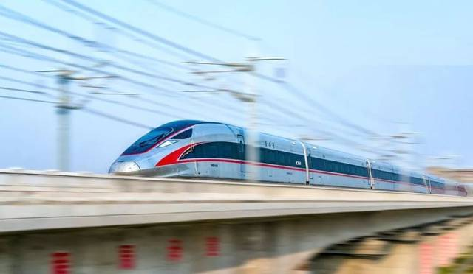
Research Background and Problem Statement
Impact of Turbulent Flow underneath the Rear Cowcatcher on the Flow Field of
Bogie Region and Aerodynamic Noise Characteristics of High-Speed Train
Transportation
and
Environment
Aerodynamic noise becomes predominant as V > 300 kph
The bogie area of leading car dominates the aeroacoustic noise
Notes:
It is well accepted that the aerodynamic noise becomes predominant as the running speed increases above 300 km/h for high-speed trains. Among all parts, the first bogie and its cavity of the leading car contribute the most to aerodynamic noise and do harm to the environment, which is perfectly relevant to the topic of our session and also urgent to be controlled.

Slide 4
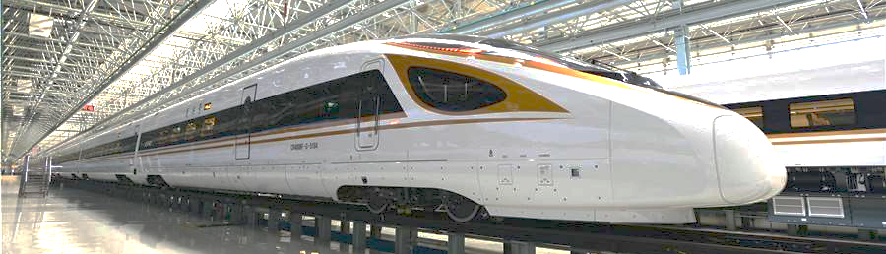
Research Background and Problem Statement
Impact of Turbulent Flow underneath the Rear Cowcatcher on the Flow Field of
Bogie Region and Aerodynamic Noise Characteristics of High-Speed Train
Fairings
  ✓ Direct and effective
  ✗ Limited by safety and reliability
Semi-closed fairings
Notes:
By far, solutions and studies on this problem are mostly limited to approaches of installing fairings outside the bogie cavity which can reduce the noise directly and effectively but merely in the full-closed form. For those in semi-closed form, the noise reduction effect is not that ideal. Unfortunately, however, under the requirements of safety and reliability and also subject to the spatial movement of bogies and its accessories, full-closed bogie fairings are not that practical for most of the high-speed trains.

Slide 5
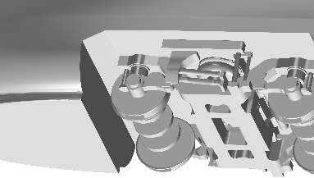
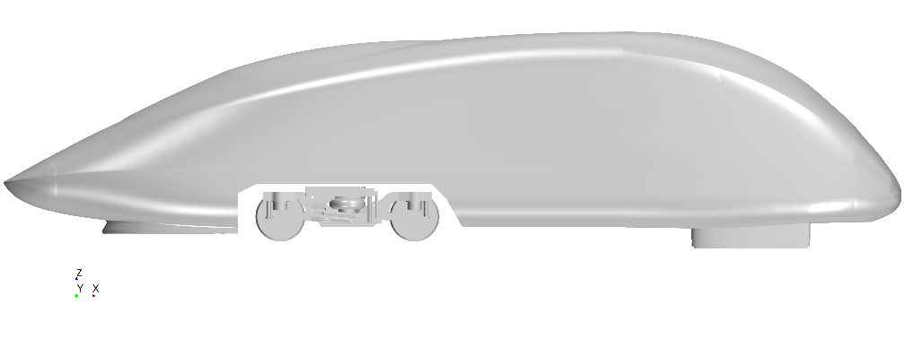
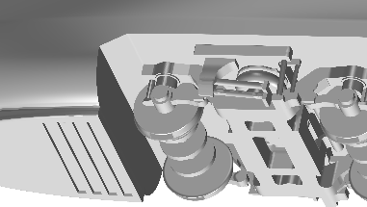
Research Content and Methodology
Impact of Turbulent Flow underneath the Rear Cowcatcher on the Flow Field of
Bogie Region and Aerodynamic Noise Characteristics of High-Speed Train
Model
Case A
3rd Scaled Model of A High-speed Train Nose Car
Streamlined Rear Section
Case A: Baseline Case B: Optimized Model
L: 5.8m W: 1.4m H: 1.1m
Case B
Notes:
Therefore, our research introduced a new flow control approach to reduce the aerodynamic noise in the bogie areas by setting a series of parallel grooves at the rear part of the cowcatcher bottom surface, to disturb the flow developing around the leading edge of the bogie cavity.
In order to verify the effect of this method and understand the mechanism of it, both the CFD simulation and wind tunnel experiment have been carried out based on the one third scaled model of the nose car with two different types of cowcatchers. Also, in order to avoid the aerodynamic noise produced by the flow separation at the tail and reduce the flow interference, the rear section is streamlined and supported by two airfoils from the ground.

Slide 6
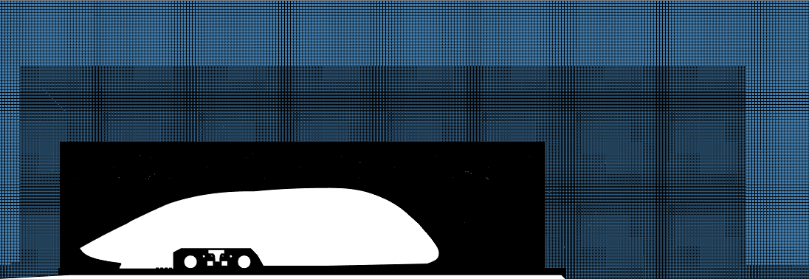
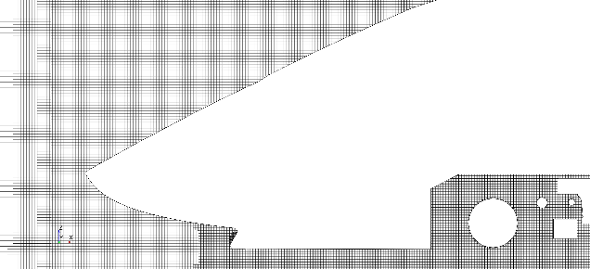
Impact of Turbulent Flow underneath the Rear Cowcatcher on the Flow Field of
Bogie Region and Aerodynamic Noise Characteristics of High-Speed Train
Research Content and Methodology
Unstructured Mesh: Trimmed Hex Grid N=120 Million
Transient CFD Simulation: LES + FW-H U=250kph
Wall y⁺ ⪍ 1 Courant-Friedrichs-Lewy Number ⪍ 1
CFD Simulation
Notes:
In the CFD simulation, in order to assure the accuracy while making full use of computational resources, an LES+FW-H hybrid approach was adopted and a set of unstructured mesh was generated with the max yplus and CFL number less than 1.

Slide 7
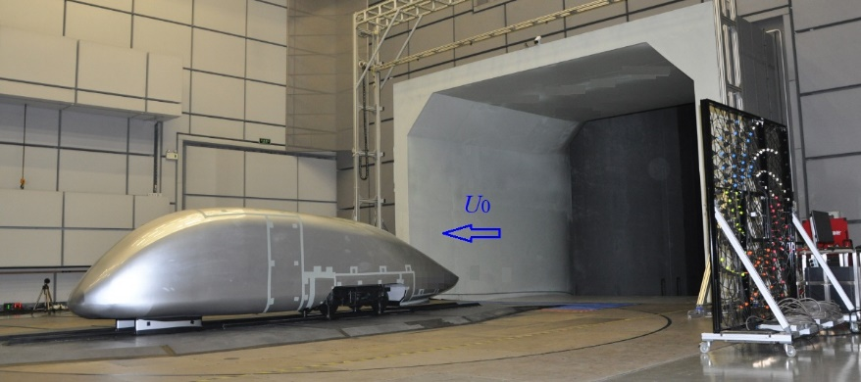
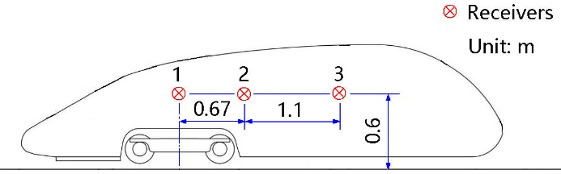
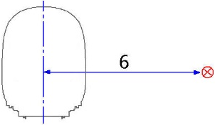
Impact of Turbulent Flow underneath the Rear Cowcatcher on the Flow Field of
Bogie Region and Aerodynamic Noise Characteristics of High-Speed Train
Research Content and Methodology
Aeroacoustic Experiment in SAWTC at Tongji University
Nozzel area 27m² 160kph: OASPL_{bg} < 61dB(A) Sampling rate = 48kHz Sampling time = 10s
Static pressure gradient < 0.001 m⁻¹ Blockage ratio < 5%
Experiment
Notes:
In the wind tunnel experiment, three colinear free-field microphones were set out of the main flow region and pointing vertically to the model surface. The sampling rate was 48kHz while the sampling duration was 10s.

Slide 8
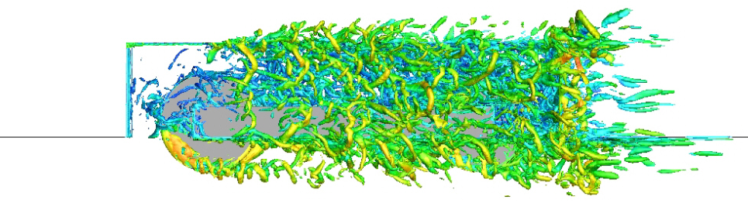
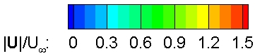
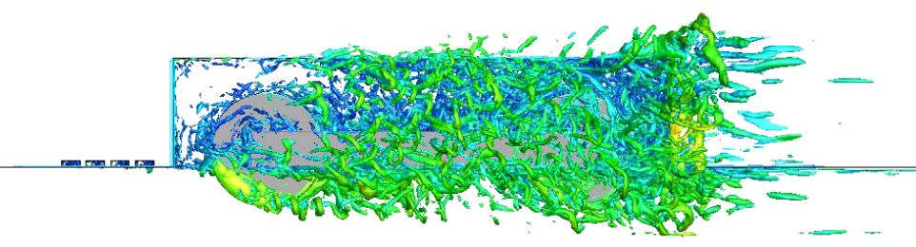
Main Results and Conclusions
Impact of Turbulent Flow underneath the Rear Cowcatcher on the Flow Field of
Bogie Region and Aerodynamic Noise Characteristics of High-Speed Train
Results: Vortex Structure
α = 20
Case A
α = Q/(U∞/D)²
Q-plot
  Large-scale coherent vortices
  Irregular turbulence vortices
  Impingement on the cavity
  Velocity distribution
Case B
Iso-surfaces of the instantaneous normalized 𝑄-criterion (side views)
Notes:
In order to understand the flow behavior around the cowcatcher, the calculation results of instantaneous isosurface of normalized Q-criterion of the two cases are compared and shown here. It can be found that the flow separated at the leading edge of the bogie cavity acts mutually with the geometries inside the cavity. Large-scale coherent vortices are formed outside the cavity and a great number of small-scale irregular turbulence vortices are generated within the bogie cavity. These complex vortex structures interplay with each other and impinge strongly on the rear edges and walls of the bogie cavity. Compared with case A, in case B, the vortices are more uniform with a lower velocity amplitude and the large-scale coherent vortices are reduced remarkably. This is due to the parallel grooves settled at the rear end underneath the cowcatcher changing the flow generated around it, restraining the shear layer development and mitigating the mutual interference of flow around the bogie cavity.

Slide 9
Main Results and Conclusions
Impact of Turbulent Flow underneath the Rear Cowcatcher on the Flow Field of
Bogie Region and Aerodynamic Noise Characteristics of High-Speed Train
Results: Far-field Aeroacoustics
Far-field noise measurement results
  Receiver No.2
  Case 1: OASPL = 87.0dB
  Case 2: OASPL = 86.6dB
  Reduction: 0.4dB
Receiver No.2
Receiver | No.1 | No.2 | No.3
Case 1 | 87.2 | 87.0 | 86.7
Case 2 | 86.8 | 86.6 | 86.2
Reduction/dB(A) | 0.4 | 0.4 | 0.5
1300
Notes:
The far-field noise measurement results show that for all three receivers, the reduction of noise is considerable which reaches between 0.4 and 0.5 dB(A). Now, let’s take a look at frequency domain. This figure shows the SPL spectra of receiver No.2, from which we can see that the spectrum lever is lower for case B in the range between 100 and 1300 Hertz where the Sound Pressure Level amplitude is much higher than in other range.

Slide 10
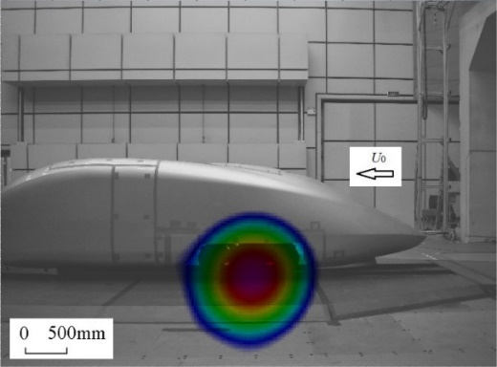
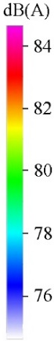
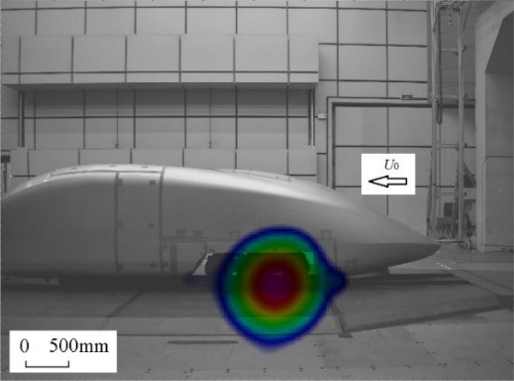
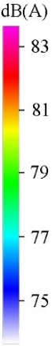
Main Results and Conclusions
Impact of Turbulent Flow underneath the Rear Cowcatcher on the Flow Field of
Bogie Region and Aerodynamic Noise Characteristics of High-Speed Train
Results: Noise Source Localization
Case A
Case B
  120-channel planar spiral array (1.8m × 1.8m)
  Noise intensity decreased and source moved forward
Notes:
Besides, in order to obtain the distribution of noise source, the experiment of localization was conducted with a planar spiral array. The results show that the noise source area shrunk with amplitude decreased by around 1dB(A).

Slide 11
Main Results and Conclusions
Impact of Turbulent Flow underneath the Rear Cowcatcher on the Flow Field of
Bogie Region and Aerodynamic Noise Characteristics of High-Speed Train
Conclusions
Mechanism of noise reduction
  Interfering with the flow separation of the shear layer at the front edge of the bogie cabin
  Reducing the pressure pulsation of the bogie and the surface of the bogie cavity
Results of noise reduction
  Far-field noise: up to 0.5dB(A) under 20kHz
  Noise source level: up to 1dB(A) under 20kHz
  The method of disturbing flow under snowplough is practicable
Notes:
To sum up, in our research, a new approach to reduce the aerodynamic noise generated around the bogie using dented cowcatcher was introduced, whose effect and mechanism were studied both by means of CFD and experiment. And I hope this research could be of helpful to better balancing the development of transportation and protection or even improvement of the environment.

Slide 12

Thanks for listening.
Please feel free to ask questions!
School of Automotive Studies
Tongji University
Notes:
Ok, I’ve covered all the points that I needed to present today. Thank you so much.
Is there any questions?

