Slide 1
Competition or Supplement? Deciphering Interaction between Autonomous Customized Bus and Public
Transit
Jiang Haoran, Shaozhi Hong
Tongji University

Slide 2
1. Introduction

Slide 3
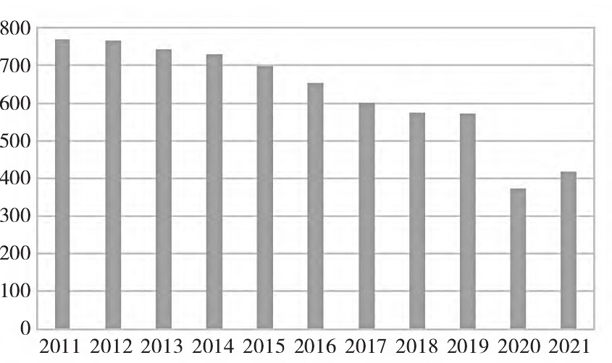
Introduction | Data | Methodology | Results | Discussion
Public transit
Regular Bus
Metro
Decline in Passenger Flow
First and last mile problem
Autonomous Customized Bus (ABs)
Daily regular bus passenger flow in Shanghai
Compared to private transport, public transit is efficient, and eco-friendly, making it vital for urban travel.
However, the declining appeal of regular bus services and the first-mile/last-mile challenge at subway stations have resulted in increased inconvenience and travel costs.
ABs are expected to play a significant role in future transportation services as an emerging mode of travel

Slide 4
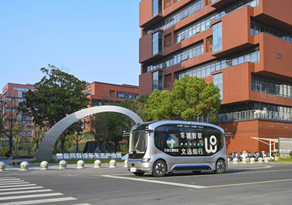
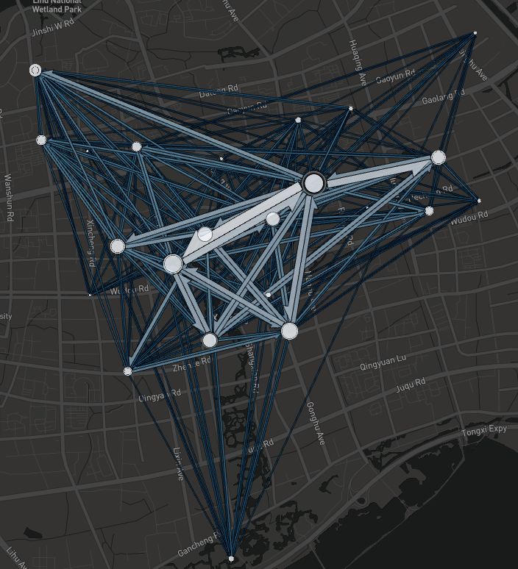
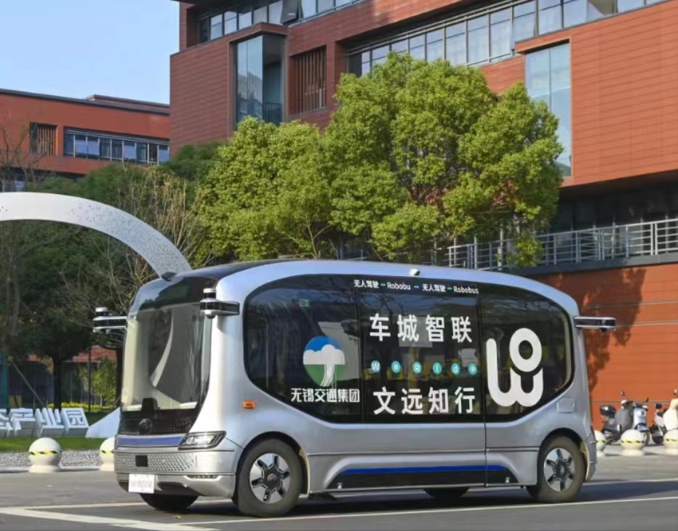




Introduction | Data | Methodology | Results | Discussion
Research subject
With a seating capacity of 10 in ABs, passengers board and alight directly at stations,
Through passenger demand submission, routes are formed for the ABs, ensuring efficient and responsive transportation services.
Autonomous customized Bus
Demand collection
Demand input
OD demand combinations
ABs route planning
Travel information publication
Passengers board and alight
ABs service pattern

Slide 5
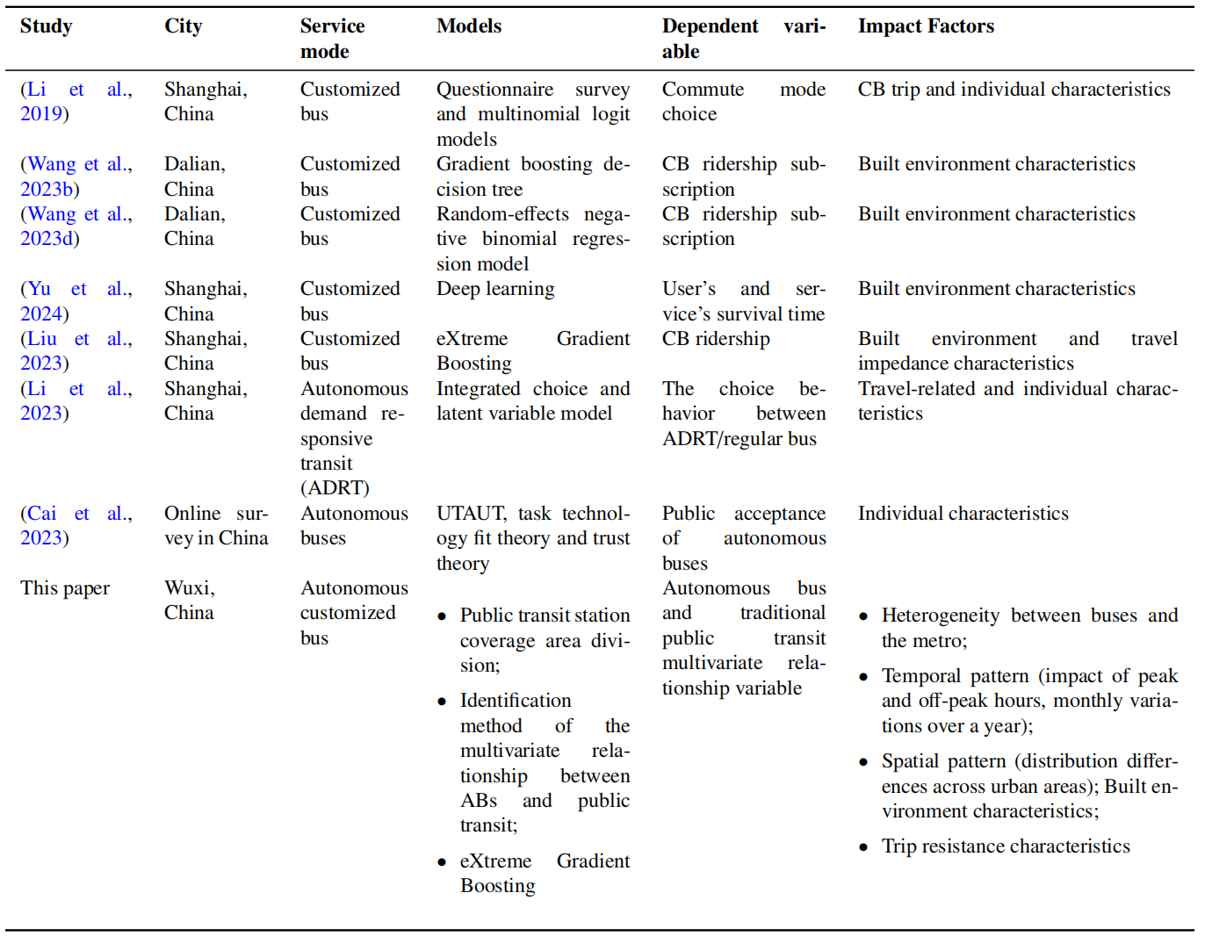
Introduction | Data | Methodology | Results | Discussion
Literature Review
Research gap
There is a notable gap in the literature on the long-term evolution of the complex multivariate relationship between ABs and existing public transit systems.
In particular there is limited analysis of how built environment factors influence these relationships and the non-linear dynamics involved
How to analyze the positioning and role of Autonomous bus in Public Transit(PT) Systems?
How to better integrate autonomous bus into PT (buses and metro systems) from the bulit environment perspective ?

Slide 6
2. Data and Methodology

Slide 7
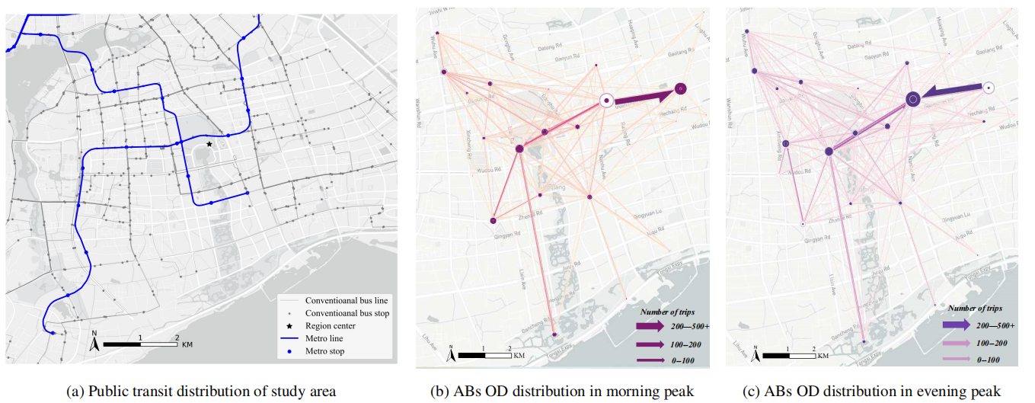
Introduction | Data | Methodology | Results | Discussion
Autonomous Buses and Public Transit data： Wuxi City, Jiangsu Province from 2023.3 to 2024.3
The study area exhibits two metro lines, totaling 939 conventional busstops and 34 bus routes.
The passenger flow distribution of ABs during morning and evening peak hours exhibits a certain tidal pattern in OD (origin-destination) movements.

Slide 8
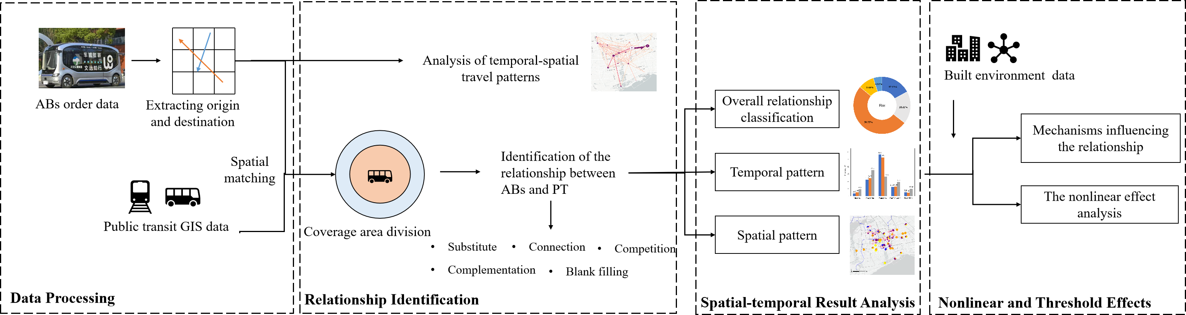
Introduction | Data | Methdology | Results | Discussion
Research framework
The research is structured into four main components: data processing, relationship identification, spatial-temporal analysis, and the examination of nonlinear and threshold effects.
Research framework

Slide 9
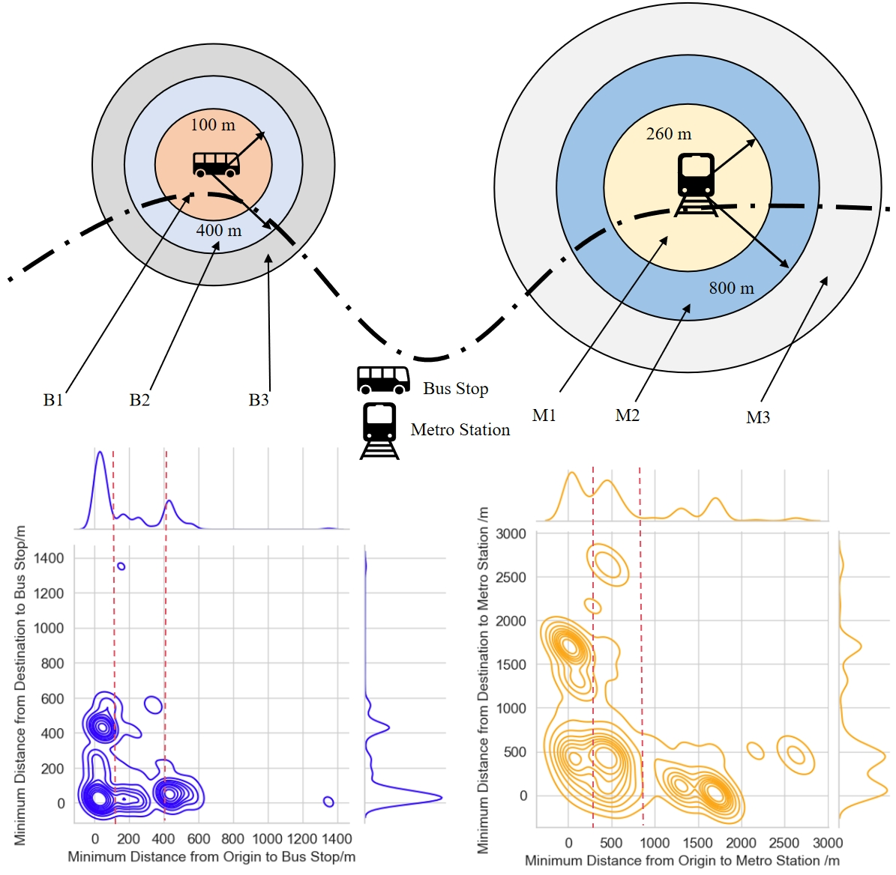
Introduction | Data | Methdology | Results | Discussion
PT station coverage area division
We employ the KD-tree method to determine the nearest conventional bus and metro stations to each ABs trip’s origin and destination points and employ kernel density estimation (KDE), a non-parametric method utilized to estimate the probability density function
Based on the distribution of the kernel function concerning the distances from autonomous bus stops to the nearest public stop:
We classify the analysis curves inflection points into three distinct zones:
Core area(B1,M1)
regions where people can comfortably reach the stations by walking
Buffer area(B2,M2)
the effective coverage range of the stations
Uncovered area (B3,M3)
Areas beyond these thresholds are considered uncovered areas for stations.
Station Area Division

Slide 10
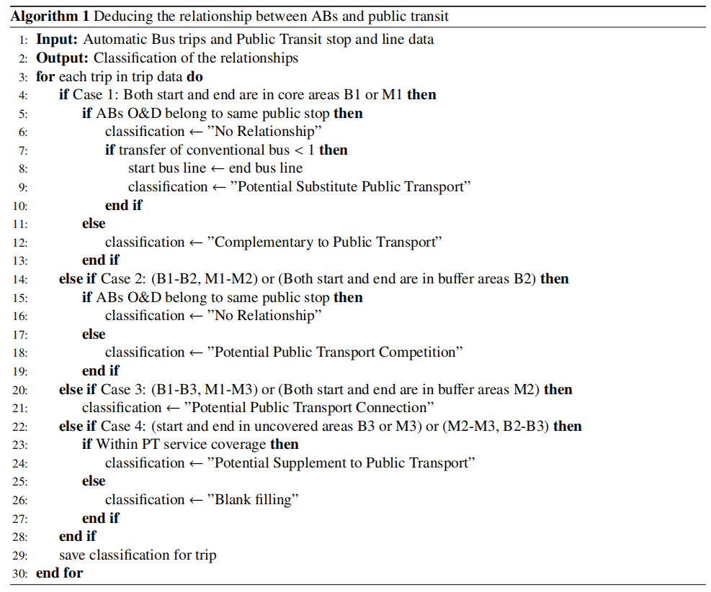
Introduction | Data | Methdology | Results | Discussion
Identification of relationship between ABs and PT
Based on the three types of areas and the OD data, we can categorize five types of relationships between ABs and PT:
Substitute
Core area—Core area :
Competition
Core area—Buffer area
Buffer area—Buffer area
Connection
Core area—Uncovered area
Complementation/Blank filling
Uncovered area —Buffer area
Key steps
Filter out the station with the same coverage
Identify specific stations
Public transit coverage

Slide 11
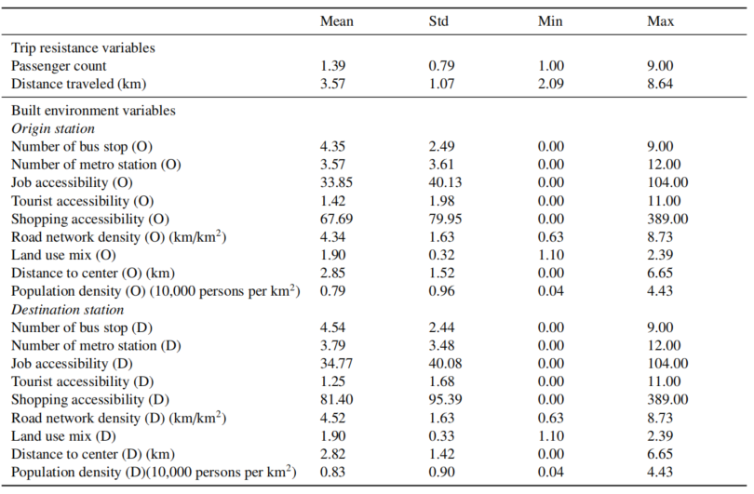
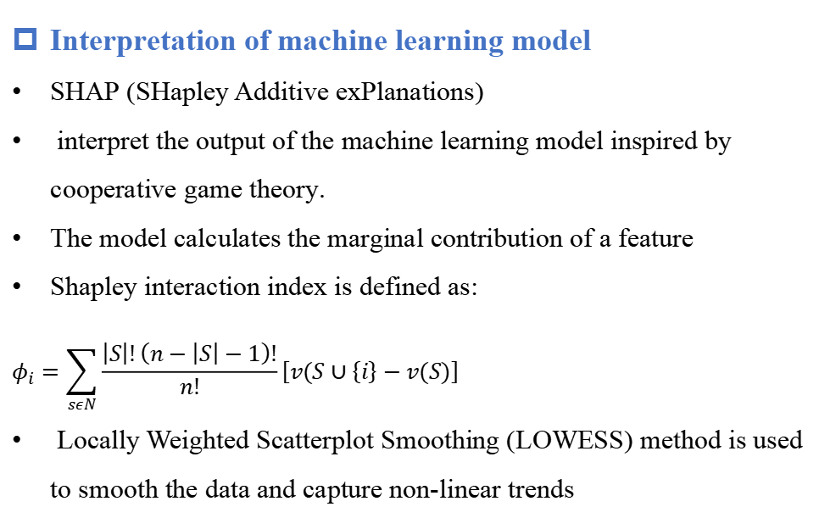
Introduction | Data | Methdology | Results | Discussion
Modeling the relations: Machine learning
Randomforest is used to leverage the data-driven mechanism of machine learning algorithms.
Varibles
The relational categories are treated as the dependent variables and selects two types of independent variables: trip resistance variables and built environment variables.
This distinction between stops at origins and destinations is essential.
Interpretation of machine learning model
SHAP (SHapley Additive exPlanations)
interpret the output of the machine learning model inspired by cooperative game theory.
The model calculates the marginal contribution of a feature
Shapley interaction index is defined as:
$$φ_{i}=\sum_{sεN}{\frac{\left|S\right|!\left(n−\left|S\right|−1\right)!}{n!}}\left[v(S∪\left\{i\right\}−v(S)\right]$$
Locally Weighted Scatterplot Smoothing (LOWESS) method is used to smooth the data and capture non-linear trends
Descriptive Statistics of independent varibles

Slide 12
3. Results and Discussion

Slide 13
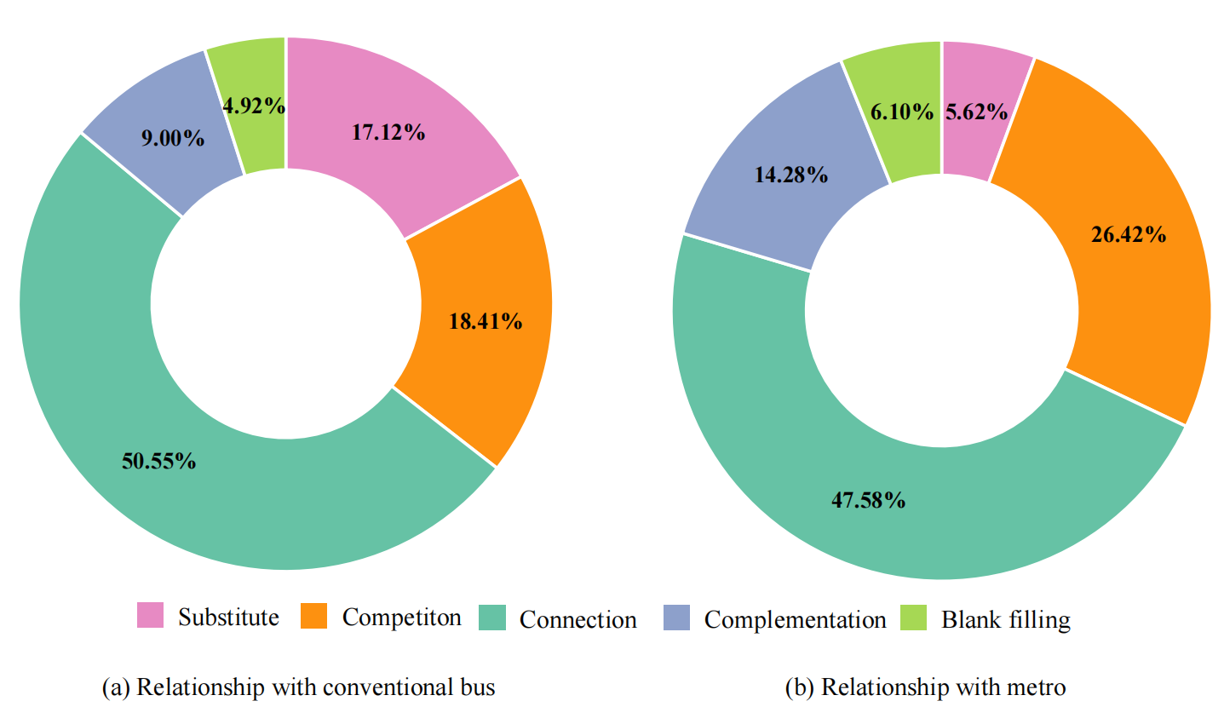
Introduction | Data | Methdology | Results | Discussion
Relationships between ABs and public transit
Connectivity Dominance:
ABs strongly connect with regular buses and metros, at 50.55% and 47.58% respectively, emphasizing their flexibility in public transit.
Substitution Effect:
ABs notably replace regular buses more than metros, with rates of 17.12% and 5.62%.
Complementation Role :
ABs show higher complementation and competition with metros than regular buses. This is closely related to the service model and spatial distribution of the metro line.

Slide 14
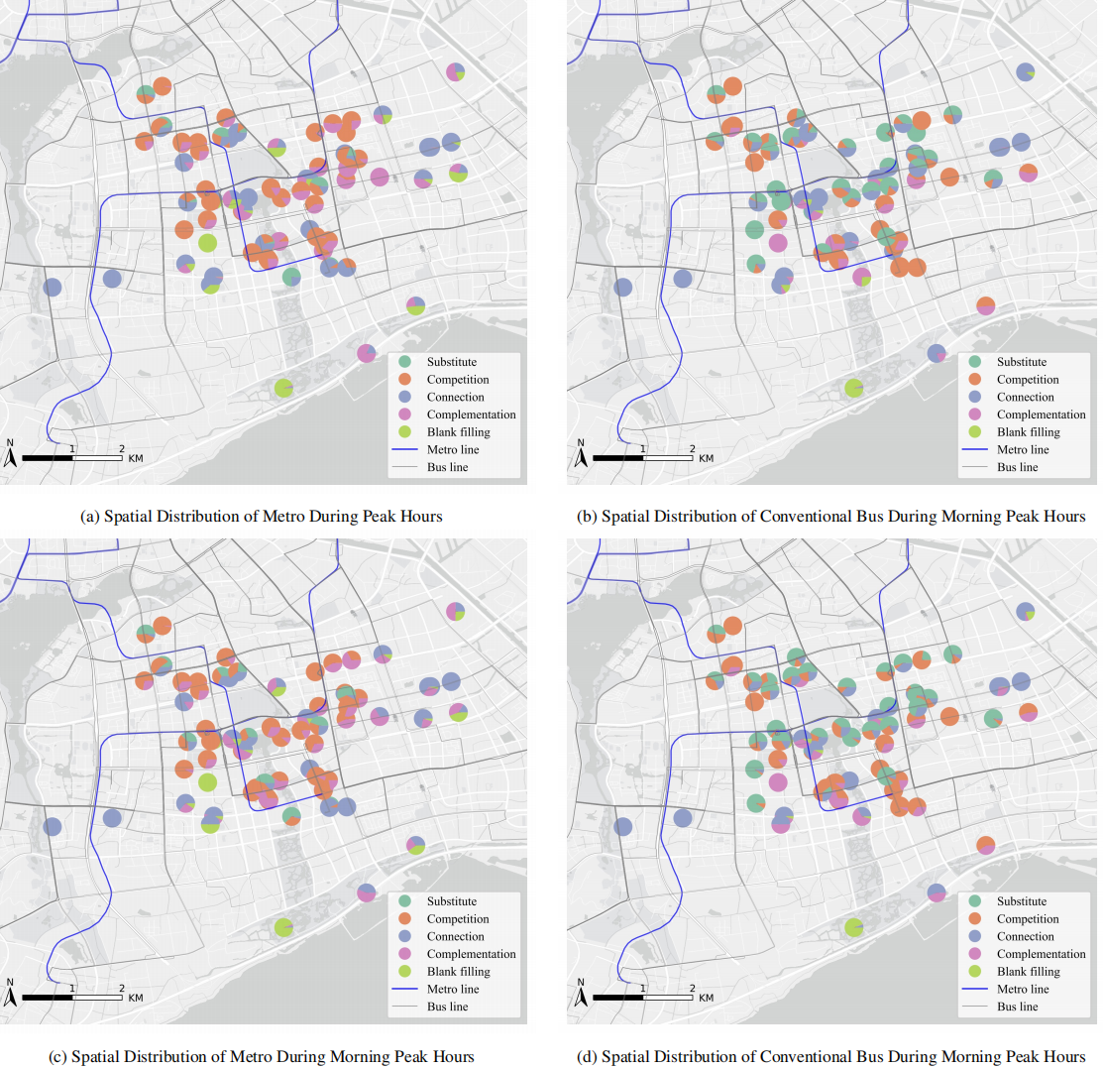
Introduction | Data | Methdology | Results | Discussion
Spatial pattern of multivariate relationships-Peak hours
  In the central area, ABs mainly compete with metros.
  ABs connect and complement with metro, particularly in regions with sparse metro coverage.
  In the central area, ABs largely substitute regular buses.
  Connections to regular buses primarily occur at specific distant stations.

Slide 15
Introduction | Data | Methdology | Results | Discussion
Spatial pattern of multivariate relationships- Off-Peak hours
Similar trends exist, but station relationships become more intricate.
Further temporal analysis is required to fully comprehend the specific differences in temporal patterns between the two time periods.

Slide 16
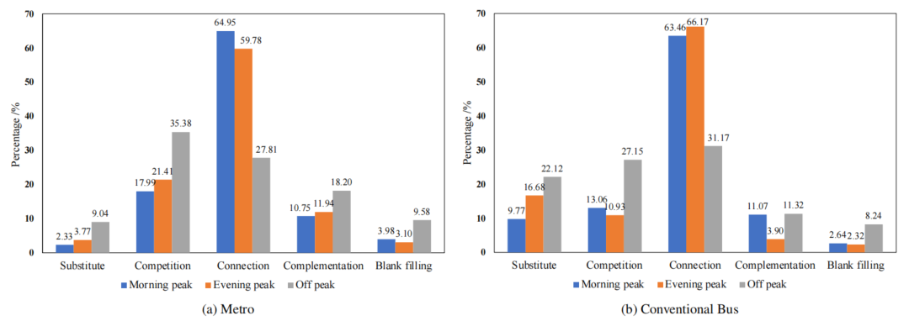
Introduction | Data | Methdology | Results | Discussion
Comparison between Different Time Periods
During peak hours, ABs primarily connect with metro and bus.
During off- peak hours :while competition relationships rise to 35.67%,27.15%, becoming predominant.
Relationship variations are partly influenced by residents' commuting preferences.
These higher proportions during off-peak periods suggest that ABs play a more versatile role in the transportation network when travel demands are less focused on commuting

Slide 17
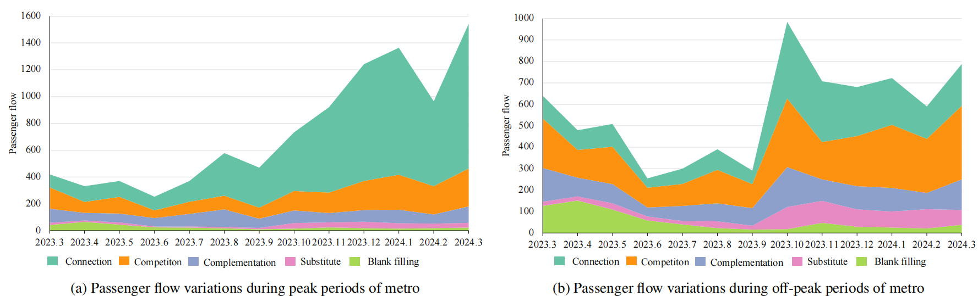
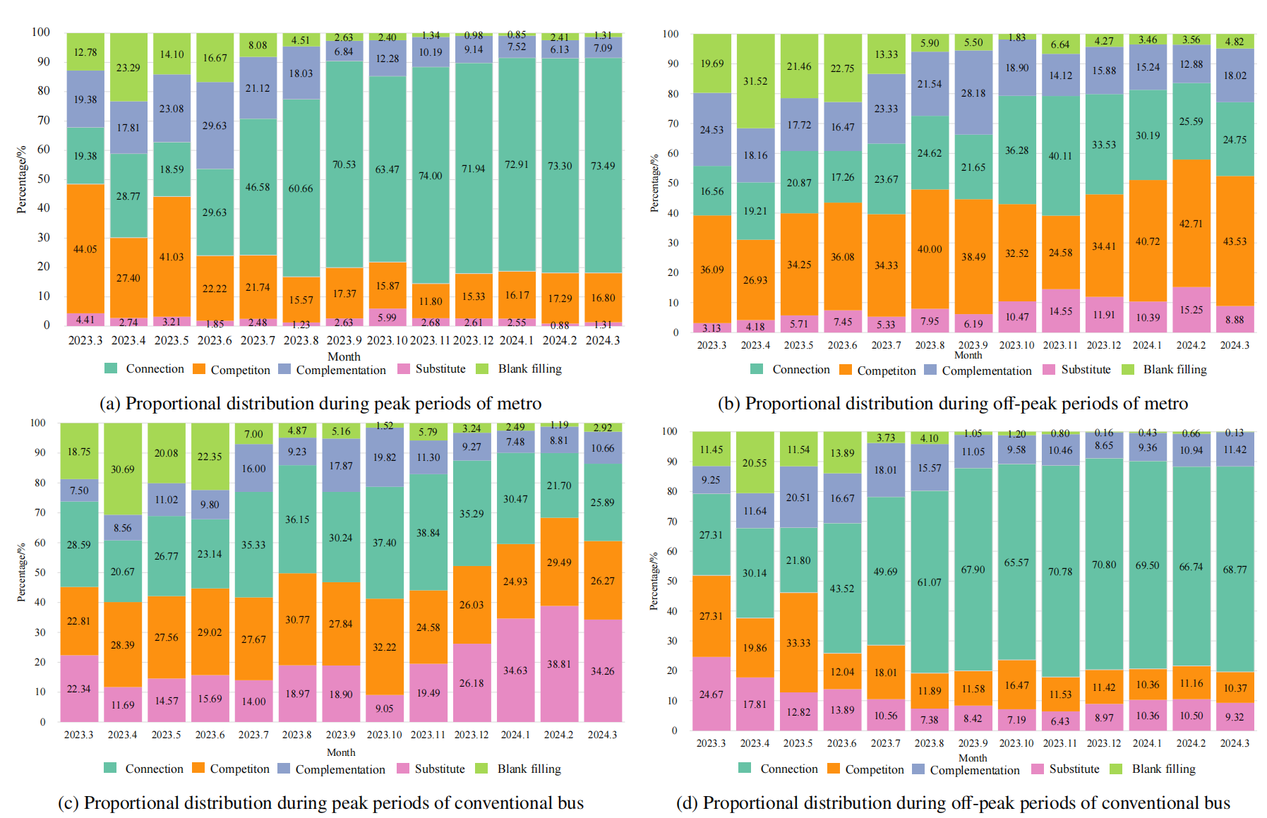
Introduction | Data | Methdology | Results | Discussion
Relationship Changes Across Different Months--Metro
The introduction of ABs can be divided into three phases: initial introduction (March 2023to June 2023), mid-term adaptation (June 2023 to September 2023), and long-term stabilization (September 2023 to March 2024)
The long-term stabilization phase shows a significant increase in peak period connections with metro and conventional buses, indicating a gradual acceptance of ABs as a stable commuting tool.
The patterns observed at different stages exhibit similarities with those of the morning and evening peak periods.

Slide 18
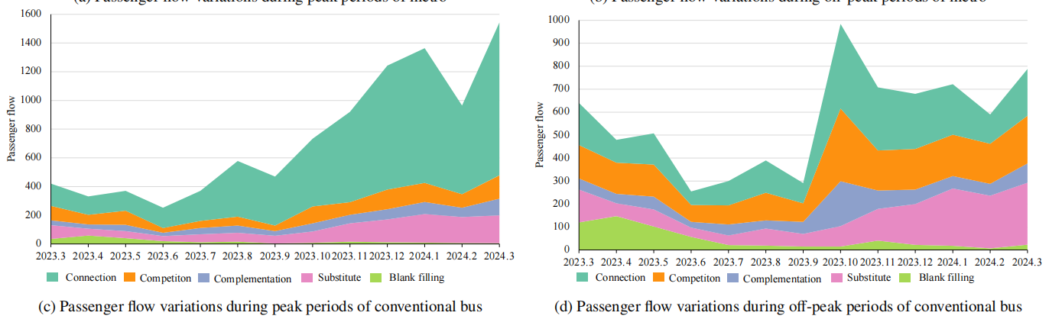
Introduction | Data | Methdology | Results | Discussion
Relationship Changes Across Different Months--Conventional bus
The same three-stage variation patterns are present in the relationship between AB with conventional buses;
however, the substitution and competition are notably more pronounced compared to the metro.

Slide 19
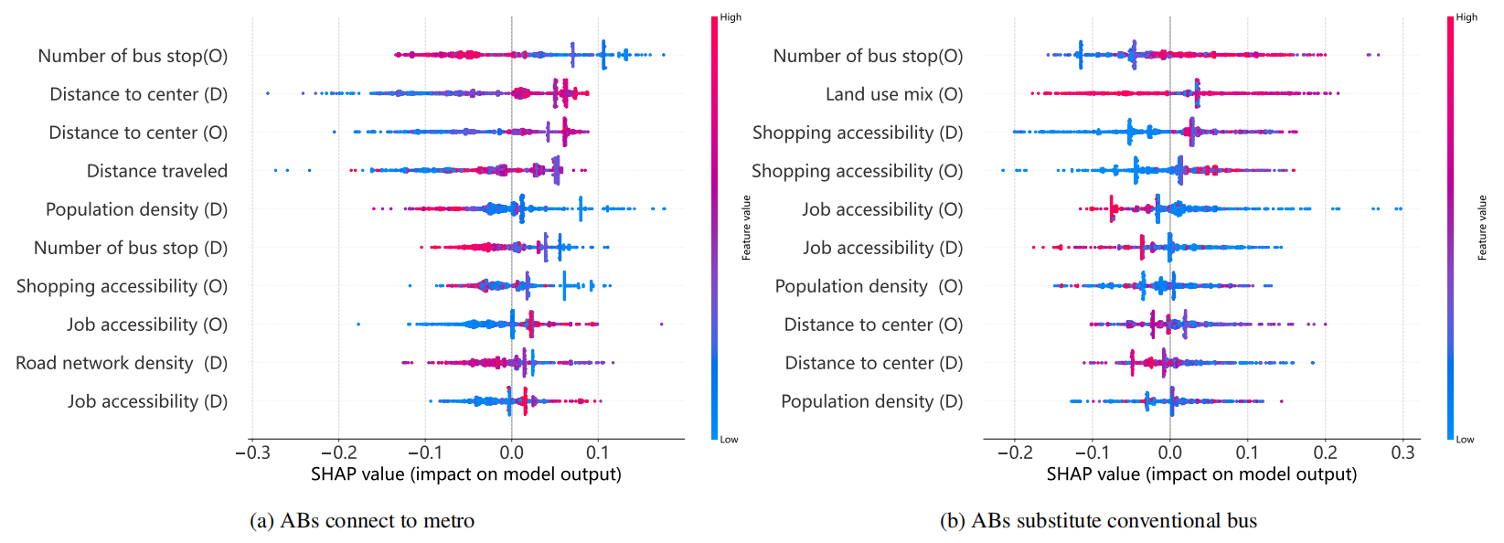
Introduction | Data | Methdology | Results | Discussion
Impact factors analysis of multivariate relationships
Key factors influencing ABs’ connections to metro services include spatial and geographical elements such as the distance to the regional center, distance traveled, population density
Conversely, factors influencing ABs’ substitution of conventional buses are primarily related to land use characteristics, including the number of bus stops at the origin, land use mix, and job and shopping accessibility at both origin and destination stops

Slide 20
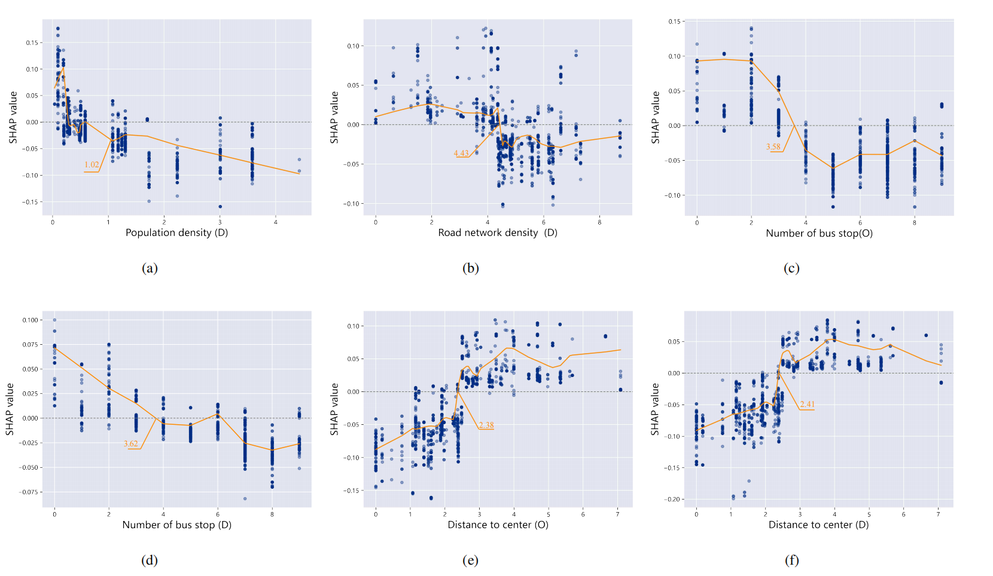
Introduction | Data | Methdology | Results | Discussion
Non-linear effects of ABs connect to the metro
In areas with relatively low population density and road density, residents are more inclined to use ABs to connect to metro services.This preference leverages the high flexibility of ABs, contributing to enhanced public transit efficiency
As the number of bus stops rises, the positive impact decreases, showing a negative effect. A relatively small number of conventional bus stops indicates limited bus routes, which restricts residents’ spatial and temporal travel choices, thus highlighting the role of ABs connecting to the metro

Slide 21
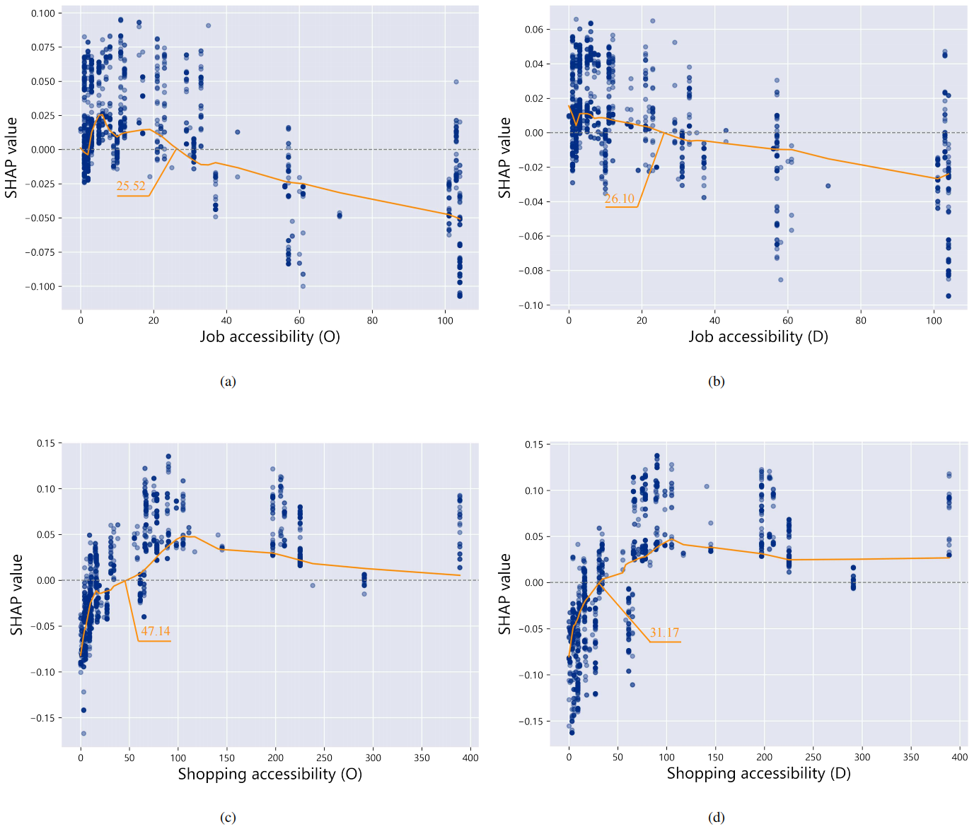
Introduction | Data | Methdology | Results | Discussion
Non-linear effects of ABs substituting conventional buses
When shop accessibility at the origin and destination stations is low, specifically below the thresholds of 47.14 and 31.17, respectively, it negatively impacts ABs substituting conventional buses.
However,as shop accessibility increases, it increasingly supports ABs substituting conventional buses
This indicates that ABs are advantageous for non-commuting shopping trips, with passengers more likely to use ABs in denser shopping areas.

Slide 22
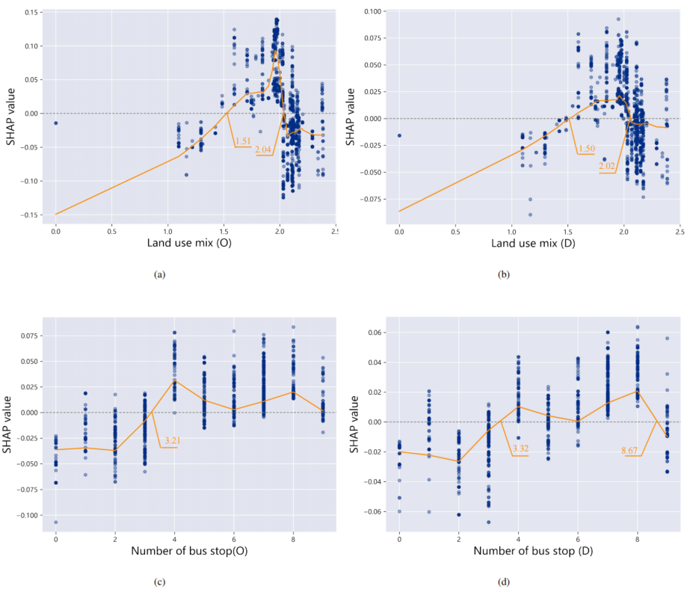
Introduction | Data | Methdology | Results | Discussion
Non-linear effects of ABs substituting conventional buses
As the land use mix continues to increase, the positive impact gradually diminishes, reflecting a higher density and diversity of travel demands that are less conducive to ABs replacing conventional buses
As the number of bus stops increases beyond this threshold, it positively influences ABs that substitute conventional buses.
This deviation from traditional understanding is primarily due to the higher demand for buses in areas with more stops, but the limitations of conventional buses (fixed routes and schedules) lead passengers to prefer ABs over conventional buses.

Slide 23
Introduction | Data | Methdology | Results | Conclusion
Conclusion
Autonomous customized buses (ABs) interact with conventional buses and metro systems, exhibiting
notable heterogeneity and temporal variability.
ABs enhance connectivity during peak hours and replace conventional buses during off-peak times.
ABs replace conventional buses for peak commutes and off-peak shopping but struggle in complex, developed areas.
In low-population, sparse road network areas, ABs should connect with metro services to enhance transit
efficiency.
Policy Recommendations
Implementing ABs operational policies temporally and spatially, emphasizing ABs connections during peak hours, optimizing and adjusting regular bus services during off-peak periods, and highlighting the flexible mobility role of ABs.

Slide 24
Competition or Supplement? Deciphering Interaction between Autonomous Customized Bus and Public
Transit
Jiang Haoran, Shaozhi Hong
Tongji University

